Slide 1
Mastering the optimization journey: Streamline, scale, and automate your MSP operations
Chris Plouffe/Rolando Jimenez
Notes:
Welcome to mastering the Nerdio Optimization Journey. Today we want to help you streamline, scale, and automate your MSP operations.

Slide 2

Chris Plouffe
Senior Technical Trainer
Owned my MSP for 17 years (CSP Technologies)​
Successfully exited and sold my MSP 2022
Member of The20, then “rolled up”
Heavily cloud focused
With Nerdio 2+ years

Slide 3
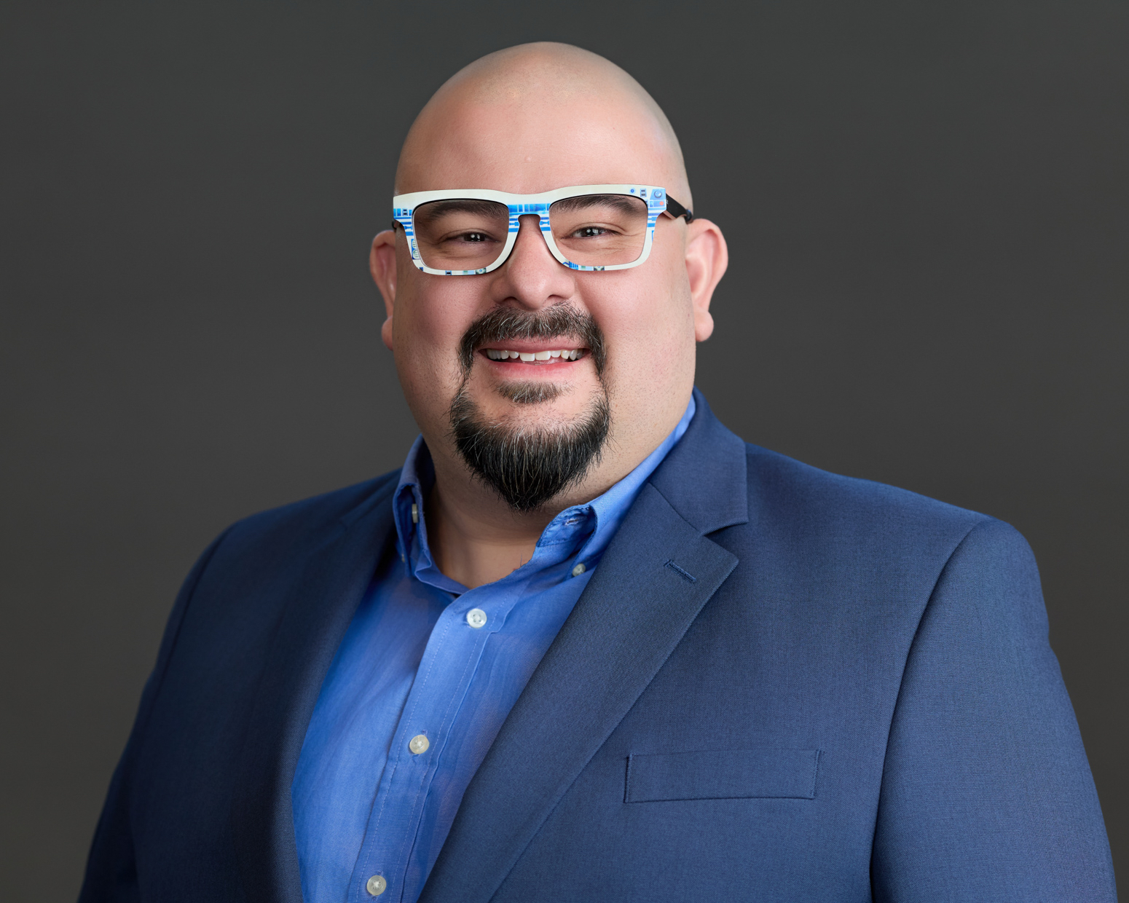
Rolando Jimenez
Technical Trainer
Started at Microsoft retail
Helped support the IEC in Redmond
Microsoft funded Intune and W365 workshops
I am a huge gamer/Star Wars nerd

Slide 4
Environment types
The optimization journey steps
Unified Endpoint Management
Unified Application Management
Scope for DaaS
AVD
Frameworks
Q+A
Notes:
Go over agenda. We are going to cover the environment types, or basically where your MSP may fit into a certain group. Then talk about what the steps look like. Then dive into each individual step in detail.

Slide 5
SPOT YOURSELF IN THE NARRATIVE
Environment types
Where are you today?
Chart a course forward
Start optimizing
What’s working well?
What could be better?
Which type are you currently?
How can you be more efficient?
How can you scale?
What are next steps?
What can you do today?
What can you do in the future?
How do you get there?
Notes:
Take a moment and think about these questions.
Where are you today and what steps can you take to move forward.
Go through some of these questions.

Slide 6
THE MSP OPTIMIZATION JOURNEY
Environment types
Traditional
Traditional environments
(On-premises/legacy technology-dependent)
Are dependent on legacy technologies and the workflows that support them. Common legacy technologies include:
Group Policy Objects (GPOs).
Manual administration efforts.
One-to-one workflows.
Domain controllers.
File servers.
Exchange servers.
VPNs.
Fragmented endpoint management and endpoint security practices/tools.
Notes:
The first thing I’d like to say about these environment types is that it doesn’t mean good or bad. It just a way to see where you are at as you become a more efficient MSP. Microsoft likes to mention that MSPs should be cloud-native.
We are going to talk about the types on the way to getting there.
The first one, traditional, is listed here.

Slide 7
THE MSP OPTIMIZATION JOURNEY
Environment types
Hybrid
Hybrid environments
(Deprecating legacy dependencies)
Are actively evolving toward a cloud-native posture. Legacy technologies are being retired and replaced.
GPO dependencies are transitioning to Microsoft Intune.
Automations are being built to allow common tasks to scale.
One-to-one workflows are evolving into one-to-many tools.
Endpoint management and security tools and practices are being consolidated.
Exchange and file servers are retired in favor of cloud-based solutions.
VPN dependencies are being reduced.
Notes:
Next, we move into hybrid. You have progressed some, in terms of dependencies on legacy technologies and moving more to cloud based management.

Slide 8
THE MSP OPTIMIZATION JOURNEY
Environment types
Cloud-native
Cloud-native environments
(Fully operationalized Microsoft stack)
Leverage the modernized Microsoft Cloud solution stack to meet the needs of the organization.
Microsoft Intune and Microsoft Defender are fully operationalized for modern endpoint management.
A fully realized and scalable suite of automations are implemented and evolve with business needs.
Workflows are modernized by using Microsoft solutions as a central anchor.
VPNs to access company resources are deprecated.
The user experience is fully administered and served using cloud-based solutions.
Notes:
Here is cloud-native. This is not by any means “cloud only”. Cloud-native means you are managing and configuring all of your devices and environments in the cloud.
Go through them.

Slide 9
The MSP optimization journey
The steps to a cloud-native posture.
Scope for DaaS solutions
AVD: User experience settings
AVD: Implement automations
AVD: Extend UAM to cloud endpoints
Manage via frameworks
UEM
1
2
3
4
5
6
7
8
9
10
11
12
UAM
W365
AVD: Image lifecycle management
AVD: Configure host pools
AVD: Implement auto-scale
Implement advanced optimizations
Foundations
Optimizations
9
Notes:
THIS is the MSP optimization journey — your roadmap to managing client Microsoft tenants like an absolute boss with Nerdio Manager. There are 12 steps here, and each one builds on the last. Let me break it down!​
​
Step 1 — Unify Endpoint Management: First things first, we need to wrangle all our endpoints — physical, virtual, W365, doesn't matter. One mechanism to rule them all! Getting this right is KEY before we move forward.​
​
Step 2 — Unify Application Management: Next, we automate our app installs, updates, and management. Whether apps live on physical devices or virtual ones, keeping them updated and secure is non-negotiable.​
​
Step 3 — Scope for DaaS: Once endpoints and apps are humming, we scope out Desktop as a Service. AVD or Windows 365? That's where discovery and good questions come in. Use the Force... and data.​
​
Step 4 — Windows 365: If Cloud PCs are the right fit, we configure and manage them here. Quick and clean.​
​
Step 5 — AVD User Experience: Going the AVD route? We start with user experience — FSLogix, RDP profiles. Gotta make sure users actually ENJOY logging in!​
​
Step 6 — AVD Image Lifecycle: Now we map out our image process — what images, how to update them, app installs. Automation and Auto-Scale will thank you later.​
​
Step 7 — AVD Automations: PowerShell scripts, Azure runbooks — we automate host pool configurations and operations. Less manual work, more time for... well, more Star Wars.​
​
Step 8 — AVD Host Pools: Personal or multi-session? Logoff settings? Azure capacity extender? We configure it all here.​
​
Step 9 — AVD UAM for Cloud: Remember Step 2? We're extending that same app management magic to our cloud endpoints through deployment policies and scripting.​
​
Step 10 — AVD Auto-Scale: THIS is a game-changer! Turn things on and off based on demand. Scale storage with Azure Files, scale host pools, set triggers, save money, auto-heal. It's like having R2-D2 managing your infrastructure!​
​
Step 11 — Manage via Frameworks: Package everything into repeatable frameworks for endpoint management, W365, and AVD. Consistency across the board.​
​
Step 12 — Advanced Optimizations: The final boss level! Nerdio API, hardening your installation, leveling up your scripting and automations. Full Jedi Master status.​

Slide 10
THE MSP OPTIMIZATION JOURNEY
Unified Endpoint Management
Configure AD User Management in
Nerdio Manager.
Enable Exchange Online Management.
Enable Intune in Nerdio Manager.
Configure Microsoft Intune device policies.
Implement Windows Update for Business.
Implement policy backups.
Group policies into Policy Baselines.
Assign policies and Policy Baselines to groups.
Enroll endpoints into management with Intune.
Use Tenant Monitoring to assess current posture.
Use Solution Baselines to adjust Microsoft 365 solutions.
Use reporting to track and solve for drift.
Implement Console Connect.
Notes:
As I just mentioned, unifying our endpoint management is our first step.
We can start with our users. If we use domain controllers, we can manage those hybrid users inside of Nerdio Manager. We can enable Exchange Online Management.
We need to get our user management in order before we move into devices here.
Next, we can get Intune enabled and ready to go to manage all our devices. Again, having this setup allows us to scale and manage all devices types.
Decide on the Intune policies we need as a baseline and configure those.
We want to setup WUfB to handle our updates.
Setup backups, using Recovery Services, so we can backup our policies, configurations, and assignments.
Then decide on grouping any policies together and if we want to use CIS.
We can now enroll devices that we currently manage into Intune.
As of now, we would use tenant monitoring to assess where the environment is at. This is changing soon.
Next, we can manage our Microsoft tenant settings. Manually or through our new pre-built templates. Keep an eye on them with drift tracking.
Then implement our remote-control agent, Console Connect, so we can manage these devices remotely as needed.

Slide 11
THE MSP OPTIMIZATION JOURNEY
Unified Application Management
Connect private application repositories to package and deploy your own unique applications or deploy applications from public repositories.
Create Unified Application Management (UAM) policies in Nerdio Manager to centralize the deployment of your application portfolio.
Implement maintenance windows to automate application updates.
Solve for unique needs between customers by assigning applications only where they’re needed.
Notes:
On to step 2. Our device configuration and management feel good. Let’s get our apps sorted.
We would begin by connecting any private app repos that we may want to use for special or custom apps.
Then decide which applications will get installed where and how we will deploy them.
Create maintenance windows to control when, if we need to, they get installed. This is usually good for AVD hosts.
Then create and assign these application policies. Whether a single app or a group of them that we want installed together.

Slide 12
THE MSP OPTIMIZATION JOURNEY
Scope for DaaS solutions
Define a consistent discovery process for your sales team.
Develop packages and plays built on your tech stack.
For existing traditional environments, use user behavior details, logs, and reports to scope.
For existing Azure environments, scope by combining user behavior details with data collected via Nerdio Tenant Monitoring.
For new environments (greenfield), work with application developers to scope based on anticipated user and system needs.
Decide on Windows 365 or Azure Virtual Desktop as the chosen DaaS solution.
Notes:
Step 3 allows us to determine if a current client or maybe a new prospect would be a fit for desktop as a service.
We start with a thorough and consistent discovery process. This can be for your sales team or your sales engineers or you. It helps to have a process that can be replicated each and every time.
You then need to decide how you are going to package and price this offering.
During the discovery process, asking questions are important, but if you can also pair that with data, you are more likely to get a better overall view of the environment.
Here are some examples of on-prem vs Azure environments on what you can look for.
For brand new environments, you can do some searching and talk to the vendors to understand minimum specs and environment needs.
Lastly, you need to pick the DaaS solution that fits you and your client. Depending on what you choose will determine next steps in the Op Journey.
Last note – inside of our LMS, called Nerdio University, we have training to help you decide between the two. With use cases and examples and info to help you decide what works for you.

Slide 13
THE MSP OPTIMIZATION JOURNEY
Implement Windows 365
Use the outcomes from your scoping exercise to make data-driven decisions on Cloud PC sizes.
Enable Windows 365 Enterprise or Windows 365 Business inside Nerdio Manager.
Create Windows 365 network connections.
Create Windows 365 provisioning policies.
Create Windows 365 user settings.
Assign users Windows 365 licenses.
Deploy Cloud PCs (happens once we assign license).
Notes:
If we decided on Windows 365 as our solution, then these are the steps we can take.
Decide on what size cloud PCs we need based on our discovery process and then get the licensing for those.
Inside of Nerdio Manager for MSP, we can do a few things. Depending on which license you chose, you will have different options.
For Enterprise -
Setup network connections
Setup provisioning policies
Configure user settings.
For Business –
Configure Organization settings
Then we assign the licenses to the chosen user and the W365 CloudPCs will deploy automatically.

Slide 14
THE MSP OPTIMIZATION JOURNEY
AVD: Configure user experience settings
Create centrally managed FSLogix profiles to enable user profile routing for host pools.
Create centrally managed RDP settings profiles to define behaviors for user sessions.
Notes:
Now, if during our discovery process, we decided on AVD we have much more to configure and consider.
One of the first things we want to do with AVD is decide on the settings and configurations for FSLogix and RDP profiles.
This is important because we need to setup the framework for their experience.
How big are their FSLogix profiles. Which FSLogix version are we using. Are we cleaning up invalid sessions. Etc.
For their RDP session, are we redirecting thumb drives, or allowing them to see their local drives in the session. Keeping in mind security needs.
We can do this with global profiles or customize to individual host pools.

Slide 15
THE MSP OPTIMIZATION JOURNEY
AVD: Implement image lifecycle management
Create image source virtual machines to consolidate common update and management tasks.
Reduce recovery motions for restoring environments with image versions.
Automate updates to cascade throughout your host pool ecosystem.
Notes:
Next, we move into managing our images. Before we can rollout AVD hosts, we need to decide how we will create them, update them, and keep them current.
A quick note, it’s important to understand that an image object is not the same as the image source virtual machine that we create it from.
We create this image source vm that you can log into and manage and configure as needed. Then we create the image from that configured VM, it runs sysprep and we get to use that image for host creation.
By having different image versions, it can help when needing to rollback or restore environments and hosts.
Use automation and scripting to auto update apps and windows updates throughout your images and host pool ecostystem.

Slide 16
THE MSP OPTIMIZATION JOURNEY
Implement automations
Create and/or connect GitHub repositories to create an automation toolbox.
Leverage automations you’ve already built or create new automations in Nerdio Manager.
Group individual scripts to run together to consolidate task management.
Generalize scripts and use variables for specific outcomes based on the customer account running the script.
Notes:
With this step, we are trying to reduce time spent on tasks and labor hours. Let’s try and see where we can use scripting and automations to become more efficient.
Create and or connect GitHub repositories and have a good place for your automation toolbox to sit.
Bring in scripts you already have, use the built-in ones provided by us, or create new ones.
You can use Scripted Action or Azure Runbook groups instead of having to run or assign one at a time.
Use our variables to be able to use a single script across multiple clients in different ways.

Slide 17
THE MSP OPTIMIZATION JOURNEY
AVD: Configure host pools
Use the outcomes from your scoping exercise to make data-driven decisions on host pool experience types.
Refine resource utilization by defining session limits and load balancing.
Create host pools and session hosts to deliver virtual desktops to end users.
Optimize host pool settings.
Leverage Nerdio Azure Business Reviews to identify areas to save on cost or enhance user experiences.
Notes:
Based on what we found in discovery, we will size and configure our host pools.
We will need to decide on configurations for these host pools while we are creating them.
Things like defining session limits and load balancing. This can affect the Auto-scale step, so it something important to consider.
Determine the size and then create the hosts.
Go through settings like Azure Capacity Extender, User experience settings, how VMs deploy etc.
Once you’ve been running this environment for a little while, then have an ABR with one of our engineers to see if there are ways to save or give the user a better experience.

Slide 18
THE MSP OPTIMIZATION JOURNEY
AVD: Extend UAM policies to cloud endpoints
Create deployment policies for:
Shared AVD host pools.
Personal AVD desktops.
Azure servers.
Notes:
We’ve setup UAM earlier for all device types, but in this step we can specifically tweak and assign to our AVD devices as needed.
Here are some of the targets we can push apps to.

Slide 19
THE MSP OPTIMIZATION JOURNEY
AVD: Implement Auto-Scale
Combine individual host pool configurations with auto-scale profiles to centralize management.
Add capacity (scale out) to meet waves of demand and reduce capacity (scale in) to reduce unnecessary costs.
Combine auto-scale with desktop images to automatically update production hosts.
Refine your infrastructure selections for host pools by reviewing Nerdio Auto-Scale history.
Enable Auto-Heal to detect and remediate broken hosts.
Optimize your storage spend by leveraging auto-scale for Azure Files Premium.
Notes:
One of the last AVD steps is to go in and implement Auto-scale.
A quick note on Auto-scale. You can enable and configure this as soon as a host pool is created. This allows you to tell AS what to create and it will go and create the hosts for you.
In this example, we are coming in and enabling after the host pool was created and configured. Either way works.
To start, we can configure AS profiles at the global and account level. This allows us to assign these settings across more than one host pool. But we can also set them individually.
We need to decide on triggers for scaling in and scaling out based on demand. There are many triggers, from user count, to cpu and ram usage.
We can use it for updating hosts, auto-healing nonresponsive hosts, and even check the history to determine if Reservations are better than using Auto-scale.

Slide 20
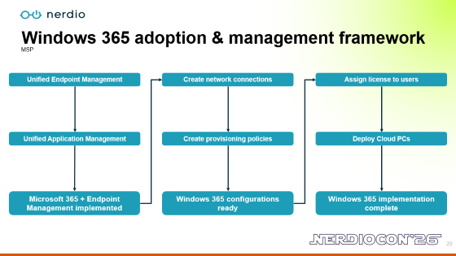
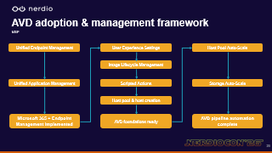
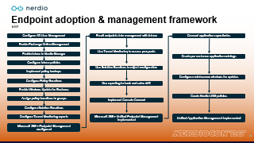
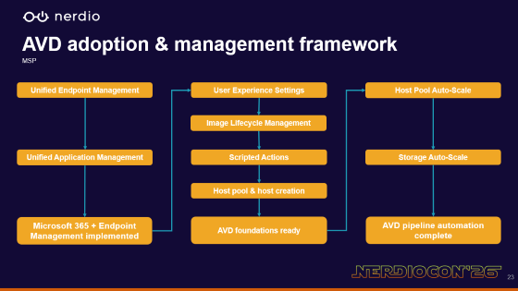
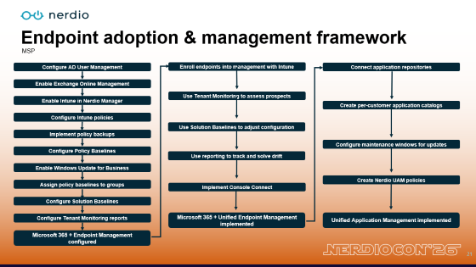
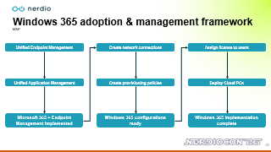
THE MSP OPTIMIZATION JOURNEY
Manage via the Foundations frameworks
Notes:
One of the last steps is really a reminder of what the steps look like to configure some of these features.

Slide 21

Endpoint adoption & management framework
MSP
Configure AD User Management
Enroll endpoints into management with Intune
Connect application repositories
Enable Exchange Online Management
Enable Intune in Nerdio Manager
Use Tenant Monitoring to assess prospects
Create per-customer application catalogs
Configure Intune policies
Use Solution Baselines to adjust configuration
Implement policy backups
Configure maintenance windows for updates
Configure Policy Baselines
Use reporting to track and solve drift
Enable Windows Update for Business
Assign policy baselines to groups
Create Nerdio UAM policies
Implement Console Connect
Configure Solution Baselines
Configure Tenant Monitoring reports
Microsoft 365 + Unified Endpoint Management implemented
Unified Application Management implemented
Microsoft 365 + Endpoint Management configured
Notes:
As you can see here, the steps we went through before to make sure our endpoints are managed properly are listed, as well as UAM.
We can use this as a guide to making sure we are on top of our endpoints.

Slide 22
Windows 365 adoption & management framework
MSP
Unified Endpoint Management
Create network connections
Assign license to users
Unified Application Management
Create provisioning policies
Deploy Cloud PCs
Microsoft 365 + Endpoint Management implemented
Windows 365 configurations ready
Windows 365 implementation complete
Notes:
If we chose Windows 365, this will give us the steps to deploy Windows 365 and Cloud PCs. But we still have the Endpoint Management steps implemented. Then we can step through the network connections, provisioning policies and license assignment.

Slide 23

AVD adoption & management framework
MSP
Unified Endpoint Management
User Experience Settings
Host Pool Auto-Scale
Image Lifecycle Management
Unified Application Management
Scripted Actions
Storage Auto-Scale
Host pool & host creation
Microsoft 365 + Endpoint Management implemented
AVD foundations ready
AVD pipeline automation complete
Notes:
If we chose AVD, this will guide us on the steps we need to take after we have our Endpoint Management in order. We will start with the AVD foundation steps we saw in the previous Op Journey steps. Then add in Auto-scale to finish.

Slide 24
THE MSP OPTIMIZATION JOURNEY
Implement advanced optimizations
Extend further into your tech stack with Nerdio API.
Harden your Nerdio Manager install.
Continuously improve automations.
Notes:
The last step in the journey is implementing advanced optimizations.
If you use API, being able to tap in and extend it further into your stack can help.
Harden your Nerdio Manager install to make sure it is secure as possible.
Continue working on automations and scripting to turn manual efforts into repeatable ones.

Slide 25
Chris Plouffe

Slide 26
Rolando Jimenez

Slide 27
Thank you
Please remember to fill out the post-breakout survey in the app.
Stop by the Nerdio booth in the Expo Hall to take advantage of our exclusive, lowest-ever pricing on Microsoft 365 management!

