Slide 1

Modern app management at scale: KPMG UK’s switch from SCCM & Intune to Shell Apps
Dave McCormack, Neil McLoughlin

Slide 2

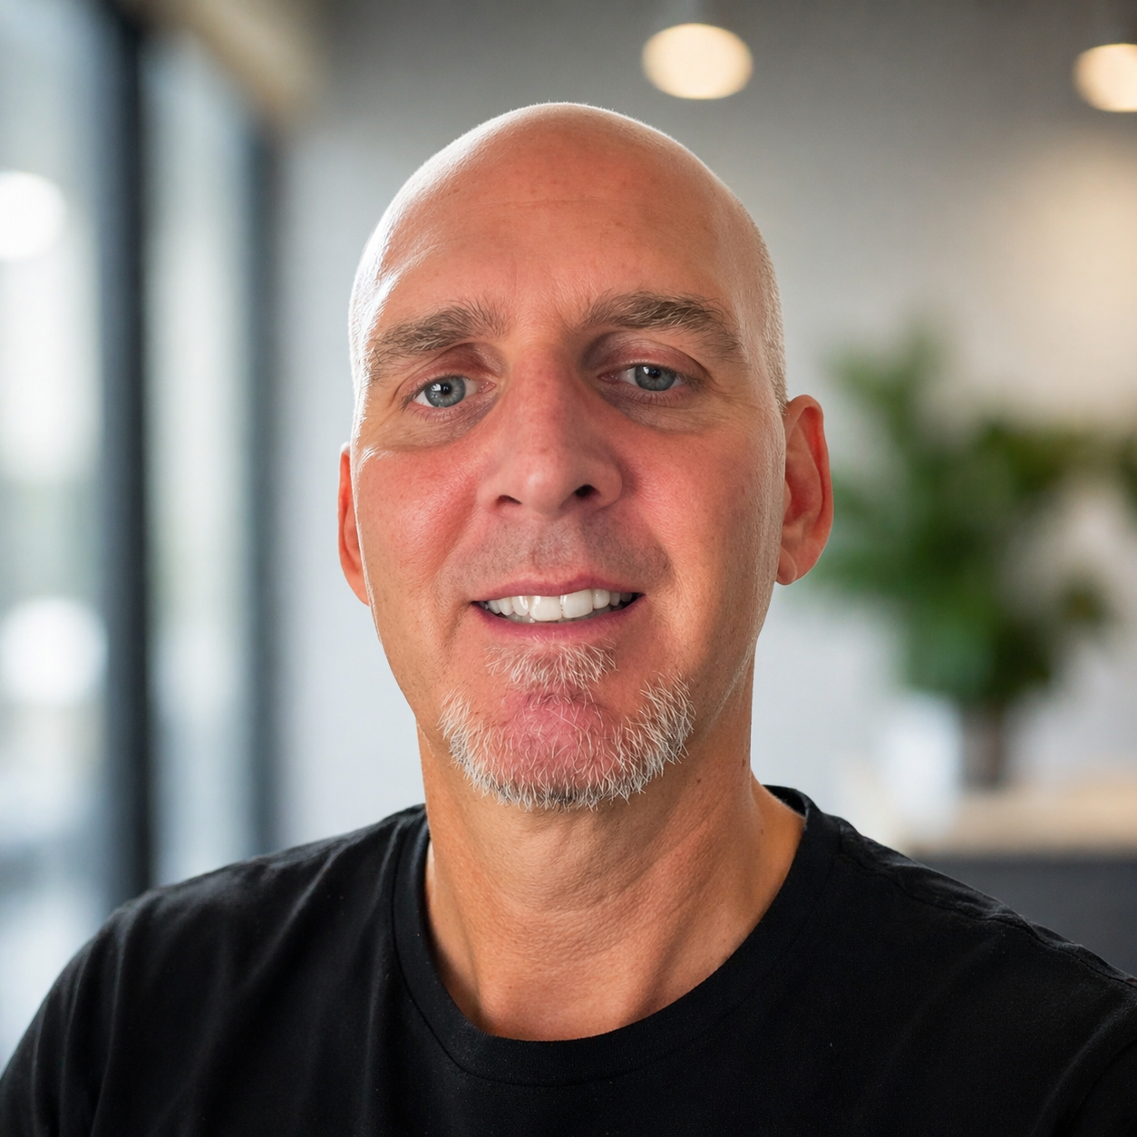
WHO ARE WE?
Neil McLoughlin
Dave McCormack
Principal Technical Account Manager, Nerdio
Lead DevOps Engineer, KPMG UK

Slide 3
The Windows 10 baseline and its operational pain
What KPMG UK wanted from a Windows 11 AVD reset
How Shell Apps enabled an imageless runtime architecture
Deep dive: Shell Apps deployment model
Operational outcomes, lessons learned, and Q&A

Slide 4
Why this story matters
This is not just a migration story. It is an operating model shift.
6,000
AVD users in scope
KPMG UK needed to move from a high-touch Windows 10 VDI model to a modern Windows 11 AVD platform.
The legacy stack relied on image maintenance, SCCM, on-premises AD, and weekend patch windows.
The target state was Entra ID-based, highly automated, and manageable by a small engineering team.
Shell Apps became the enabler for runtime app delivery without maintaining golden images.
5,500
Personal desktops
500
Multi-session hosts

Slide 5
The Windows 10 AVD landscape before transformation
Legacy control plane
Hybrid operating model: On-premises Active Directory, Group Policy, SCCM, and image-led desktop management
A globally distributed user base connecting from the UK, Europe, India, and South Africa
Different requirements across personal desktops and multisession hosts
A very small engineering team protected and maintained multiple golden images month after month
On-premises AD
Group Policy
SCCM
Golden images
Everything above had to stay aligned before users saw a stable desktop.

Slide 6
PAIN POINTS
Why the old model became unsustainable
Weekend maintenance
Desktops had to be powered on for patching, app updates, and security changes.
Image sprawl
Multiple images needed monthly patching, testing, sealing, and gallery publishing.
SCCM failure handling
Patch and app deployment issues created extra troubleshooting overhead.
Team bottleneck
A small number of engineers owned every image and every sensitive change.
Cost and risk
High operational cost, delayed change windows, and more opportunity for drift.
Net effect: The team spent too much time servicing the platform and not enough time improving it.

Slide 7
TARGET SITE
What KPMG UK wanted from the Windows 11 reset
Move away from
Move toward
On-premises AD and GPO dependencies
Entra ID and modern cloud-first identity
SCCM-led app and patch motion
Automated delivery through Nerdio and selective Intune use
Monthly golden image maintenance
No-image platform with runtime app provisioning
Manual maintenance windows
Policy-driven deployments when no sessions are active
Inconsistent multi-session policy results
A model tuned for AVD reliability and scale

Slide 8
ARCHITECTURE
The new operating model:
Dynamic, imageless runtime delivery
Base Windows 11 host
Nerdio UAM
Shell Apps policies
App install at runtime
User gets ready-to-work
desktop
Keep the base image as thin and standard as possible.
Attach core apps dynamically instead of baking them into golden images.
Use automation to power on, deploy, and return hosts to their original state when required.
Make auto-scale practical, because apps can arrive in real time.

Slide 9
SCALE
Why Shell Apps changed the economics of app delivery
45 min
~5 min
15–20 min
20–30 min
Early Office deployment to one AVD
Office after Nerdio improvement
One personal desktop
One multi-session host
Operational meaning
Deploying apps at this speed made real-time host readiness viable.
Auto-scale became useful because new capacity no longer depended on pre-staged images.
The team could standardize personal and multi-session app sets: 18 core apps for personal, 24 for multi-session.
Performance feedback directly influenced Nerdio engineering improvements.

Slide 10
DEEP DIVE
How Shell Apps works in the real deployment flow
What makes this different from legacy tooling:
Deployment is aware of session state.
Power management is built in.
No dependence on users leaving devices online.
Ideal for evening and unattended fixes.
1
2
3
4
5
Policy targets
host pool/ring
Nerdio powers on
host if needed
Checks for zero
active sessions
Launches scripted
install package
Validates and
returns host state

Slide 11
AUTOMATION
Shell Apps + PSAppDeploy Toolkit: a practical packaging pattern
Package source
PSADT wrapper
Shell Apps policy
AVD host
Vendor bits
+ config
+ detection
Pre-checks
install logic
post-actions
Assignment
schedule
retry rules
Silent install
validation
reporting
Use PSADT to standardize install, uninstall, logging, user messaging, and exit handling.
Keep Shell Apps focused on orchestration, targeting, timing, and state-aware execution.
This separation makes the application lifecycle easier to test, update, and roll back.

Slide 12
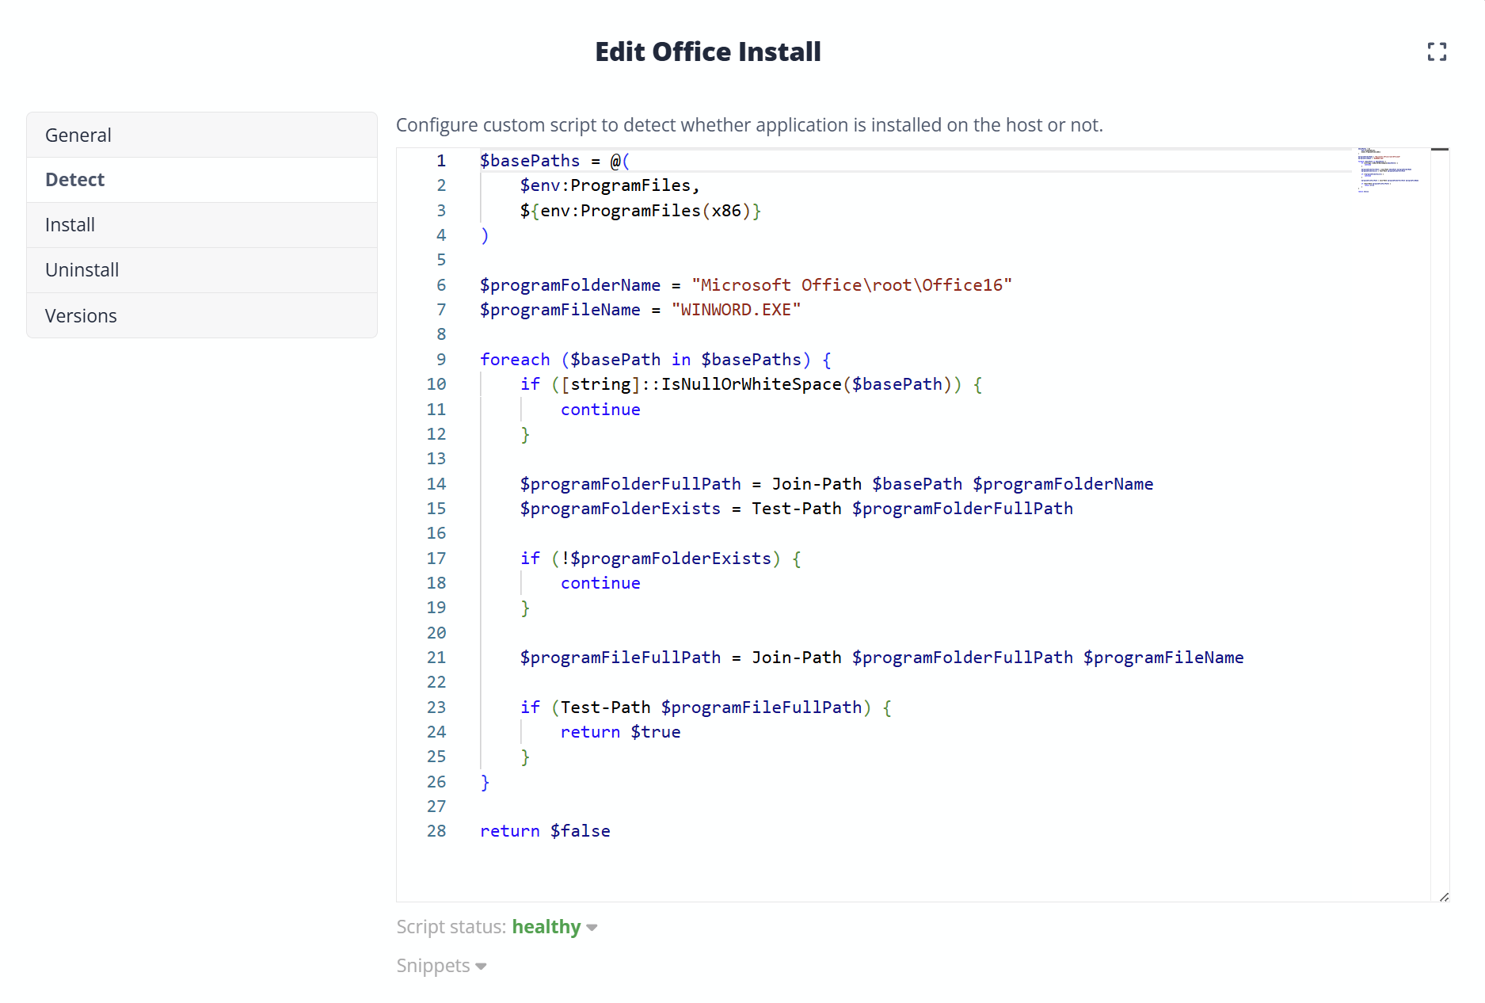
Example Shell App deployment script

Slide 13
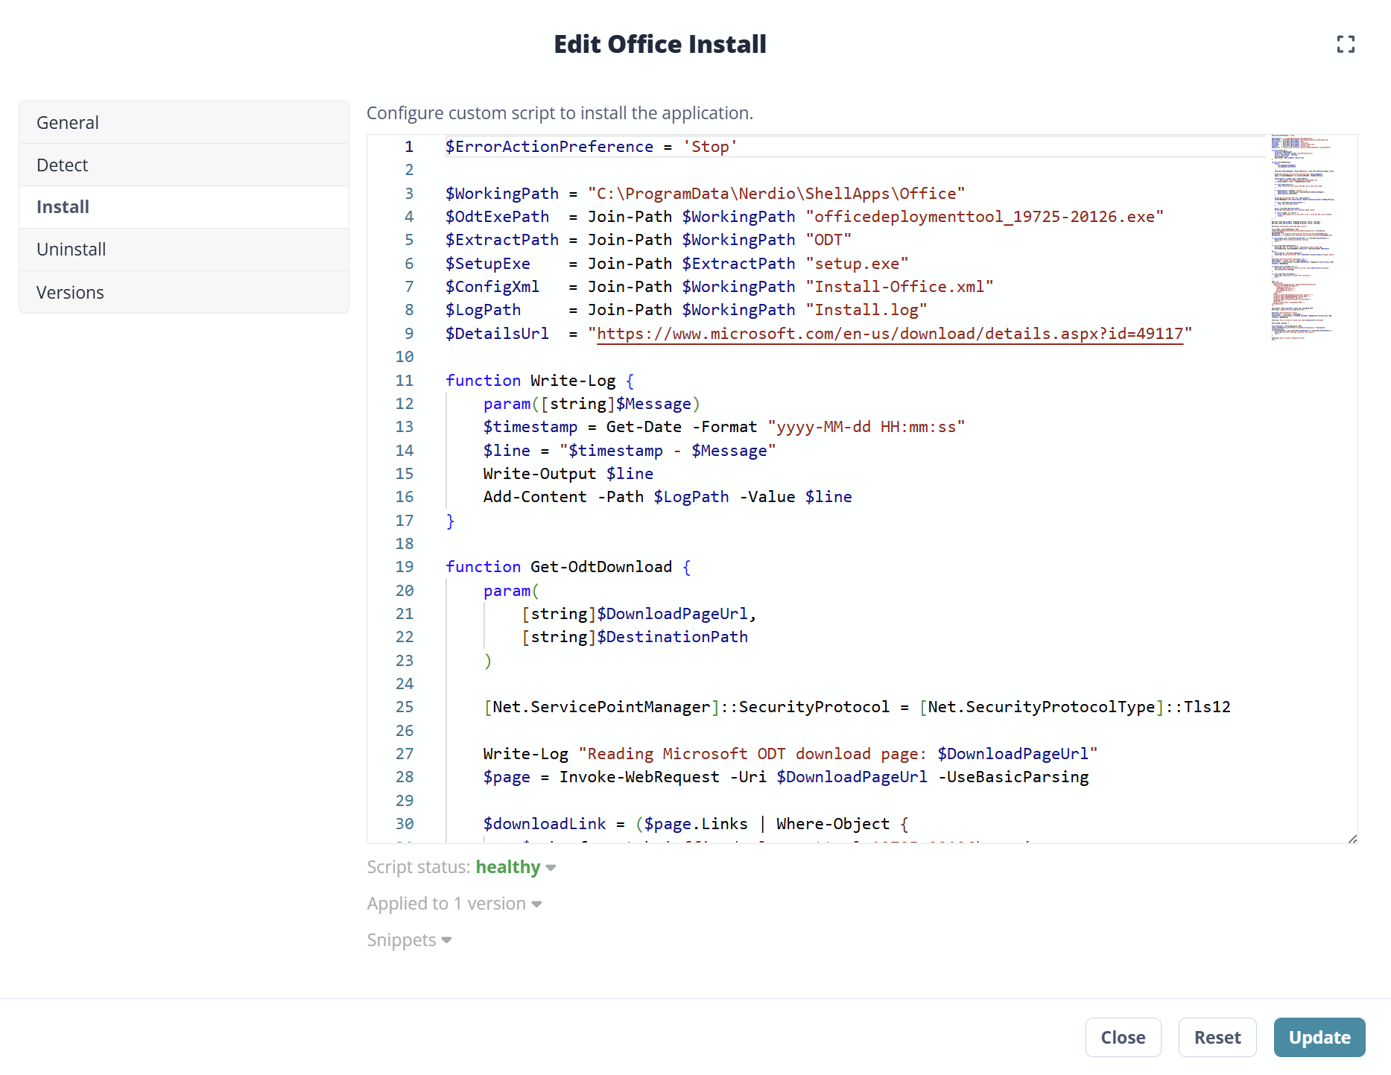
Example Shell App deployment script

Slide 14
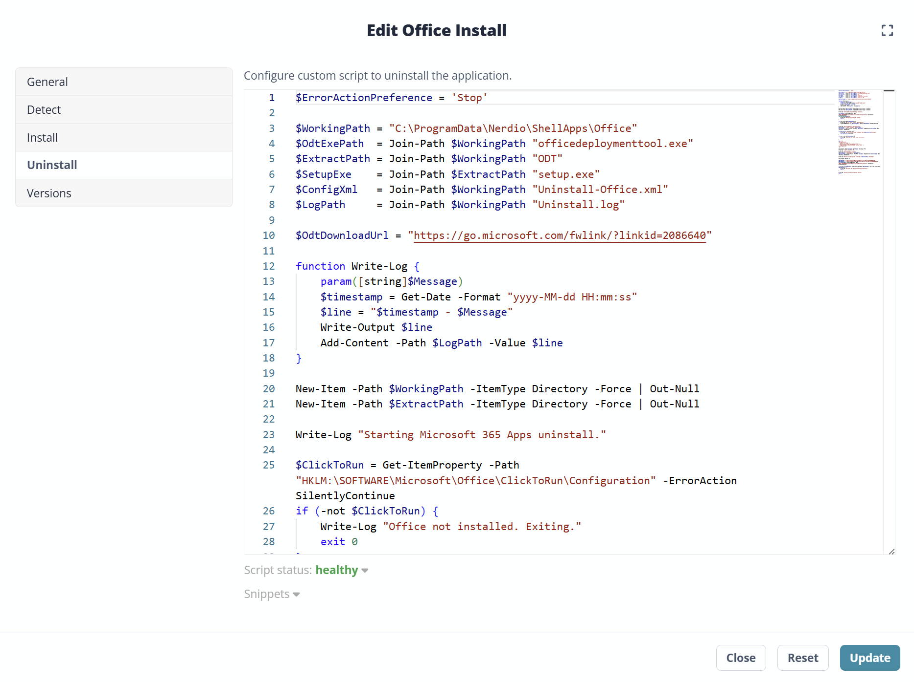
Example Shell App deployment script

Slide 15
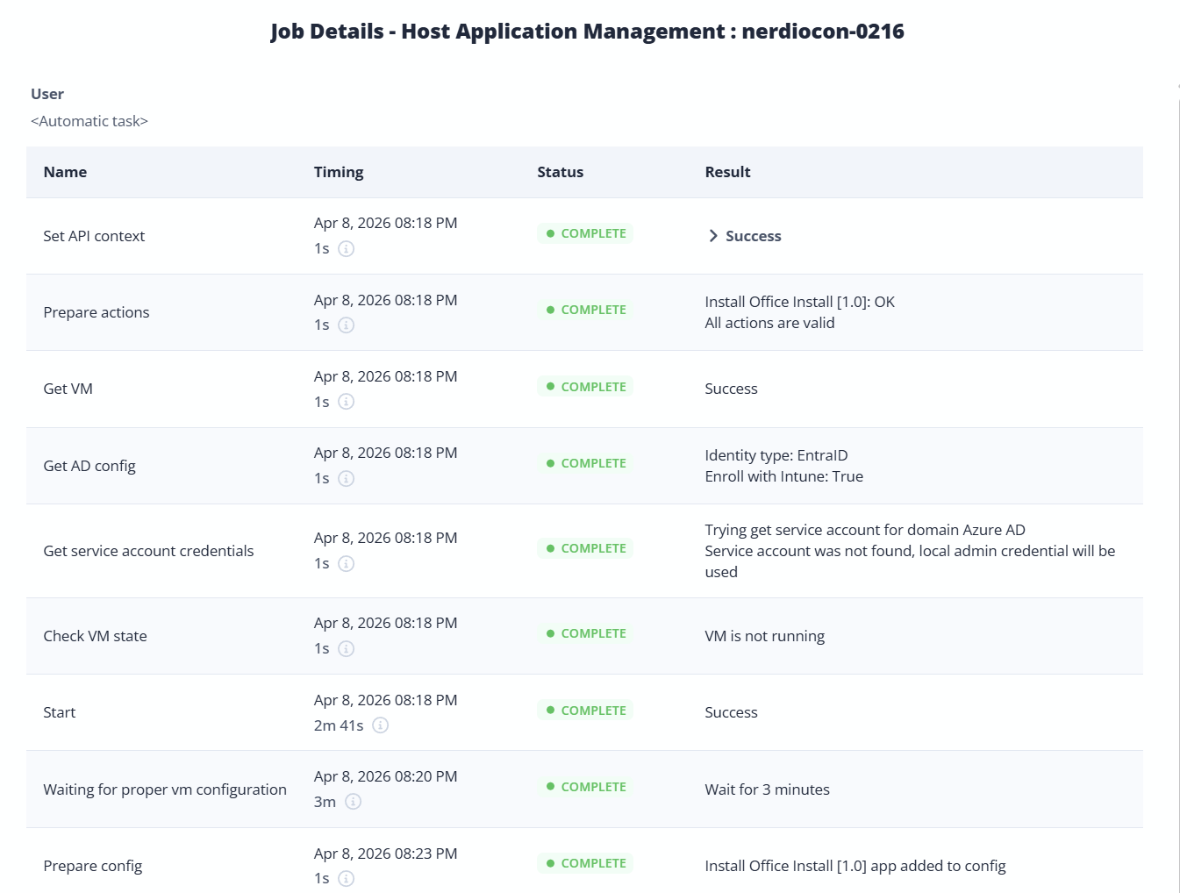

Slide 16
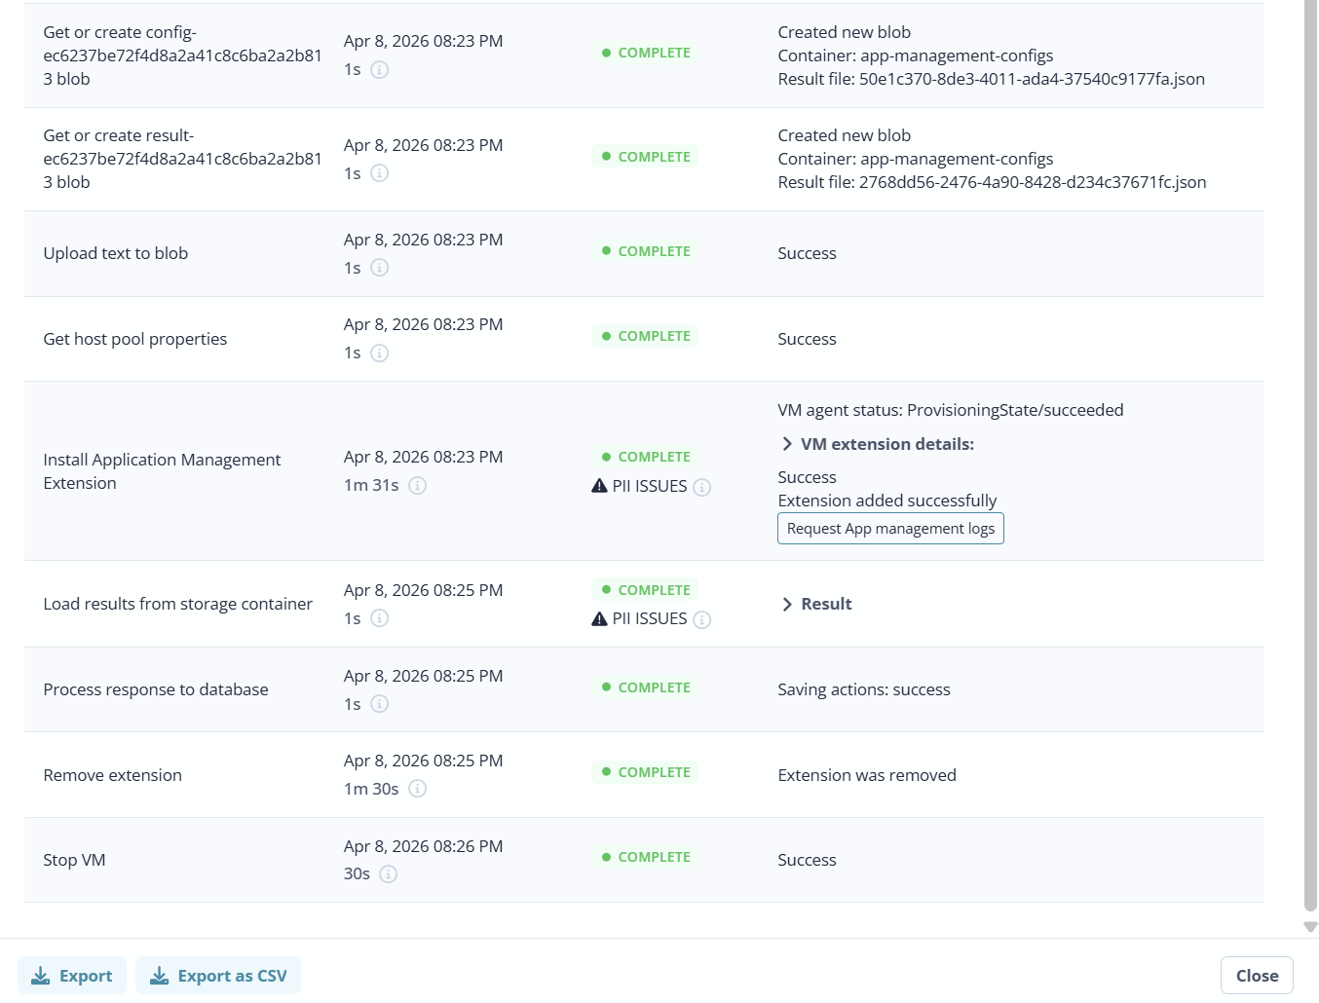

Slide 17
Demo

Slide 18
Shell App feature release timeline
Nerdio Manager for Enterprise | Unified Application Management
Shell Apps
introduced
.ZIP archive
support
REST API
endpoints
Bulk
actions
Apr 2024
Aug 2024
Aug 2025
Apr 2026
v6.0
v6.2
v7.2
v7.7
v6.1
v6.6
v7.5
Jun 2024
Dec 2024
Nov 2025
Secure
variables
Versioning
support
Sorting &
max versions
Source: Nerdio NME Release Notes

Slide 19
APPLICATION LIFECYCLE
Packaging standards that scale with a small team
Engineering guardrails
Recommended package structure
Separate core apps from optional or ring-based apps.
Use consistent detection logic so reruns are safe and idempotent.
Track versioning in the package, not in the image.
Pilot on a small host subset before broad rollout.
Treat registry fixes and configuration changes as packaged artifacts, too.
• Source files
• Deploy-Application.ps1
• Detection logic
• Parameters/transforms
• Logging and return-code map
• Version metadata

Slide 20
MIGRATION
Windows 10 to Windows 11: the migration sequence that kept things manageable
1
2
3
4
5
6
Start with a clean Windows 11 AVD baseline
Move identity and profile strategy to Entra ID/FSLogix aligned model
Define personal and multi-session core application sets
Package apps for Shell Apps orchestration
Pilot, measure deployment times, and tune problem apps
Scale out with auto-scale and phased cutover
The crucial mindset shift: Migrate the platform and its delivery method together, not as two disconnected projects.
NerdioCon 2026

Slide 21
OUTCOMES
Operational outcomes: less servicing, more engineering
Before
After
Weekend patch windows and powered-on estates
Policy-driven unattended deployment
Image patching, sealing, and gallery uploads
Thin base image with runtime apps
SCCM troubleshooting overhead
Central orchestration through Nerdio
Limited agility for auto-scale
Real-time host readiness becomes practical
Small team tied up in BAU maintenance
Small team can focus on reliability and improvement

Slide 22
LESSONS
What we learned along the way
Do not try to reproduce every old management pattern in the new platform.
Multi-session needs purpose-built testing; assumptions from single-session or physical endpoints do not always hold.
Performance testing matters. A single slow app can undermine the whole operating model.
Treat packaging as product engineering—with standards, telemetry, and release discipline.
Keep the customer feedback loop tight. In this case, Nerdio product improvements materially changed the outcome.
Best advice to peers
Start with the thinnest possible base image, package the top apps well, and prove the runtime model early.
That gives you evidence, confidence, and executive air cover to go further.

Slide 23
TAKEAWAYS
TAKEAWAY
Key takeaways for your own AVD transformation
1
An imageless AVD architecture is viable at enterprise scale when orchestration is strong.
2
Shell Apps reduced the operational burden of app delivery and made auto-scale more valuable.
3
PSADT complements Shell Apps by making packaging repeatable, supportable, and automatable.
4
The biggest win is not just faster installs. It is a simpler platform that a small team can run confidently.

Slide 25
Please remember to fill out the post-breakout survey in the app.

