Slide 1
Nerdio Manager for Enterprise roadmap
Yangzhi Zhao, Chad Manzer, Dave Grain, Raul Morales

Slide 2




SPEAKERS
Yangzhi Zhao
Chad Manzer
David Grain
Raul Morales
Senior Director, Enterprise Product
Sr. Product Manager, Enterprise Product
Product Manager, Enterprise Product
Product Manager, Enterprise Product

Slide 3




SPEAKERS
Yangzhi Zhao
Chad Manzer
David Grain
Raul Morales
Senior Director, Enterprise Product
Sr. Product Manager, Enterprise Product
Product Manager, Enterprise Product
Product Manager, Enterprise Product

Slide 4
Nerdio Manager for Enterprise overview
Platform roadmap
Azure Virtual Desktop roadmap
Windows 365, Intune, & UAM roadmap
Insights, Advisor, & Copilot roadmap

Slide 5


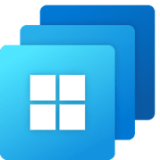
Unified management for Microsoft EUC
Granular RBAC | REST API | Logging | Alerting | Integrations
Nerdio Insights: Real-Time Monitoring, Deep Analytics, & Universal Search
Nerdio Advisor: Pre-Deploy Planning & Post-Deploy Optimization
Nerdio Copilot: AI-Augmented Administration
Windows Cloud Delivery
Multi-Cloud Orchestration
Endpoint Management
Operational Control
VM Lifecycle Management
Device Lifecycle Management
Enterprise Scalability
Compute & Storage Auto-Scaling
Configuration & Compliance
Image Management
Network Management
Application Management
Seamless Migrations
High-Availability & Disaster Recovery
Workflow Automations
Profile Management
Multi-Tenant Support
User Self-Service Portal
Azure
Azure Gov
Azure Local
Nutanix AHV
Remote Assist & Control
Azure Virtual Desktop
Windows 365
Intune

Slide 6
ROADMAP: Nerdio Manager for Enterprise
Nerdio Manager 8.0 Highlights
User Interface and experience
Workflows
Menu layout refresh
All Features page
Internationalization and Japanese localization
Global Pools Announcement
AVD Hybrid on Nutanix (Public Preview)
Intune Policy Studio (Public Preview)
Scripted Sequences:
Cross-tenant support
Scripted Actions
Migrate:
Citrix/Horizon/W365 Ent --> W365 FLD
Console Connect:
UK Region support and more logs!
PowerShell Module update
Terraform support for Nerdio installations
Artificial Intelligence
Search 2.0
Secure by default for Nerdio Copilot

Slide 7
Platform
Chad Manzer
Sr. Product Manager

Slide 8
ROADMAP: PLATFORM (CONSOLE CONNECT, MIGRATE, RBAC, UI, INSTALLER, ETC.)
Now
Next
Later
Menu layout refresh
All Features page
Internationalization
Japanese localization
Terraform support for install
Console Connect:
UK Region support
Enhanced logging
PowerShell Module update
Migrate: Citrix/Horizon/W365 Ent > W365 FLD
Localization:
French
German
Portuguese
Spanish
API: Least permission keys
API: Gap analysis for MCP
CMK support for storage
Migrate: Citrix/Horizon/AVD multi-session> W365 FLS
Migrate: Move across subscriptions and VNets
Least Privileged Permissions
API: MCP support
API: Terraform support
Console Connect: Session Recording and more RBAC

Slide 9
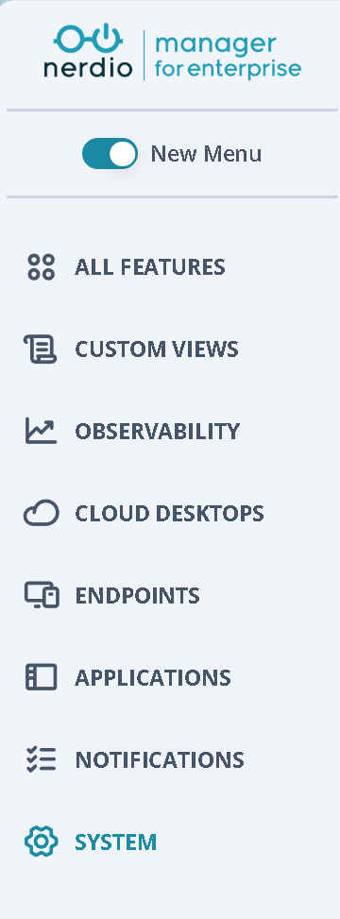
ROADMAP: PLATFORM (CONSOLE CONNECT, MIGRATE, RBAC, UI, INSTALLER, ETC.)
New menu layout
Reorganized 3-tier menu
Less (and more) use of horizontal space
Optional initially

Slide 10
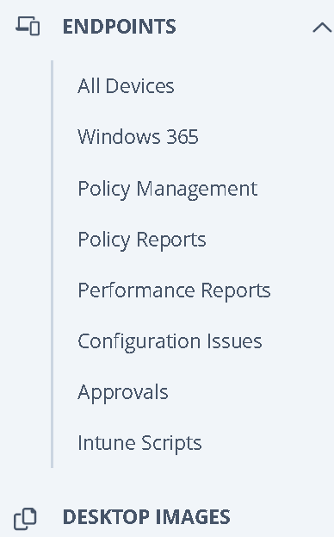
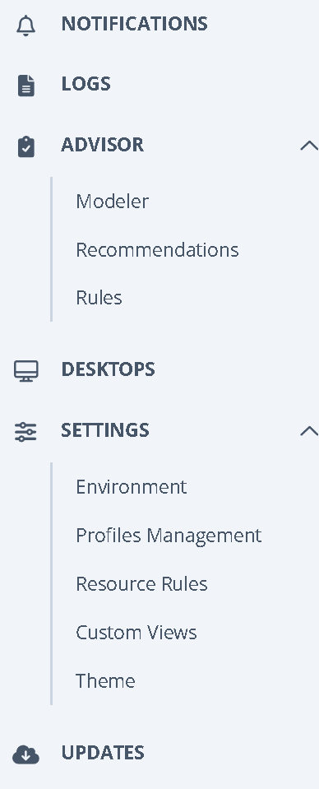
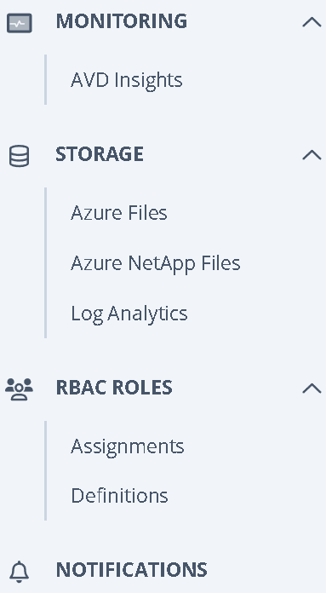
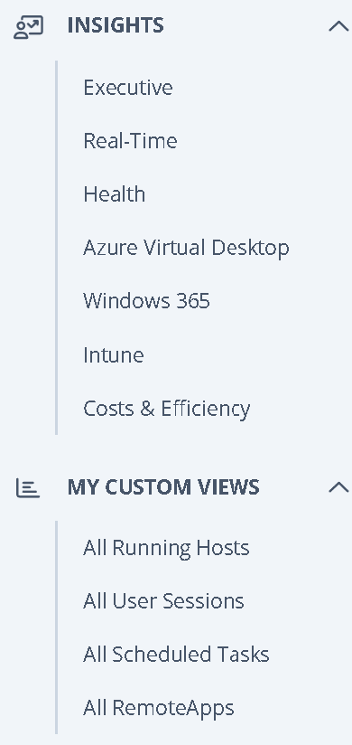
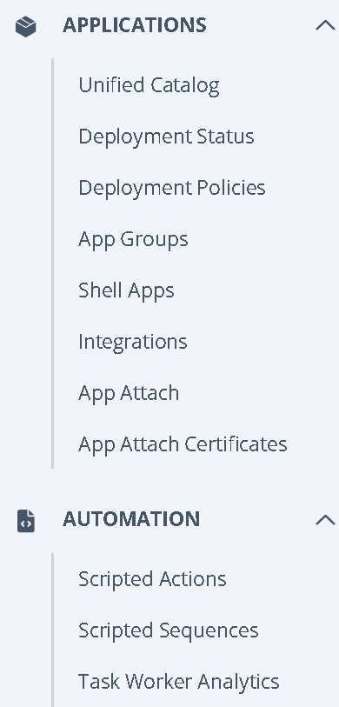
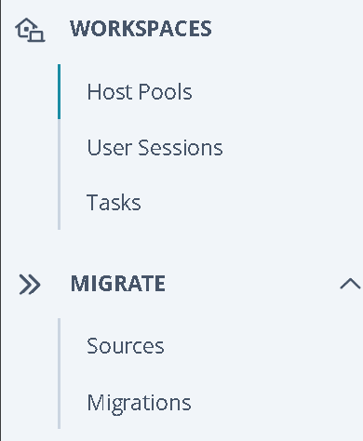
ROADMAP: PLATFORM (CONSOLE CONNECT, MIGRATE, RBAC, UI, INSTALLER, ETC.)
Old Menu

Slide 11
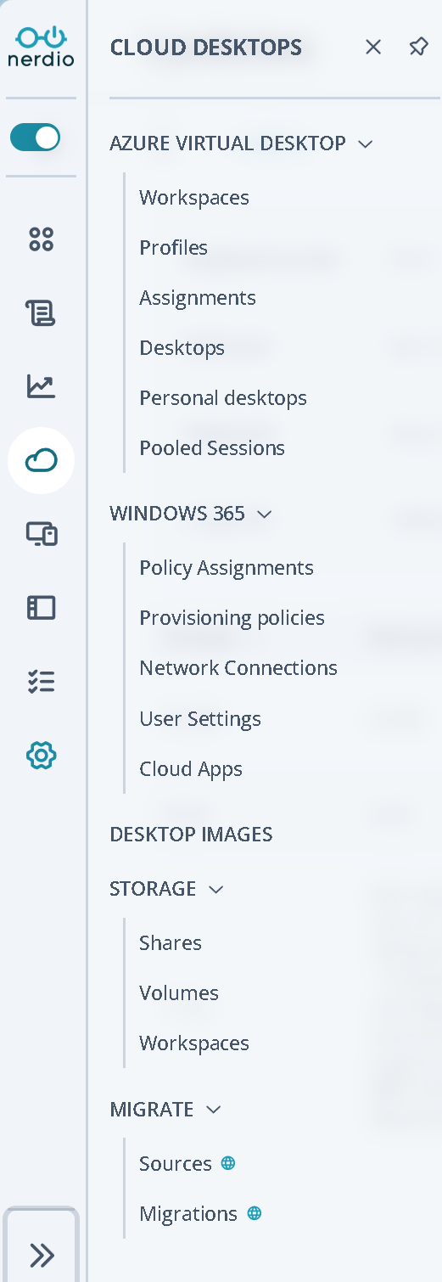
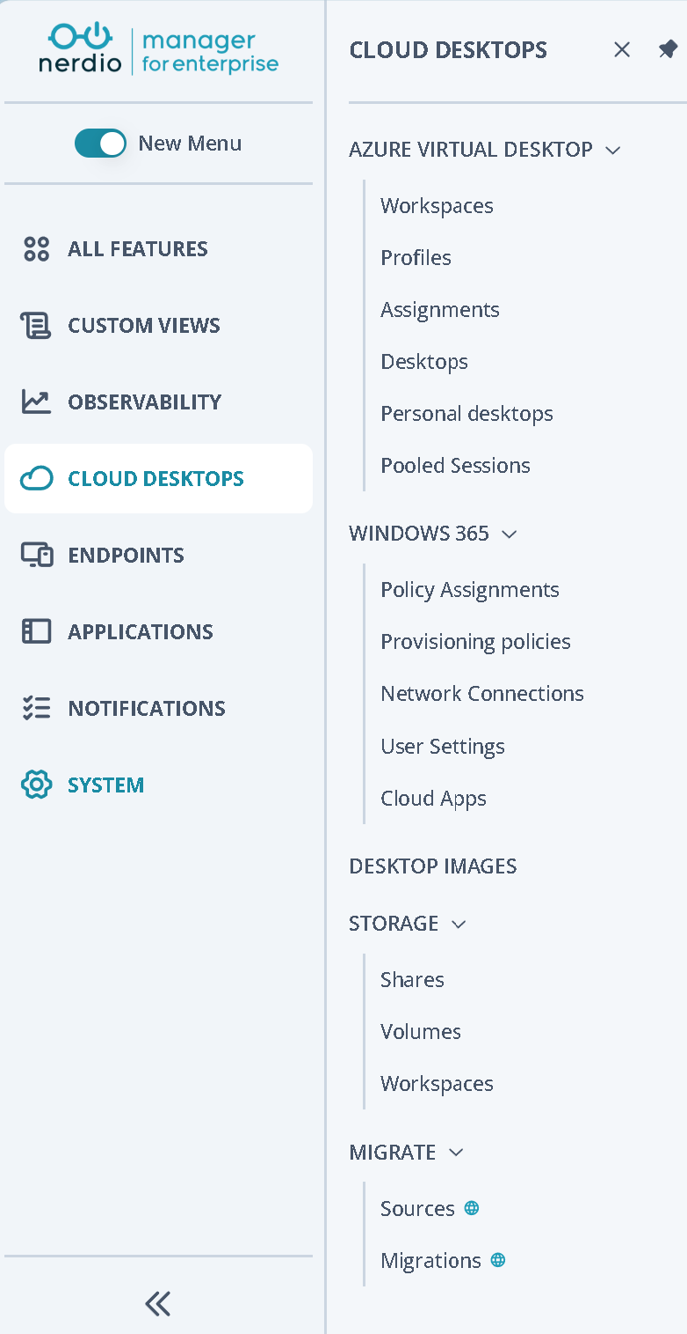
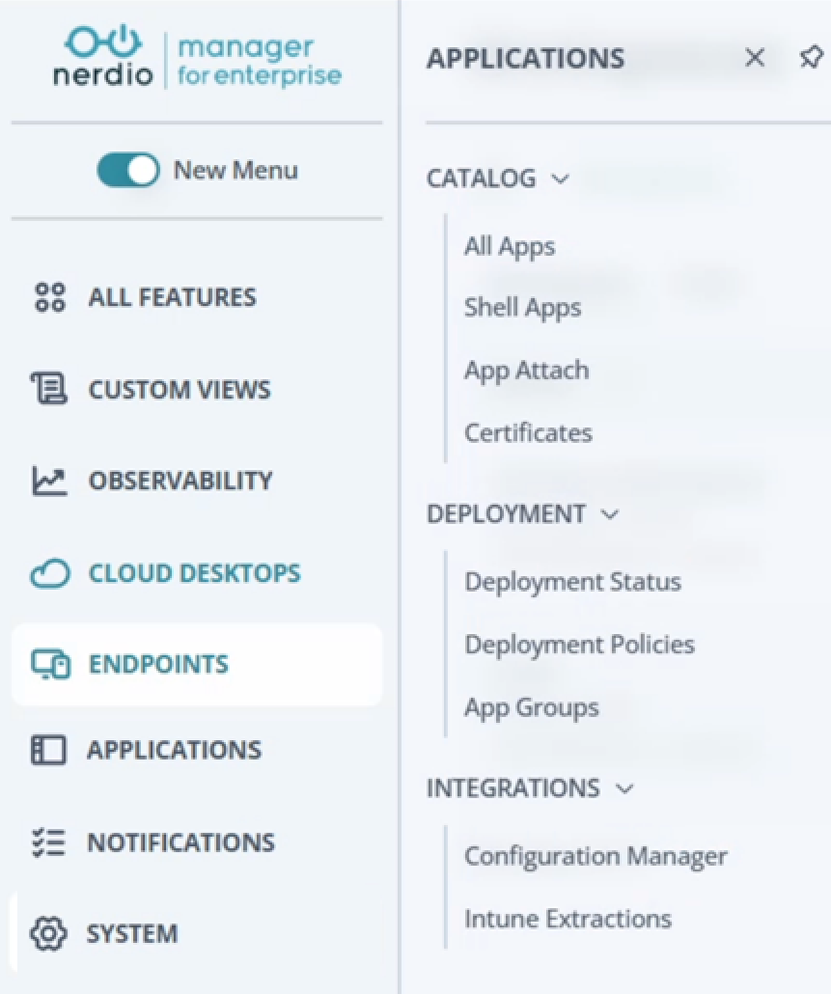
ROADMAP: PLATFORM (CONSOLE CONNECT, MIGRATE, RBAC, UI, INSTALLER, ETC.)
New menu layout

Slide 12
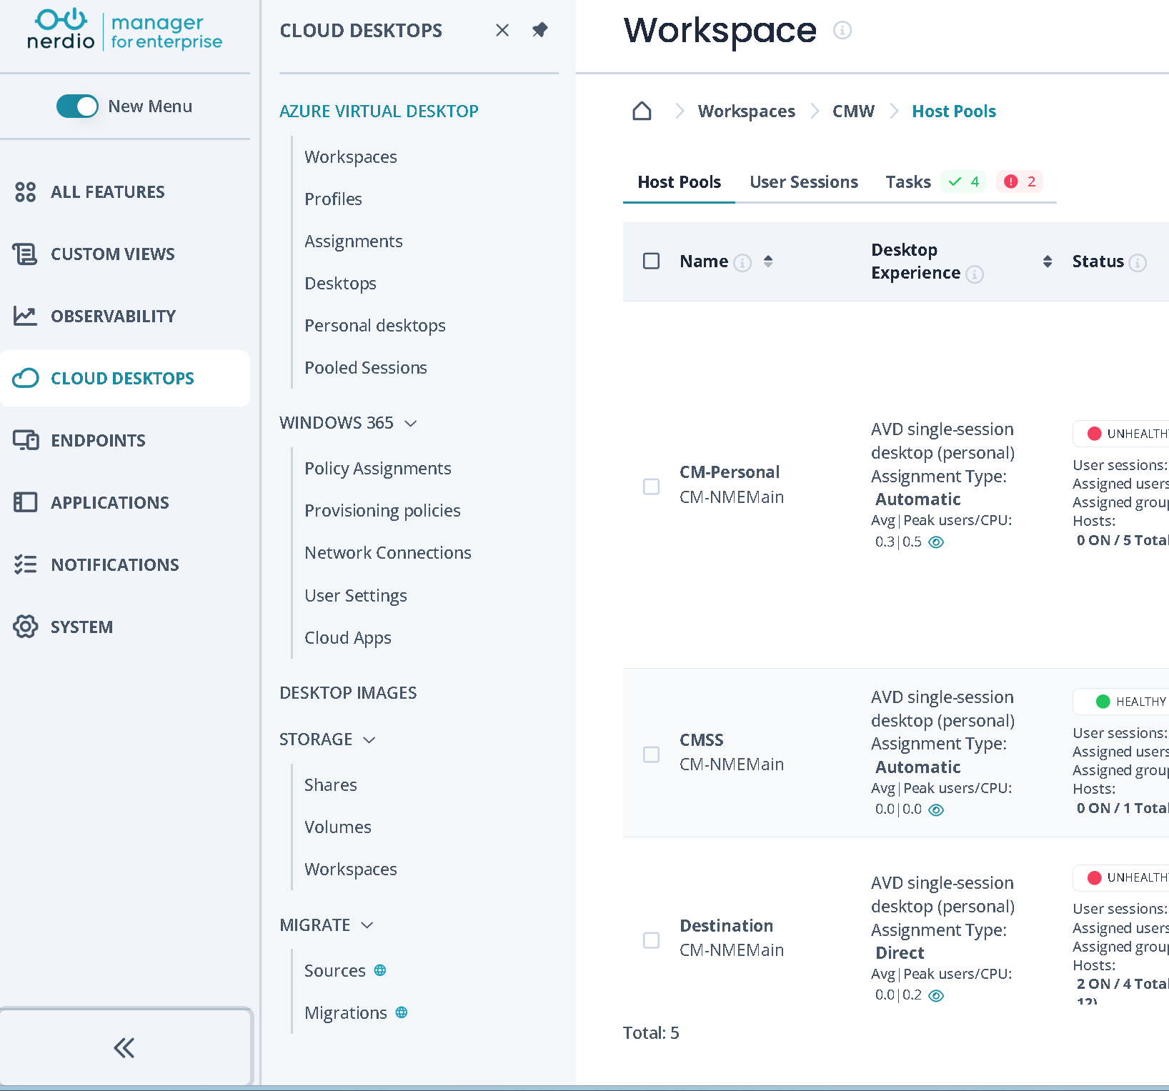
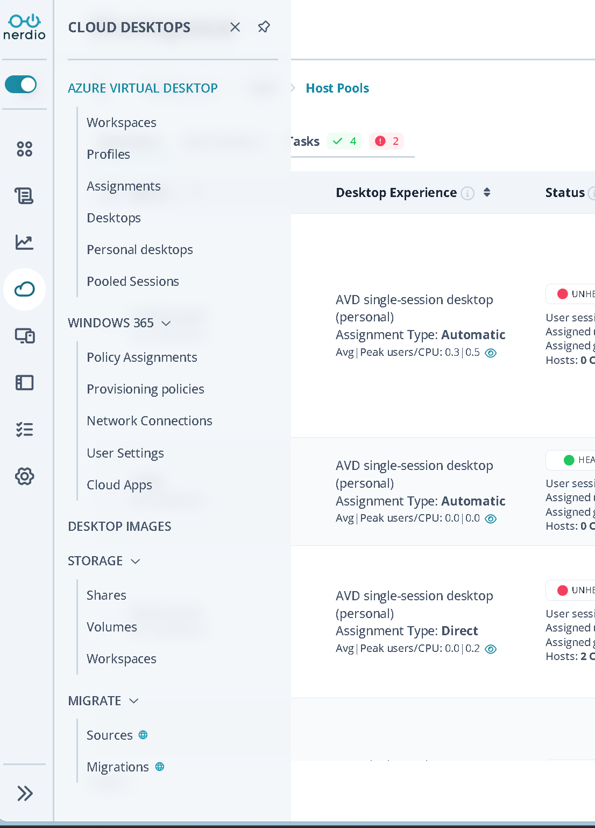
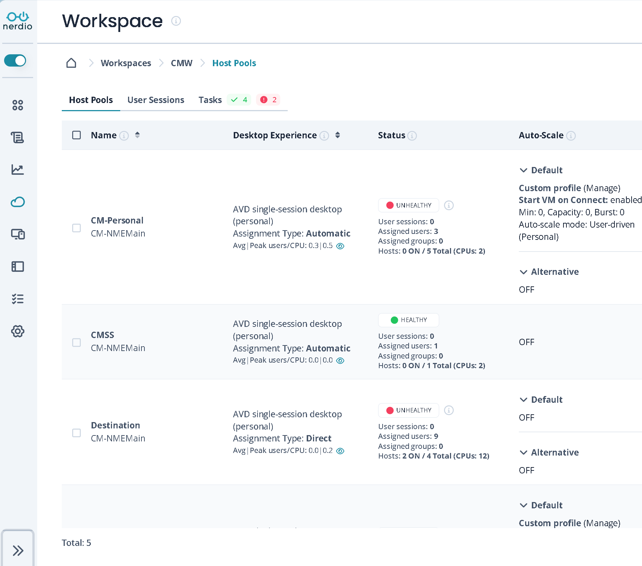
ROADMAP: PLATFORM (CONSOLE CONNECT, MIGRATE, RBAC, UI, INSTALLER, ETC.)
New menu layout

Slide 13
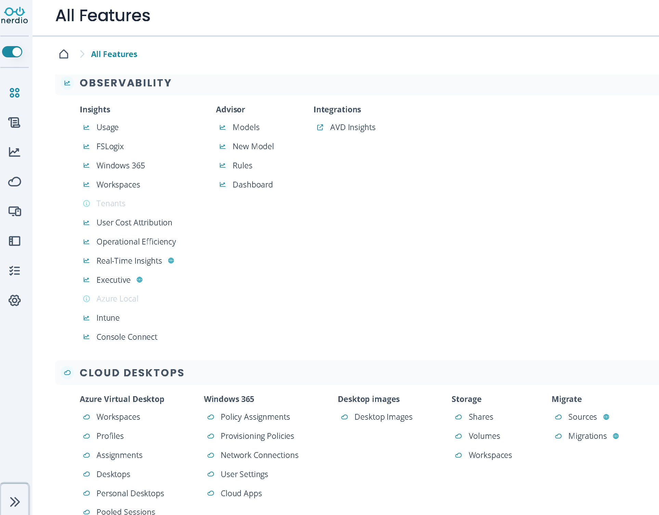
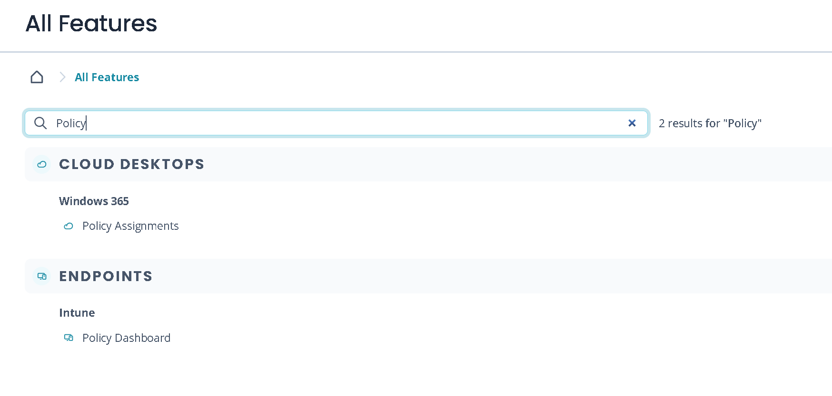
Roadmap: Platform (Console Connect, Migrate, RBAC, UI, Installer, etc.)
All Features page
New landing page
Easy access to any component
Favorites menu coming soon

Slide 14
ROADMAP: PLATFORM (CONSOLE CONNECT, MIGRATE, RBAC, UI, INSTALLER, ETC.)
Migration
Migrate from Citrix or Omnissa to AVD/W365
Import user assignments: Skip discovery
Snapshot management
Resize/move device to a new resource group
Updated wizard UI

Slide 15
ROADMAP: PLATFORM (CONSOLE CONNECT, MIGRATE, RBAC, UI, INSTALLER, ETC.)
Migrate future
Recommended sessions:
Aaron and Andrei (from Microsoft) May 6 @ 12:30pm
Recast May 6 @ 9:35 am
How Ergo migrated 1,500 users from Citrix in 90 days May 6 @ 3:15 pm
Aaron May 6 @ 2:30 pm
Doug Lind – Alchemy Technology Group May 6 @ 2:30pm
Windows 365
User Experience Sync to FSLogix
Ent <-> FLS FLD
Citrix & Omnissa Discovery
Devices, images
Users & profiles
Applications
Automate migration too
Azure Virtual Desktop & FSLogix
Remote App
Windows 365 E,FLS,FLD & User Experience Sync
Golden Image Migrate

Slide 16
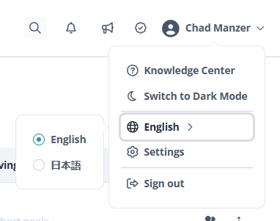
ROADMAP: PLATFORM (CONSOLE CONNECT, MIGRATE, RBAC, UI, INSTALLER, ETC.)
Localization
i18next adoption
AI Strings Extraction
Build TMS Automation
Translate new strings with MT then review with native speakers
Microsoft and Nerdio custom style guides
Initial ja-JP Japanese roll out in 8.0
Followed by German, French, Spanish, Portuguese

Slide 17

ROADMAP: PLATFORM (CONSOLE CONNECT, MIGRATE, RBAC, UI, INSTALLER, ETC.)
Terraform support
Check out the private preview install process and give feedback.
Looking to add management of Nerdio Manager resources starting with AVD
Support for Private Endpoints and existing vNets
Working to remove the need to open a browser for the Nerdio Manager OOBE
Private Preview: https://github.com/Get-Nerdio/NME-Terraform
Recommended session: Aaron & Roan, Wednesday, May 6 @ 3:30 pm in Diego 3

Slide 18
Azure Virtual Desktop
Raul Morales
Product Manager

Slide 19
ROADMAP: AZURE VIRTUAL DESKTOP
Now
Next
Later
Global Pools Announcement
AVD Hybrid on Nutanix Public Preview
Deploy Scripted Actions and Applications (UAM)
Scripted Actions profiles
Session Time Limits
App Attach
Desktop Image Management
Default outbound access warnings
Managed identities for host pools
Azure Capacity Extender: Revert option
Global Pools: Preview
AVD Hybrid on Nutanix GA
AVD Hybrid on other hypervisors
Key Vault support for directory profiles
Host Pool Profile: Session Limits
Azure Files v2 creation and auto-scale support
Desktop Image: Schedule Scripted Actions and apps
Global Pools: GA
Continue AVD Hybrid development and feature implementation
Azure Files Entra ID support
Host Pool Profiles: AVD, Desktop Images, and more
Azure NetApp Files: FSLogix support
Move AVD Personal hosts across host pools
Notes:
Updated 4/14

Slide 20
ROADMAP: AZURE VIRTUAL DESKTOP
Nerdio Global Pools
What are Global Pools?
Unify multiple host pools into a single logical resource layer, eliminating administrative overhead.
Global Pool = multiple host pools
Leverage Entra ID groups (and in the future, Entra ID attributes) to assign users based on percentage-based allocation to host pools or, in the future, assignment policies.
Decouples users from fixed infrastructure, allowing fluid user assignments between host pools.
Assignment Policy examples (configurable percentage options):
Region Policy: Split users based on assigning 50% of the user load to Host Pool 1 in region A and 50% to Host Pool 2 in region B
Self-service Portal: Allow self-reassignment of their own assigned host pool to different regions based on their own schedule/travel
AVD Hybrid or Azure Local <-> Azure Cloud: If an on-premises host pool has issues (e.g., cluster failures), failover to Azure Cloud
Staggered desktop images for host pools: Seamless testing of new desktop images and transitioning users manually or automatically
Percentage-based or a ring-like approach (when using automated methods)
Notes:
Explain Global Pools + Key Value Propositions

Slide 21
ROADMAP: AZURE VIRTUAL DESKTOP
Nerdio Global Pools: deep dive
Time and location:
Wednesday: 3:30 pm – 4:15 pm
Room: Diego 1
Notes:
Explain Global Pools + Key Value Propositions

Slide 22
MEET CUSTOMERS WHERE THEY ARE ON THEIR CLOUD JOURNEY
Microsoft is opening AVD to on-premises
AVD with on-premises hypervisors
AVD customers can run AVD on-premises using the infrastructure they already own—no disruption, no re-platforming, no downtime.
Meet regulatory & sovereignty requirements
Sensitive workloads can stay local while still gaining cloud-level control, security, and management.
Hybrid bursting to Azure
Scale out of the datacenter to the cloud whenever needed—remote users, seasonal workloads, DR, new sites—all from the same platform.
Notes:
Microsoft announced back in November at Ignite the ability to use AVD on essentially any on-premises infrastructure – previously only Azure Local was supported for customers who wanted to deploy AVD on-premises.
Now, with AVD Hybrid, customers can leverage their existing hardware and any hypervisor.
This obviously brings a lot of value for organizations who want to move their VDI/DaaS use cases to the leading solution available in the market in AVD without needing to re-platform and leverage the infrastructure they already own.
This also helps organizations with data sovereignty requirements where workloads must remain on-premises.

Slide 23


INTEGRATION NOW AVAILABLE! NERDIO MANAGER FOR ENTERPRISE 7.7
Nerdio and Nutanix are announcing a strategic technology alliance for Azure Virtual Desktop for hybrid environments to help organizations modernize their legacy VDI deploymentS.
Notes:
This is why Nerdio is incredibly excited to announce we have entered into a strategic technology alliance with Nutanix to accelerate the adoption of AVD Hybrid by extending Nerdio Manager’s desktop orchestration and management capabilities to include AVD session hosts running on Nutanix AHV.

Slide 24
AVD Hybrid on Nutanix roadmap
Nerdio Manager for Enterprise v7.7
Nerdio Manager for Enterprise v8.0
Nerdio Manager for Enterprise v8.1+
Available now!
Q2 2026
H2 2026
Private preview​
Session Host Orchestration​
VM Settings
RDP/FSLogix/Directory
Use VM templates as desktop image​
Multiple Prism Central
FSLogix on Nutanix Files​
Deploy Scripted Actions​
Public preview​
More VM Settings
Scripted Actions
Session Time Limits
Full image management
Unified Applications (UAM)
App Attach
Resize/Reimage hosts
Custom Views
GA* and beyond​
Additional VM Settings!
Nerdio Global Pools
Auto-Scale
Real-Time Insights
Console Connect
Scripted Sequences
User self-service portal
Nutanix Flow support
GPU profiles
*Note: Public Preview and GA readiness is contingent on Microsoft reaching Public Preview and GA status for AVD Hybrid prior to Nerdio Manager for Enterprise 8.0 and 8.1 release.
Notes:
With Private Preview you get host lifecycle management — creating, starting, stopping, deleting session hosts on Nutanix AHV through Nerdio. Using existing VM templates for building and versioning your gold images. Support for multiple Prism Central instances, so if you have clusters in different datacenters, Nerdio can manage them from one console. And FSLogix on Nutanix Files, so your profiles stay on-prem. And support for Scripted Actions for custom automation
While not finalized, with NME 8.0, we do expect Nutanix Flow support, full image management with NME for creating and maintaining gold images, auto-scaling so host pool capacity adjusts based on demand, and ability to deploy apps to session hosts running on Nutanix via Nerdio’s Unified Application Management.
Then with version 8.1 in July, we are targeting Real-Time Insights for monitoring your hybrid environment, Console Connect for direct administrative access to session hosts, Scripted Sequences for multi-step automation workflows, user self-service capabilities, and vGPU profile support for GPU-accelerated workloads.

Slide 25
ROADMAP: AZURE VIRTUAL DESKTOP
AVD Hybrid for Nutanix: deep dive
Time and location:
Wednesday: 11:15 am – 12:00 pm
Room: Diego 1
Notes:
Explain Global Pools + Key Value Propositions

Slide 26
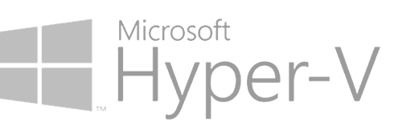
Coming soon!
Targeting Nerdio Manager for Enterprise 8.1 for Public Preview!

Slide 27
Windows 365/Intune/UAM
Yangzhi Zhao
Sr. Director

Slide 28
ROADMAP: WINDOWS 365, INTUNE, & UAM
Now
Next
Later
Intune:
Policy Studio (Preview)
Script management and versioning
Approval workflow schedule approval
Scripted Sequences:
Scripted Actions support
Cross-tenant support
Task worker deployment optimization for Intune
UAM:
Nutanix support
App ID search support for Install groups
Intune:
Device blueprints
Change approval expansion
Cross-tenant: Console Connect support
W365:
User Experience Sync management
AI Enabled Cloud PC management
End-user portal support
Scripted Sequences:
Task Worker removal
Publicly-signed task worker
UAM:
Azure Front Door for private repos
Create & manage native Intune apps
IGEL UMS integration
UMS policy assignment & status
Intune:
Device history map
Enhanced policy templates
Cross-tenant: Intune policy propagation
W365:
W365 for Agents support
License management engine
Health monitor and auto-heal
Cross-tenant: W365 image management
Scripted Sequences:
Automatic remediations
End-user portal support
UAM:
Export Winget & Shell Apps to Intune Apps

Slide 29
ROADMAP: WINDOWS 365, INTUNE, & UAM
Windows 365 Cloud Apps support
Frontline licenses required: Cloud Apps are only available in Frontline
Deliver apps rather than desktops to your Windows 365 Cloud PC users
Manage published apps per-policy based on app detected in the image

Slide 30
ROADMAP: WINDOWS 365, INTUNE, & UAM
Intune Policy Studio (Preview)
Manage polices via the new GUI or via the advanced JSON editor
Review and modify settings and assignments controlled via RBAC roles
Search for policy names & settings names to see a filtered view
Powerful policy result viewer, including conflict detection
Discover which policies propagate to which devices, users, or groups

Slide 31
ROADMAP: WINDOWS 365, INTUNE, & UAM
Script management & versioning
Supports change management, expands on our policy versioning functionality
View and edit Intune platform scripts in the UI, controlled via RBAC
Script versioning so that known good configurations can be reverted
Change history included for auditing
Broken or deleted scripts can be easily restored
Plans to support the policy approval workflow feature in future

Slide 32
ROADMAP: WINDOWS 365, INTUNE, & UAM
Scripted Sequences updates
Build out complex task sequences in a modular, user-friendly UI
Scaling enhancements to reduce the number of groups & scripts required
Import existing scripted actions into your sequences
Cross-tenant support for sequences has been added

Slide 33
Insights/Advisor/Copilot
David Grain
Product Manager

Slide 34
ROADMAP: INSIGHTS, ADVISOR, & COPILOT
Now
Next
Later
Search 2.0 (context-based search, extended results, results page)
Reports MVP (built-in reports)
Intune Insights:
Application metering
Cross-tenant support
Health Insights Alerting
UCA: Per cost group budgeting
Secure by default for Nerdio Copilot
Advisor 2.0: Refactor, support for importing existing VDI assessment
Nerdio Copilot: Generate Auto-scale schedules
Reporting: Custom reports
Real-Time Insights: Additional metrics expansion
Nerdio Copilot in Search
MCP server
Nerdio Copilot: Generate Scripted Actions and Scripted Sequences
Advisor: Intelligent Actions (cost/performance)
Insights: Custom dashboarding (widgets)

Slide 35
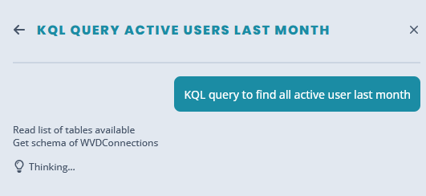
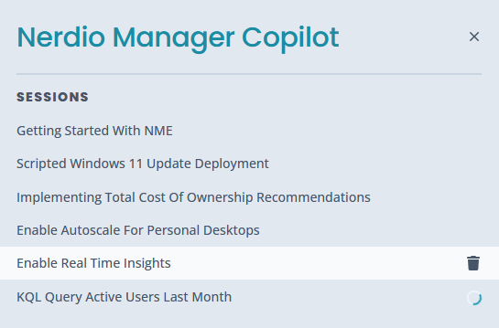
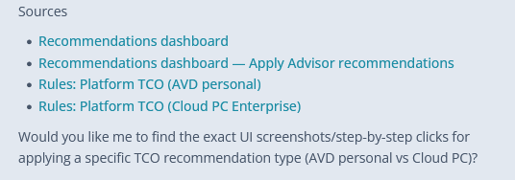
ROADMAP: INSIGHTS, ADVISOR, & COPILOT
Nerdio Copilot updates
Completely refactored and redesigned
Azure footprint reduced from over 20 separate resources down to 1
NO standing cost.
Persistent personal chat history
Search all KBs, write Scripted actions, and KQL queries
Coming soon….
Smart Actions
MCP Server

Slide 36
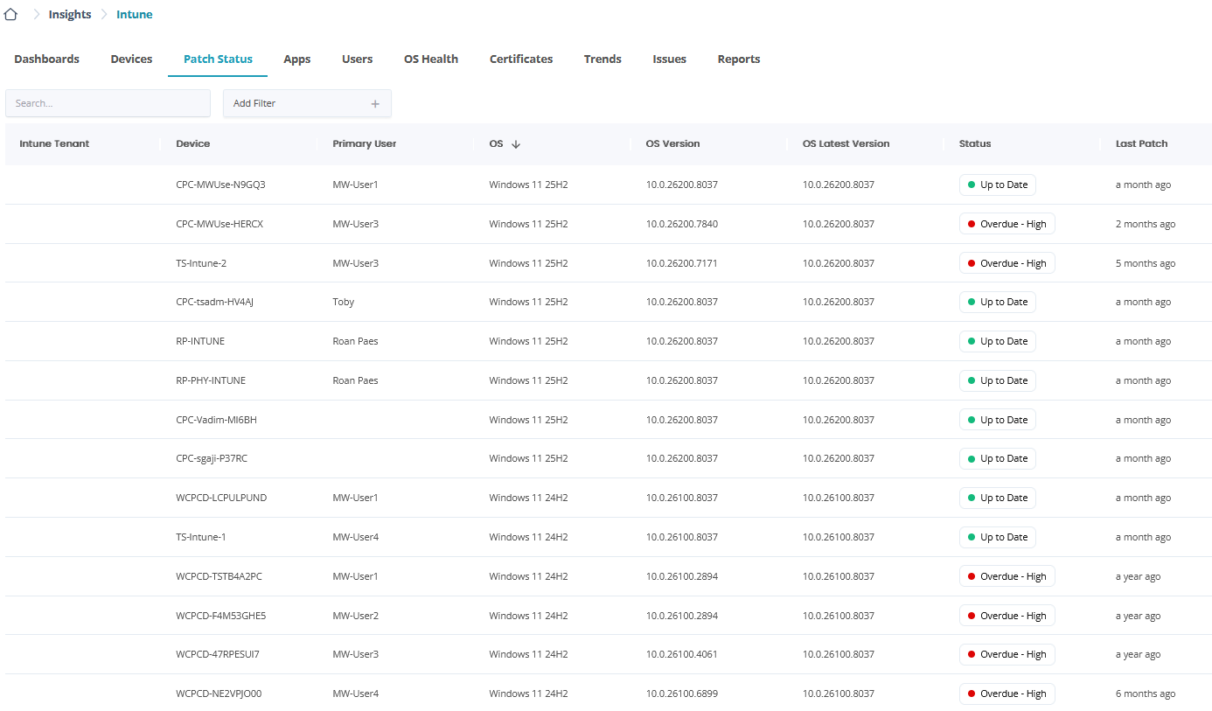
ROADMAP: INSIGHTS, ADVISOR, & COPILOT
Intune Insights updates
Cross-tenant support
Application metering
Diagnostic page
Improved scalability to 20k endpoints
Windows hot patch support

Slide 37
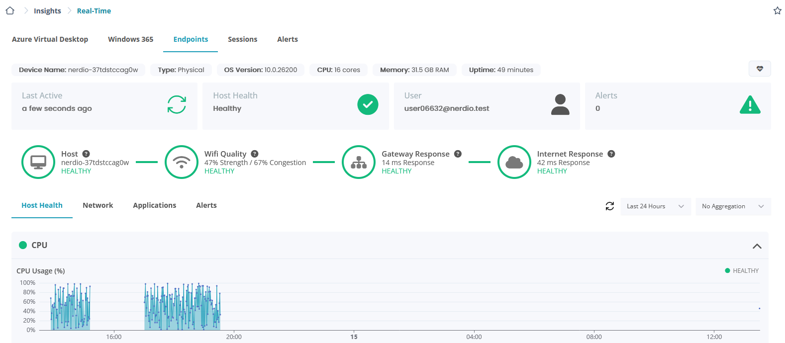
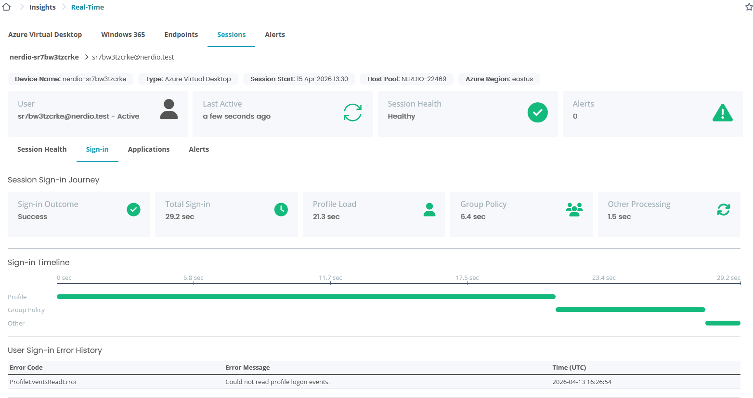
ROADMAP: INSIGHTS, ADVISOR, & COPILOT
Real-Time Insights updates
Intune endpoints now observable
Logon metrics
Local network insights
Configurable thresholds
Clearer pricing estimates and resource re-use

Slide 38
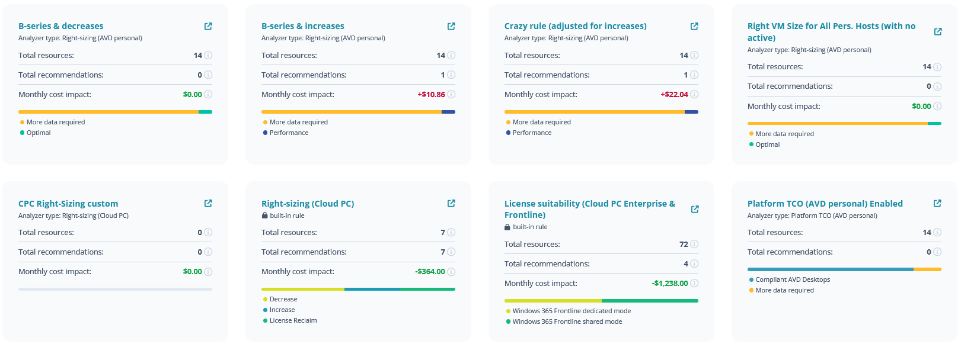
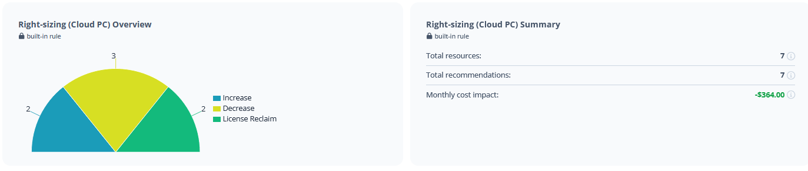
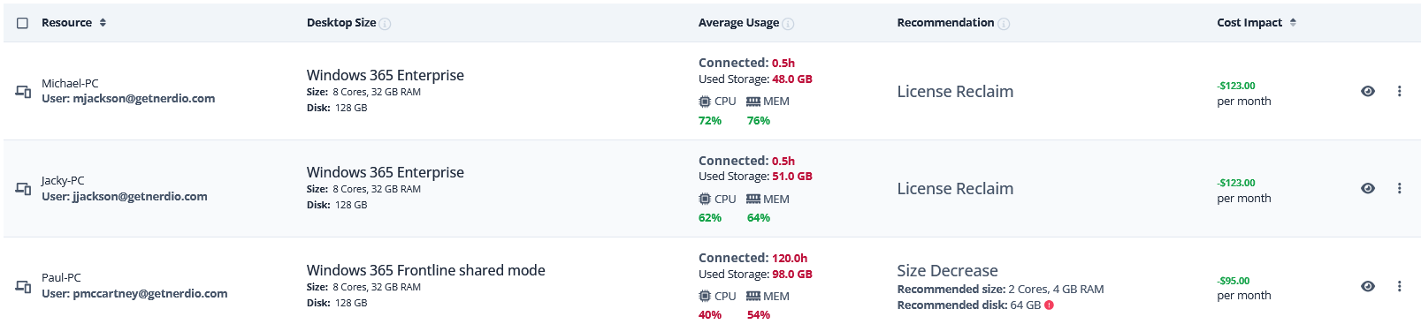
ROADMAP: INSIGHTS, ADVISOR, & COPILOT
Advisor updates
Redesigned landing page
See all recommendations and potential savings instantly
1-click remediation
Bulk right-sizing for AVD
Coming soon….
Smart actions
Smarter recommendations
Improved Modeler

Slide 39
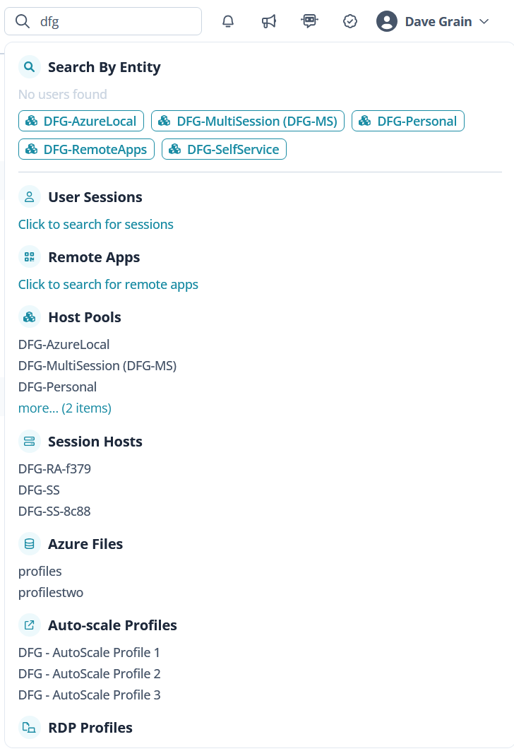
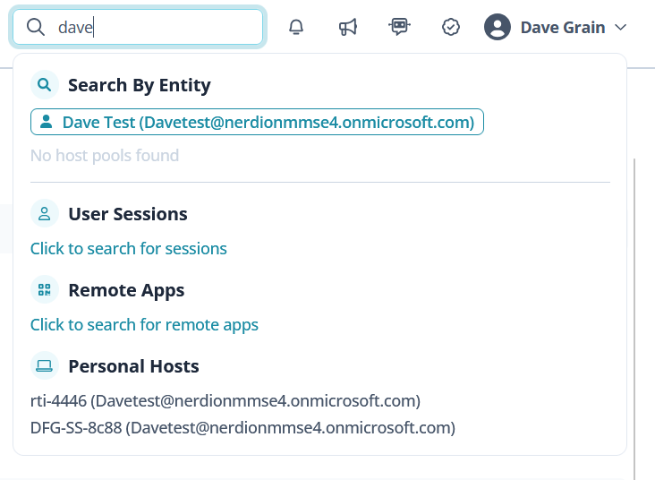
ROADMAP: INSIGHTS, ADVISOR, & COPILOT
Context-Based Search
Intelligently analyze the subject and bring focused search results.
Categorize results into relevant areas.
Make all of Nerdio Manager searchable.
Add connected Azure and Intune resources to results.
Coming soon…
Support for additional objects to search by
Integration with Nerdio Copilot

Slide 40
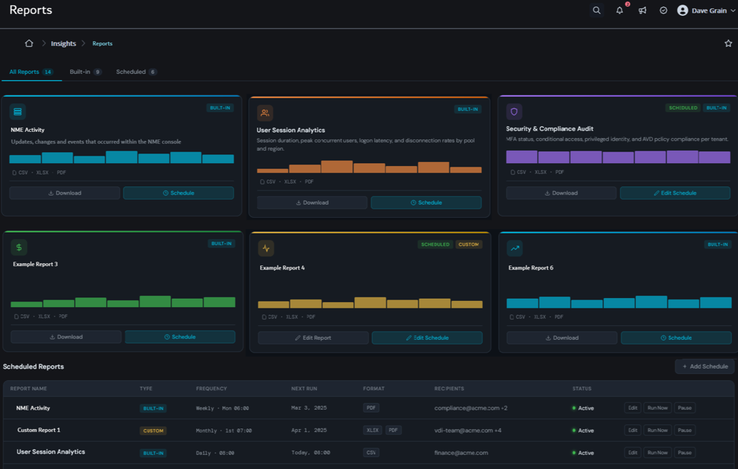
ROADMAP: INSIGHTS, ADVISOR, & COPILOT
Reporting (Targeting: NME 8.1)
Initial set of built-in reports
Usage overview
Nerdio Manager changes
Compliance report
Stale Resources
Nerdio Manager license usage
Custom reporting for business specific requirements
What reports do you need?

Slide 42
Please remember to fill out the post-breakout survey in the app.

