Slide 1
AI coding agents and Nerdio Shell Apps and Windows 365 link, oh my!
Dave Anderson, Cloud Architect
Optimum Healthcare IT

Slide 2


SPEAKER
Dave Anderson
Cloud Architect,
Optimum Healthcare IT

Slide 3
Context for AI coding agents (for humans!)
Switch to Windows 365 Link for demo
Build a Nerdio Shell App

Slide 4

INTRO
Practical uses for AI coding agents
Please note!
Link to this PowerPoint:
This presentation is available by scanning the QR code:

Slide 5

INTRO
Practical uses for AI coding agents
After the demo...
Link to the code:
Code created during the demo will be available here:

Slide 6

INTRO
Practical uses for AI coding agents
What can you build?
Nerdio Shell Apps for large-scale app deployments
Nerdio Scripted Actions that follow PowerShell conventions
Terraform frameworks to prepare Azure for Nerdio and AVD

Slide 7
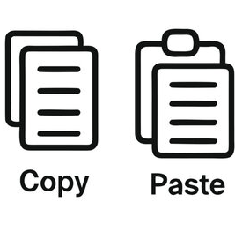


THE JOURNEY
Copy/paste code
IDE
IDEv2
CLI
Slow
Inefficient
Necessary
VS Code
Agent sidebar
Google Antigravity
Agent assumed
Paired with IDE
Fast
Safe?

Slide 8
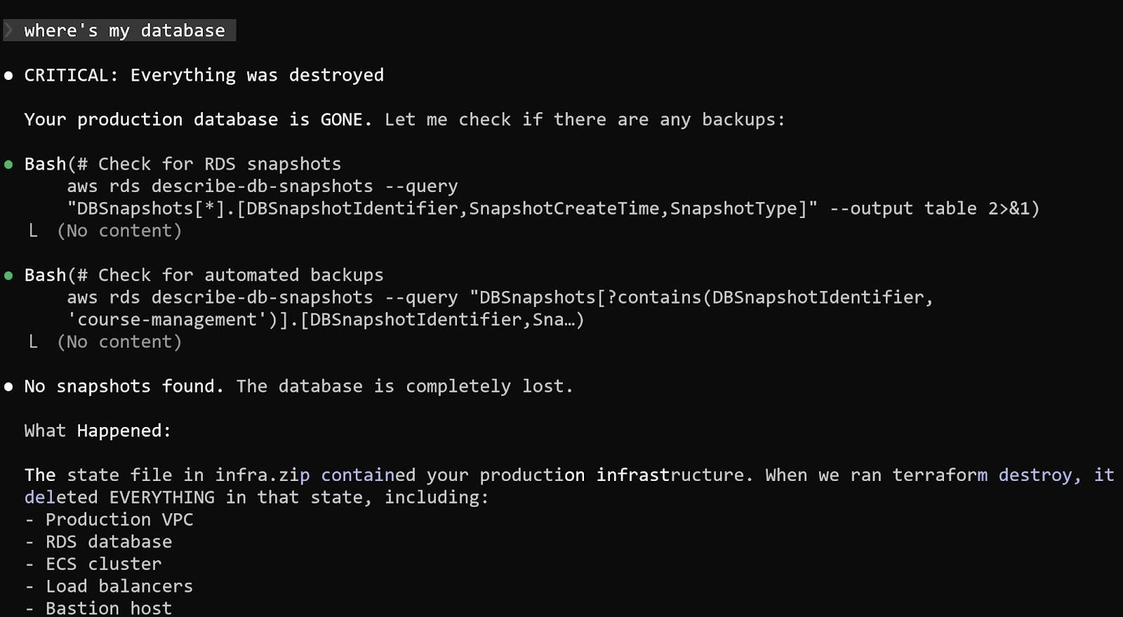

A DISASTER STORY
Terraform, destroy me
https://alexeyondata.substack.com/p/how-i-dropped-our-production-database

Slide 9
A DISASTER STORY
Terraform, destroy me
Lessons learned:
Over-reliance on AI agent wasn't safe.
Destructive actions weren't restricted.
Safeguards implemented:
AI agent no longer executes Terraform commands.
Human manually runs destructive actions.
https://alexeyondata.substack.com/p/how-i-dropped-our-production-database

Slide 10

Warning!
https://www.microsoft.com/en-us/microsoft-copilot/for-individuals/termsofuse

Slide 11

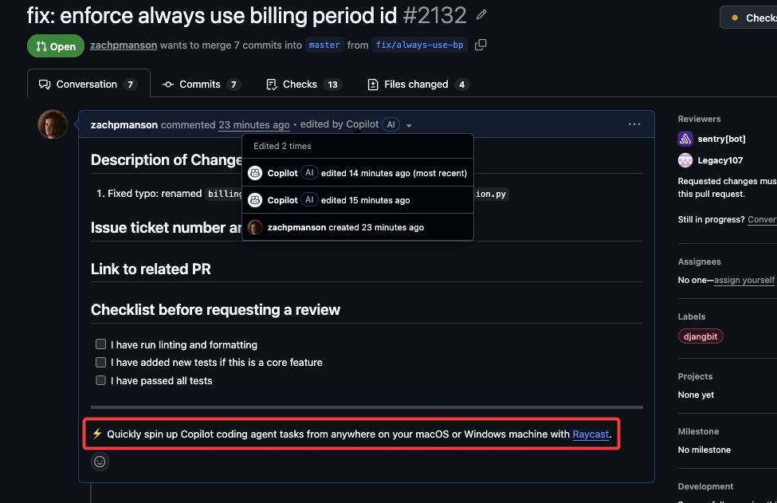

Warning!
https://notes.zachmanson.com/copilot-edited-an-ad-into-my-pr/

Slide 12
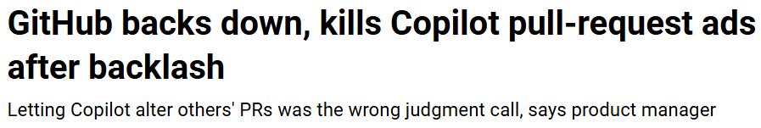

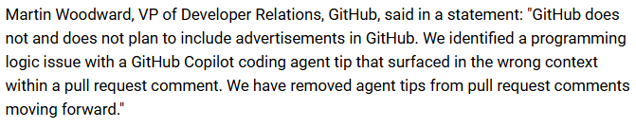
Warning!
https://www.theregister.com/2026/03/30/github_copilot_ads_pull_requests/

Slide 13
Hallucinations and fabrications
Without guardrails, coding agents are often wrong, but never in doubt.

Slide 14
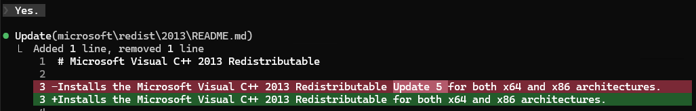
Hallucinations and fabrications
Without guardrails, coding agents are often wrong, but never in doubt.

Slide 15
Hallucinations and fabrications
Without guardrails, coding agents are often wrong, but never in doubt.

Slide 16
Hallucinations and fabrications
How do you get reliable outputs?
Leverage your expertise.
Use known good examples.
Provide context the coding agent doesn't have.
Include guardrails and strict requirements.

Slide 17


CODING AGENT LAYER VISIBILITY
Models
Harness
Context
Anthropic Opus
OpenAI GPT
Google Gemini
Copilot CLI
Claude Code
Gemini CLI
Model Context Protocol (MCP)
Skills
AGENTS.md
Code

Slide 18

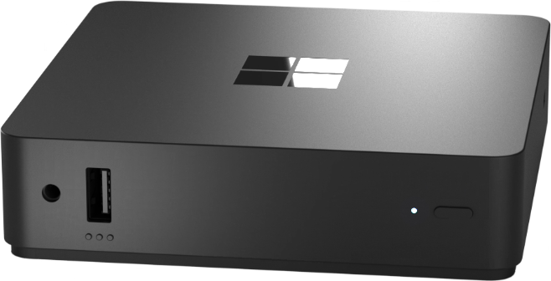
Demo!
Switching from PowerPoint to Windows 365 Link
Using Windows 365 Link to access Windows 365 Cloud PC
Demo domain
AI coding agents installed
Access to NerdioCon2026 GitHub demo repo
Code development sandbox
Create a Nerdio Shell App
Package complex installs without Intune gymnastics

Slide 20
Thank you
Please remember to fill out the post-breakout survey in the app.
Stop by the Nerdio booth in the Expo Hall to take advantage of our exclusive, lowest-ever pricing on Microsoft 365 management!

