Slide 2
Crafting the perfect desktop
end-user experience, 2026 edition
Aaron Parker and Mehdi Sebbane

Slide 3
Setting the scene
Performance impacts
User experience
Optimizing Windows
Take aways

Slide 4


SPEAKERS
Aaron Parker
Mehdi Sebbane
Senior PM Architect
Senior Technical Trainer

Slide 5
RAM prices have increased 300 to 500 percent since mid‑2025, with analysts projecting no meaningful relief until late 2027.
Notes:
RAM Prices Have Increased 300–500%
RAM prices have surged 300–500% since mid-2025, with analysts projecting no meaningful relief until late 2027. This isn't a short-term blip — it's a sustained constraint that will reshape how organisations think about device refresh cycles and VDI/AVD density.
For organisations running virtual desktop infrastructure, this directly impacts cost per session. Higher RAM costs mean fewer users per host at the same price point — unless workloads are leaner. Every megabyte of unnecessary overhead has a real dollar value.
This creates a strong business case for optimisation work that might previously have been deprioritised. When hardware was cheap, organisations could tolerate bloated images. That calculus has changed.
The organisations that will come out ahead are those that treat image and configuration hygiene as an ongoing discipline, not a one-time project. Leaner workloads mean better density, lower infrastructure spend, and more headroom for growth.

Slide 6
Why UX breaks down
Costs of poor optimization
Unoptimized Windows = inconsistency across devices.
Poor configs, multiple agents & helper apps slow startup & increase errors.
Every slowdown reduces productivity and increases support demand.
Users lose confidence when basic workflows feel unpredictable or slow.
Longer on-boarding
Higher support tickets
Reduced employee satisfaction
Reduced trust in IT
Every minute lost during sign-in, app launch, or network lag scales across the organization

Slide 7
Optimizing Windows at the image, policy, and app layers is one of the most effective ways to lift user satisfaction and productivity at enterprise scale.
Notes:
The Case for Optimisation
Optimising Windows at the image, policy, and app layers is one of the most effective ways to lift user satisfaction and productivity at enterprise scale. These aren't incremental improvements — done well, they change the baseline experience for every user in the organisation simultaneously.
The image layer sets the foundation.
A clean, standardised, regularly maintained image eliminates an entire class of device-specific and configuration-related issues before they ever reach users.
The policy layer determines behaviour at runtime.
Rationalising Group Policy, removing legacy configurations, and ensuring policies are intentional and current removes overhead and reduces conflict. This is often where the biggest performance gains are hiding.
The app layer governs what users actually interact with.
Ensuring apps are properly packaged, current, and not conflicting with each other — and that unnecessary apps aren't loading at startup — directly reduces resource consumption and improves responsiveness.
Together, these three layers represent a structured, repeatable optimisation framework. Organisations that invest here see returns in reduced support costs, improved productivity metrics, and higher employee satisfaction scores — all of which compound over time.
When Performance Improves, Productivity Improves
Users regain trust in their tools and the IT organisation.
A fast, reliable desktop changes the relationship between employees and IT. Instead of IT being the source of friction, it becomes an enabler. That trust is hard to build and easy to lose — but it starts with the experience of sitting down and having things just work.
Productivity increases because the desktop no longer gets in the way.
The best user experience is one users don't notice. When the desktop is invisible — when apps open instantly, profiles load cleanly, and connections are stable — people focus on their work, not their tools. That's the goal.
Lower frustration improves employee morale and reduces shadow IT.
When people trust their IT environment, they use it. When they don't, they find workarounds — personal devices, consumer cloud storage, unsanctioned communication tools. These workarounds create security and compliance risk. The most effective way to reduce shadow IT is to make the sanctioned environment better than the alternatives.
Smooth, predictable experiences make hybrid work and mobility more successful.
The shift to hybrid work amplified every existing desktop performance problem. Users connecting from home, from the road, or from branch offices have less tolerance for slow or unreliable environments. Organisations that optimised for this shift gave their people a genuine advantage.

Slide 8
Performance results
What happens on an unoptimized system?
With thanks to LTT: https://youtube/QKPvYbCSWT8

Slide 9
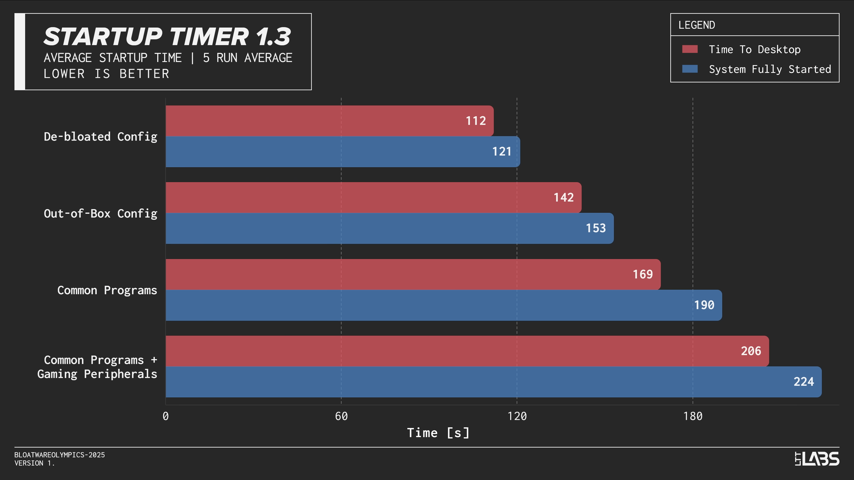
Notes:
Source: https://www.youtube.com/watch?v=QKPvYbCSWT8

Slide 10
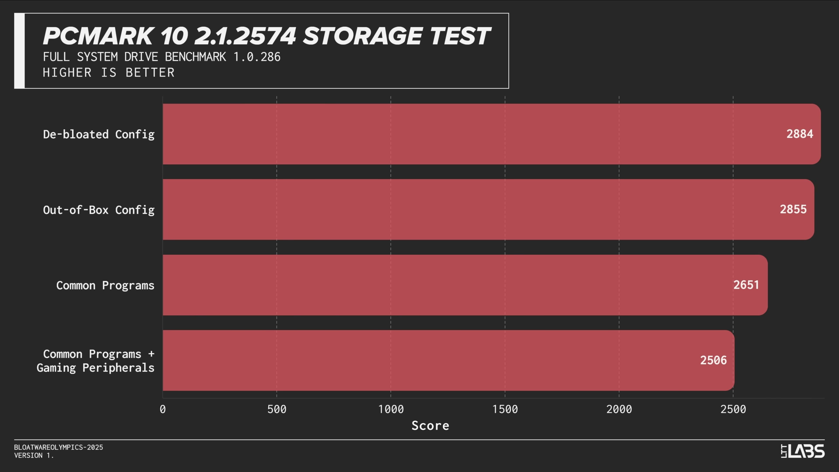
Notes:
Source: https://www.youtube.com/watch?v=QKPvYbCSWT8

Slide 11
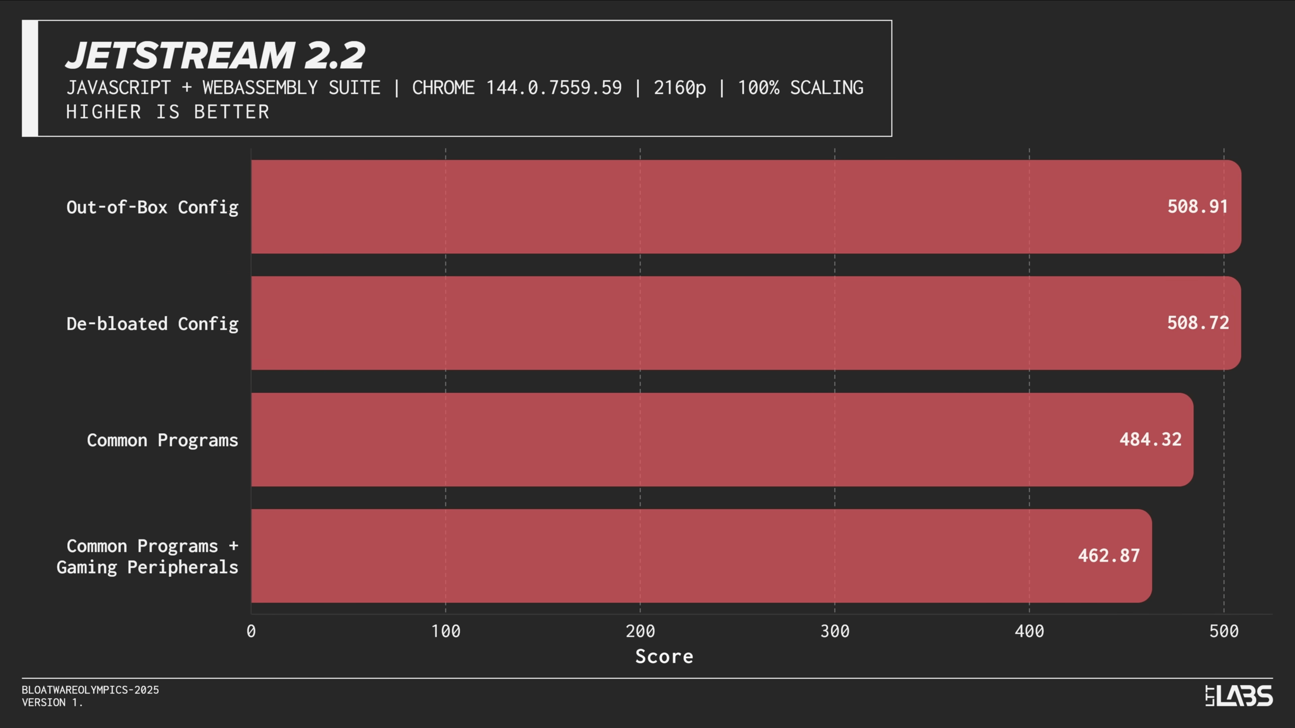
Notes:
Source: https://www.youtube.com/watch?v=QKPvYbCSWT8

Slide 12
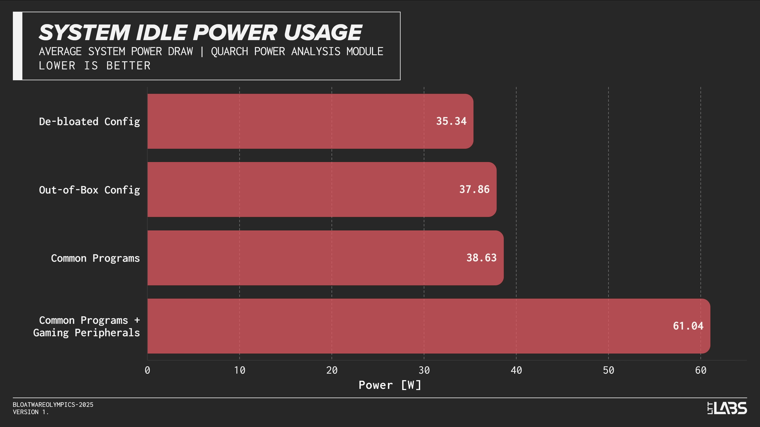
Notes:
Source: https://www.youtube.com/watch?v=QKPvYbCSWT8

Slide 13
Poor UX

Slide 14
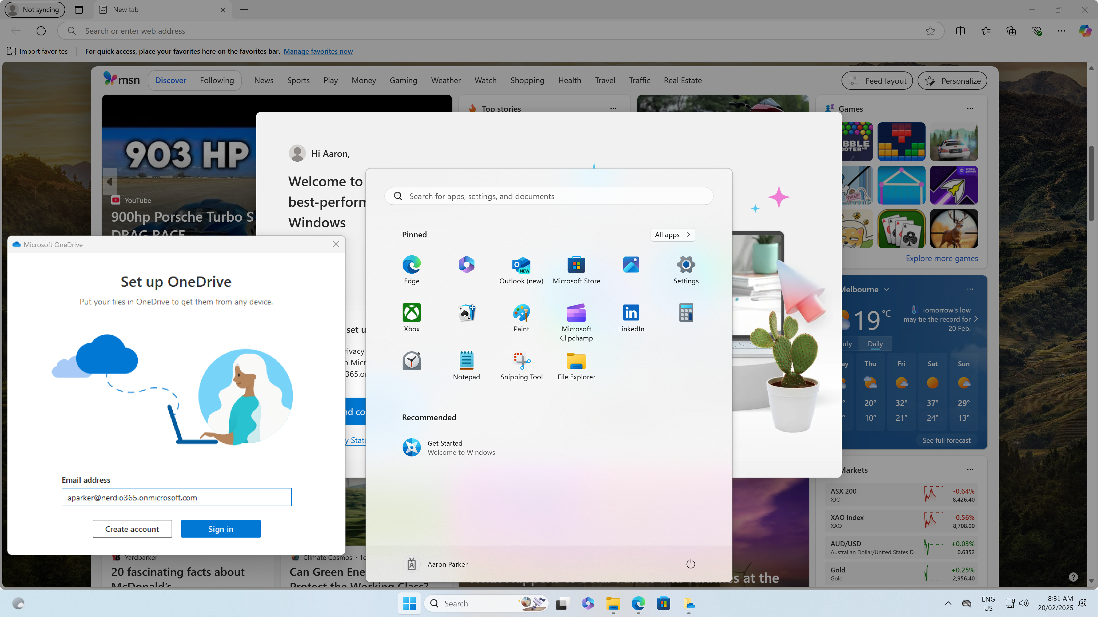
Notes:
First sign-in with a poor user experience. Default Start menu, OneDrive requires manual sign-in, Edge is noisy, time zone is not correct

Slide 15
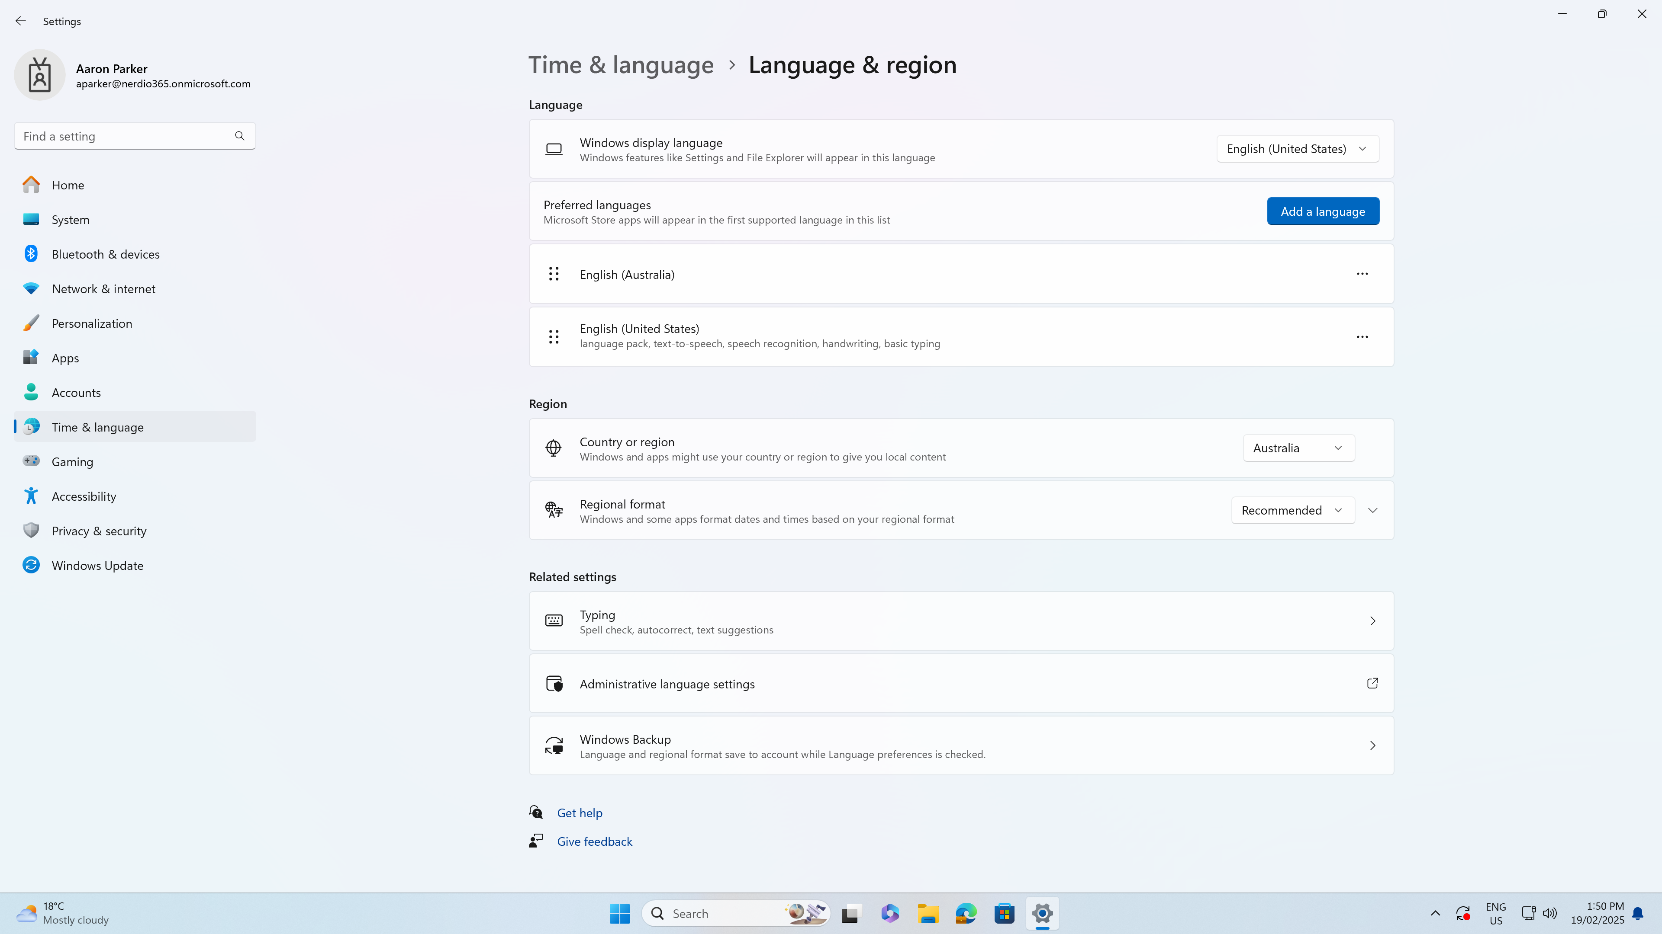
Notes:
Poor user experience with Windows display language not localised

Slide 16
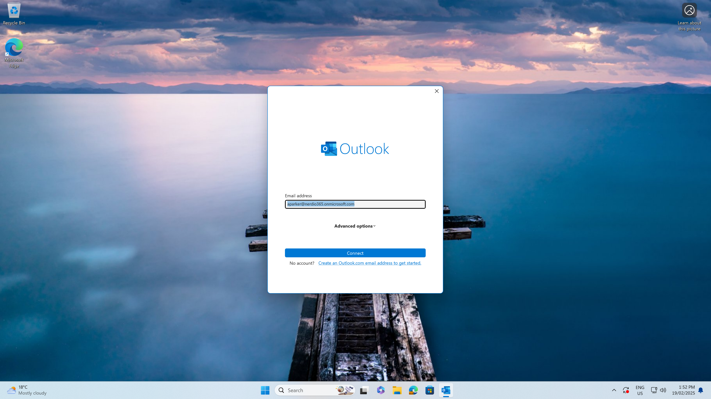
Notes:
Poor user experience with the user required to configure Outlook

Slide 17
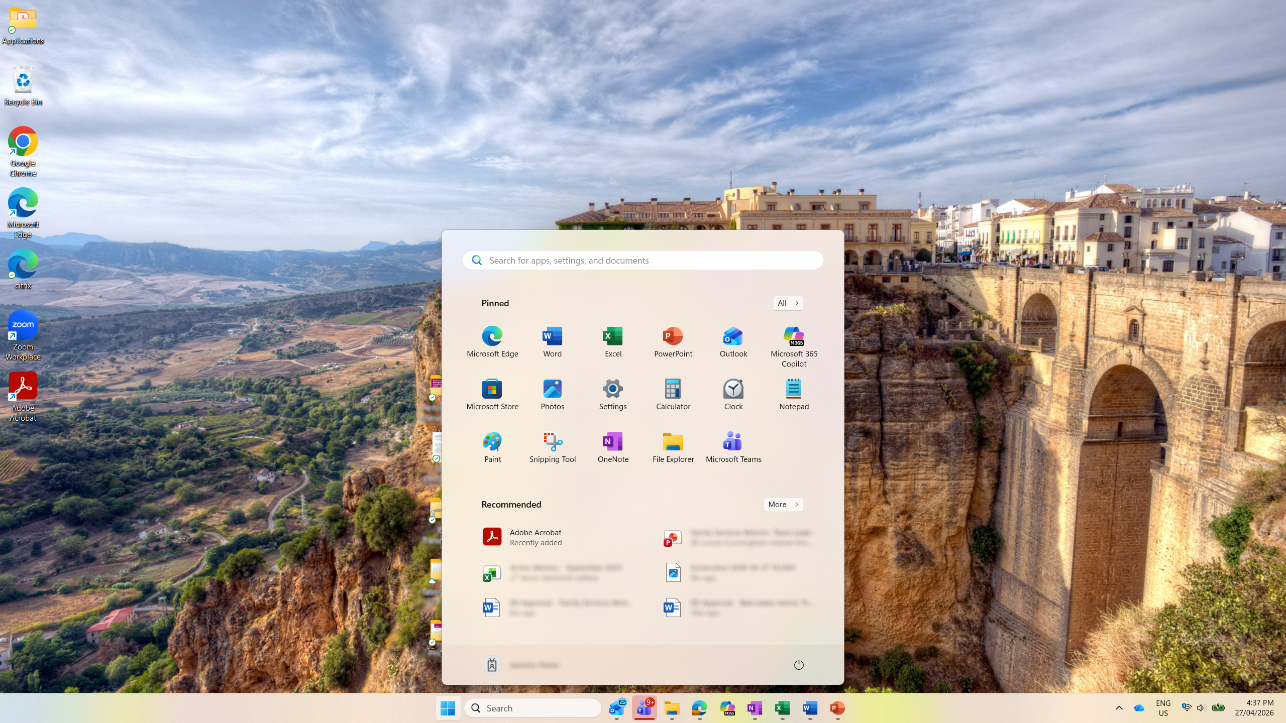
Notes:
Source: https://www.youtube.com/watch?v=QKPvYbCSWT8

Slide 18
Great UX

Slide 19
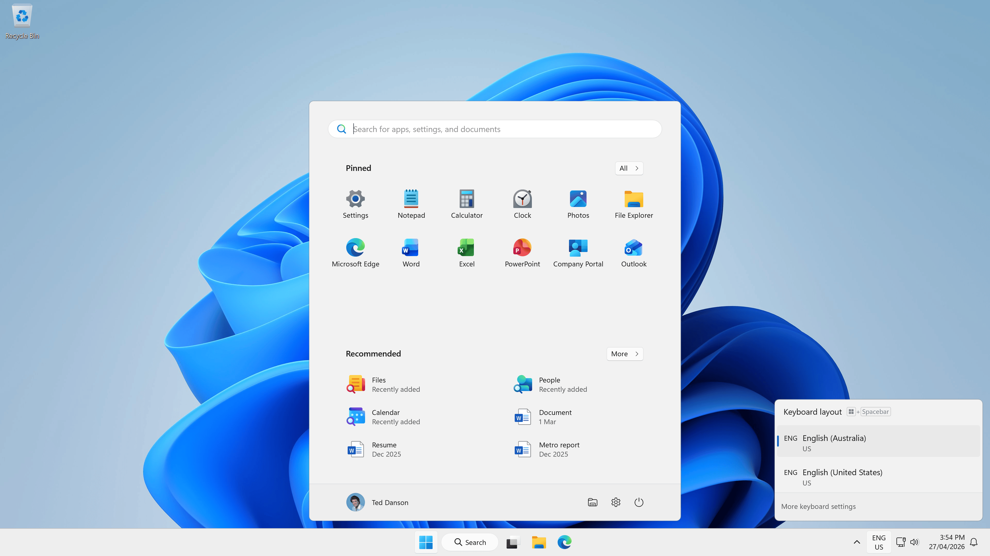
Notes:
Great user experience with customized Start menu, OneDrive known folder move, no noise when starting Edge for the first time, time zone is set correctly

Slide 20
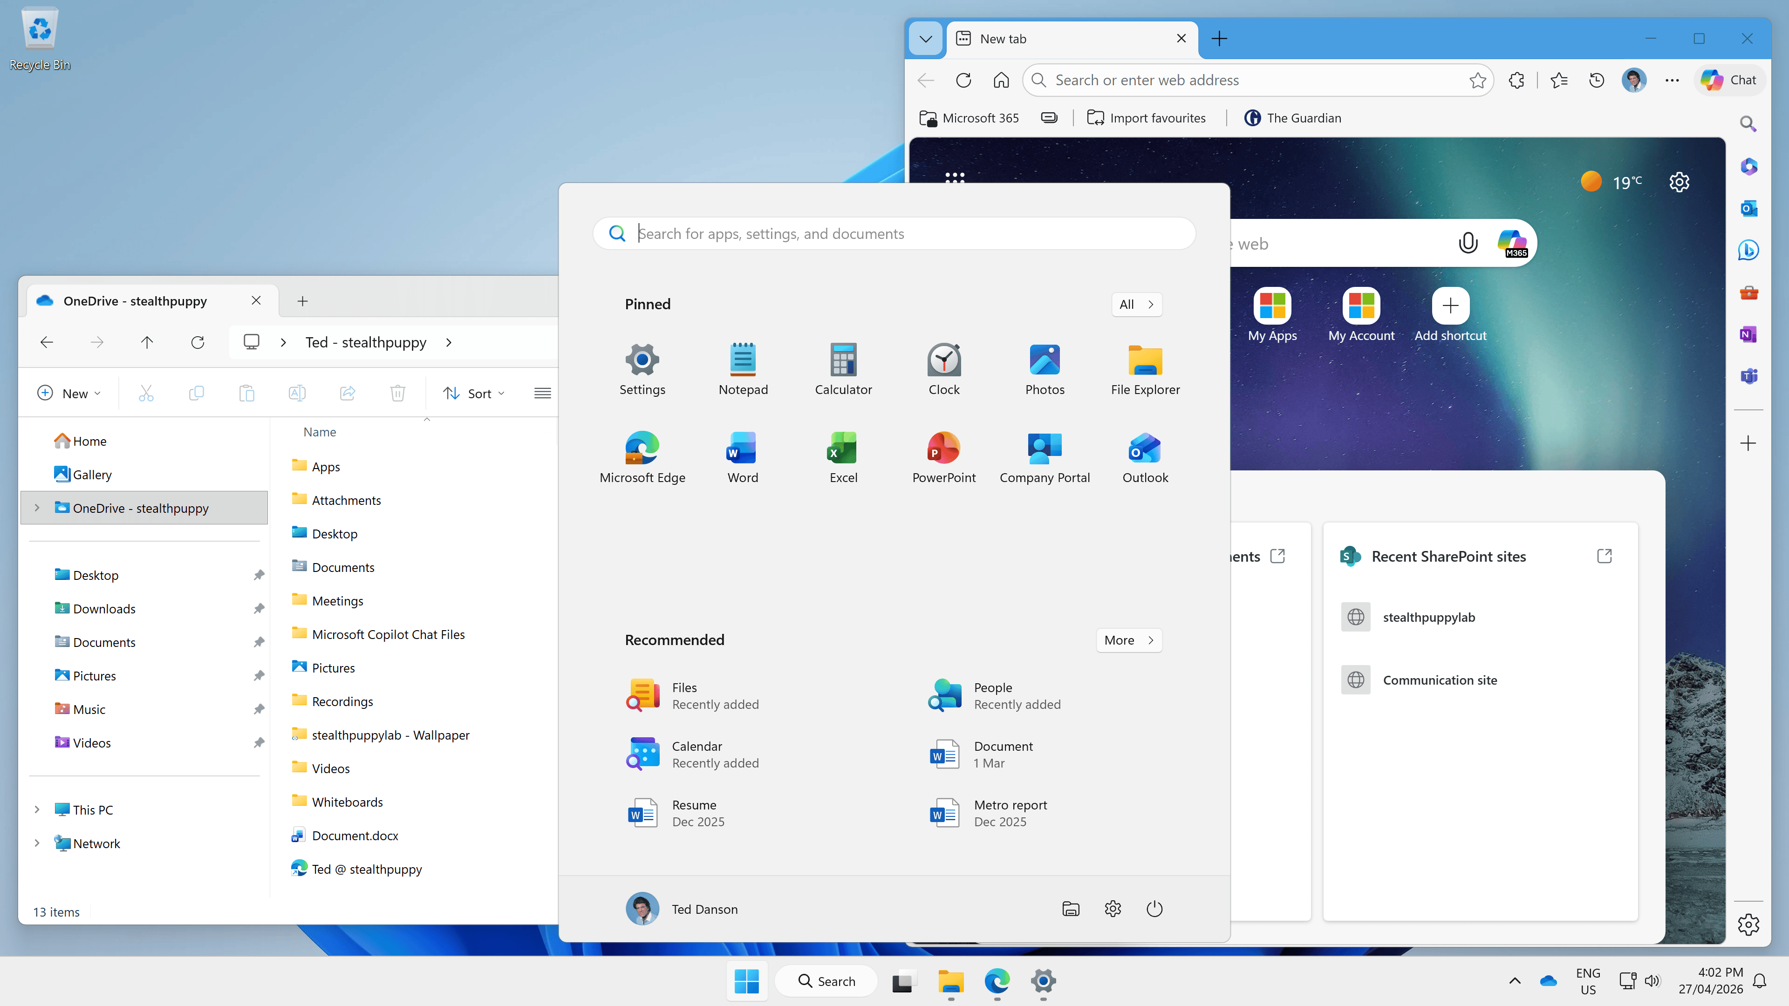
Notes:
Windows display language customised from the default English US

Slide 21
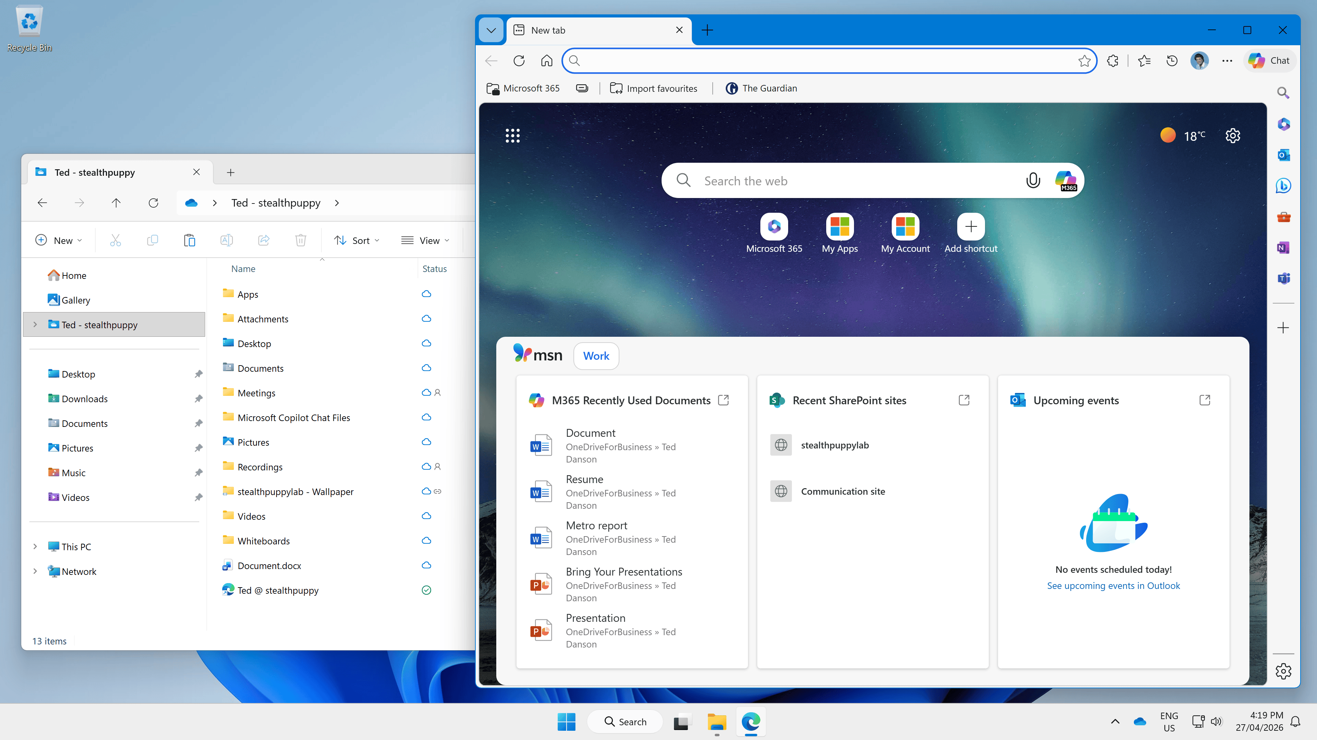
Notes:
Windows display language customised from the default English US

Slide 22
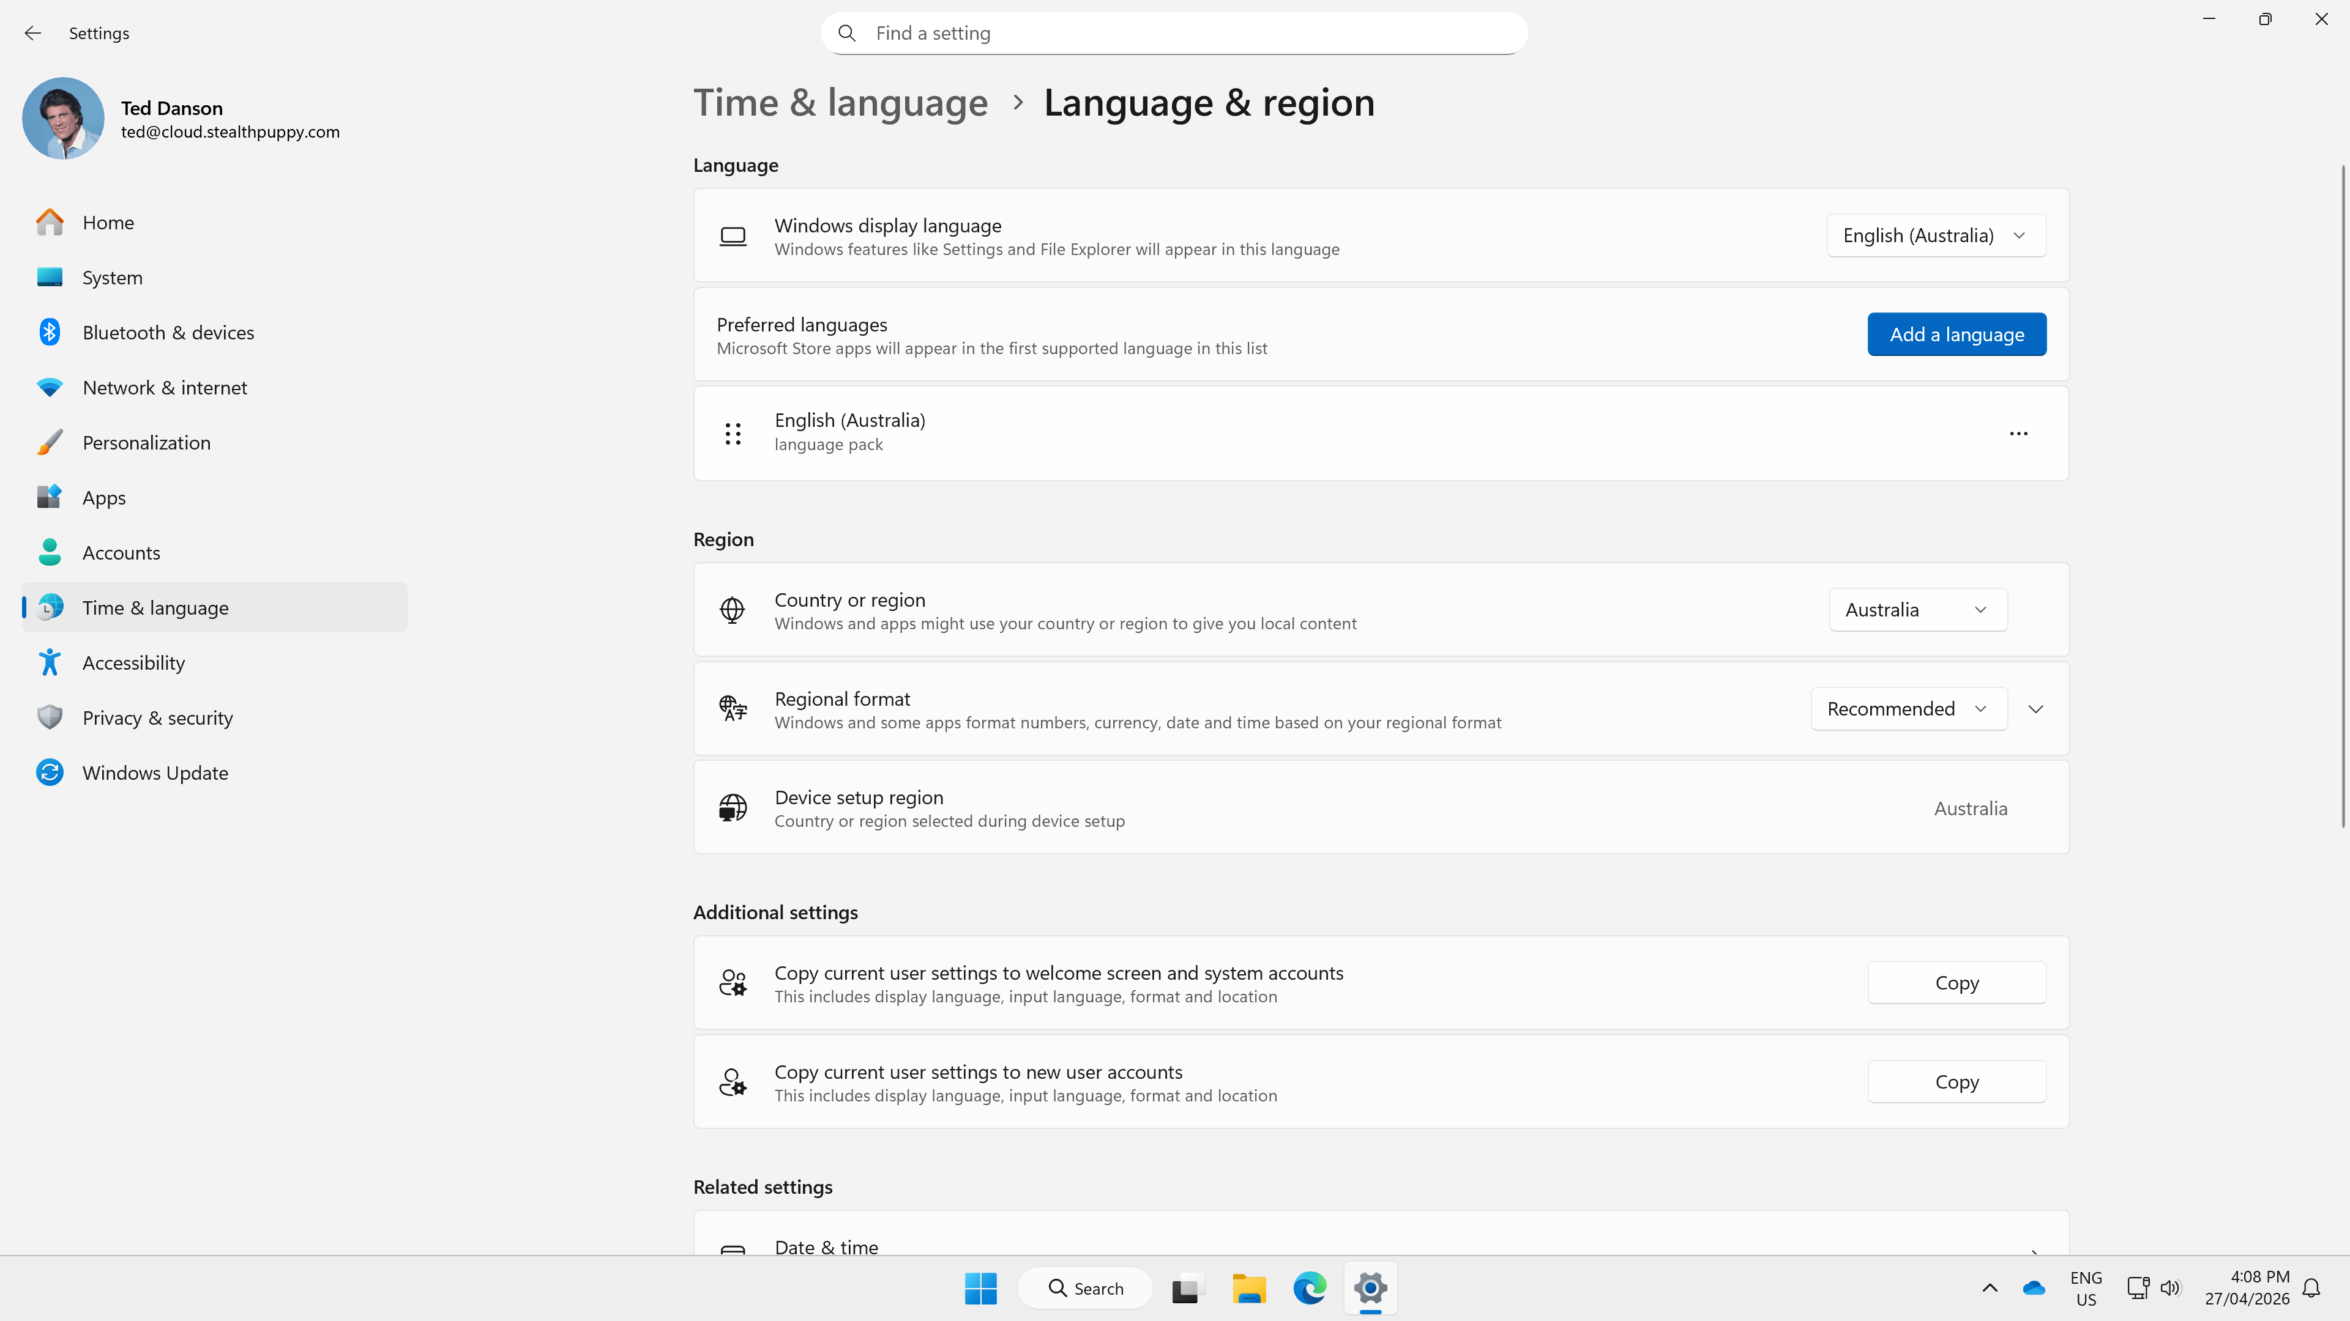
Notes:
Time zone detection configured

Slide 23
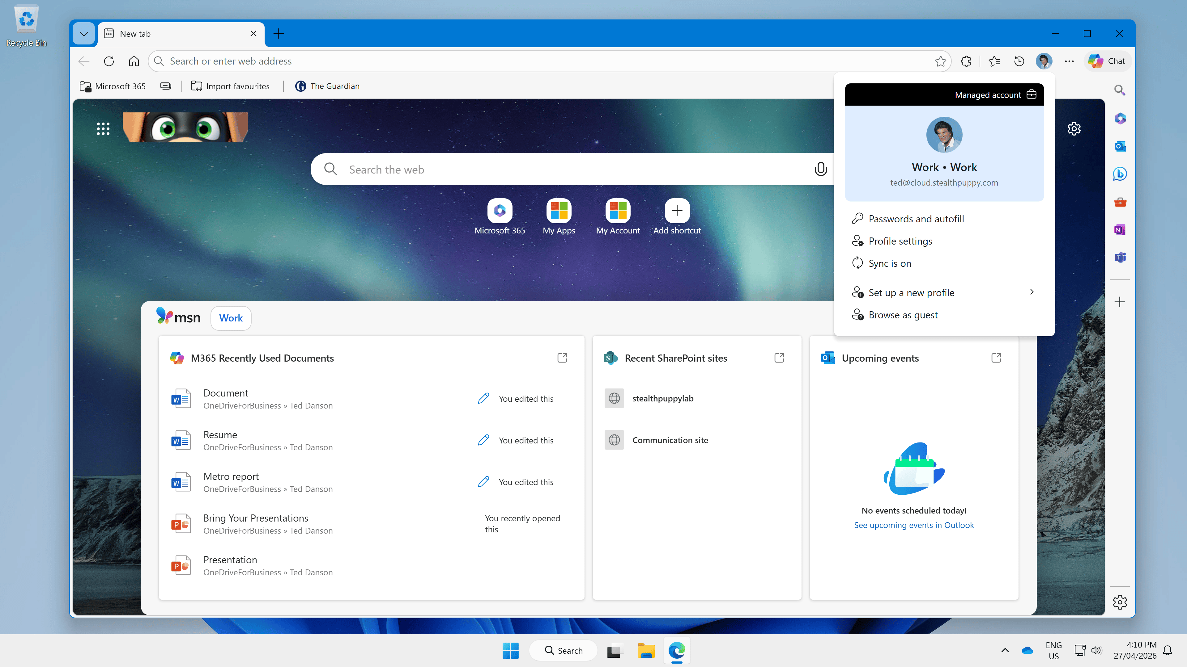
Notes:
Microsoft Edge is enterprise ready with Intune policies and Edge cloud policies

Slide 24
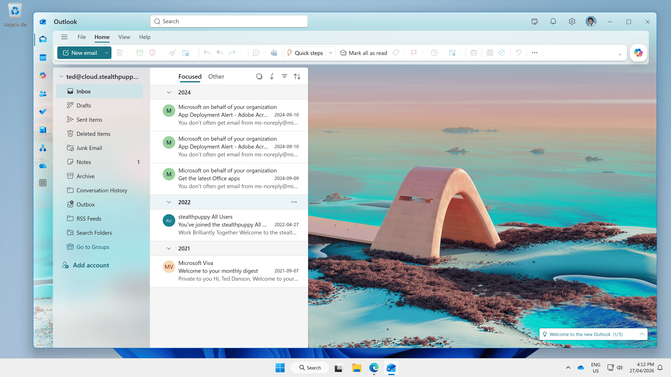
Notes:
Microsoft Outlook first launch with the user’s mailbox configured automatically

Slide 25
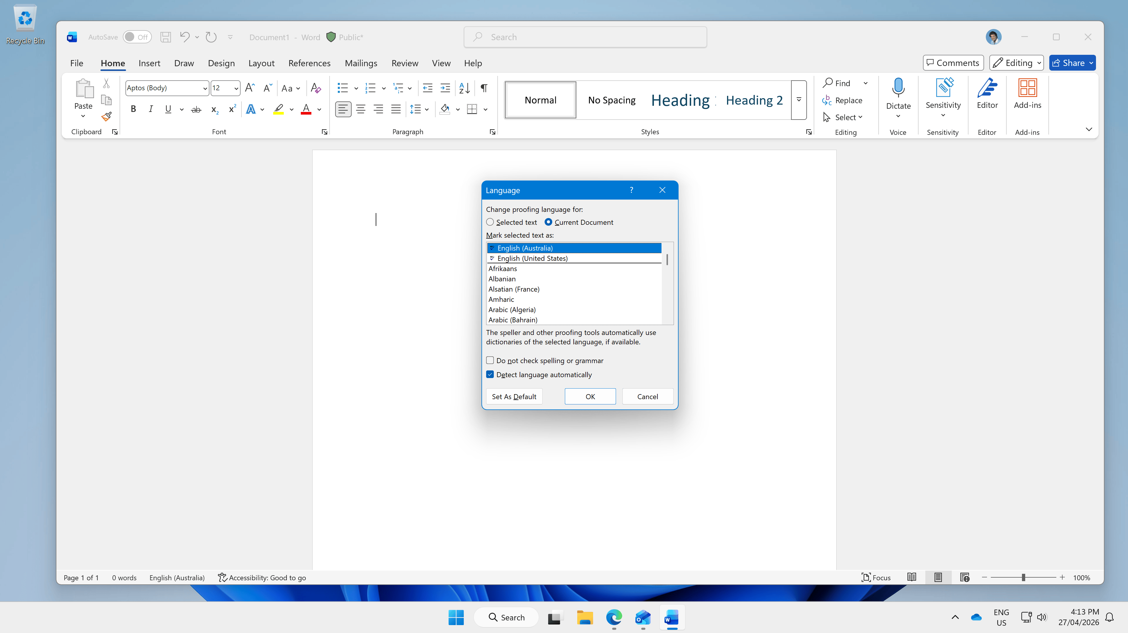
Notes:
Microsoft 365 Apps configured with the correct locale settings

Slide 26
Optimizing Windows
A well‑tuned Windows image becomes
the foundation for reliable, efficient, and
scalable end‑user computing

Slide 27
Policies vs. preferences
 | Policy | Preferences
Built-in apps | Target & remove with Intune | Remove in gold image/Autopilot
First run popups | Intune policies | Gold image/Autopilot
Start menu | Forced Start menu via Intune | Gold image/Autopilot
Wallpaper, settings, etc. | Force via Intune policies | Gold image/Autopilot

Slide 28
Building blocks
User policies
Device policies
Application packages
Microsoft 365 Apps
Enterprise Defaults
Windows Autopilot
Provisioning profiles
Gold images

Slide 29
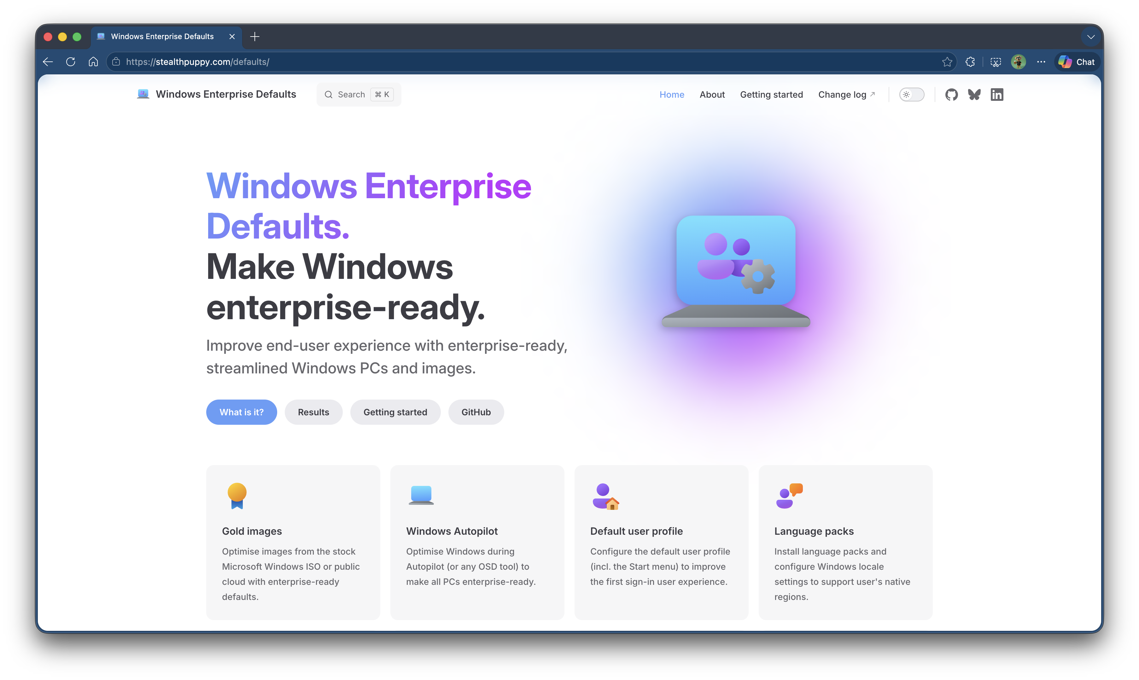

Slide 30
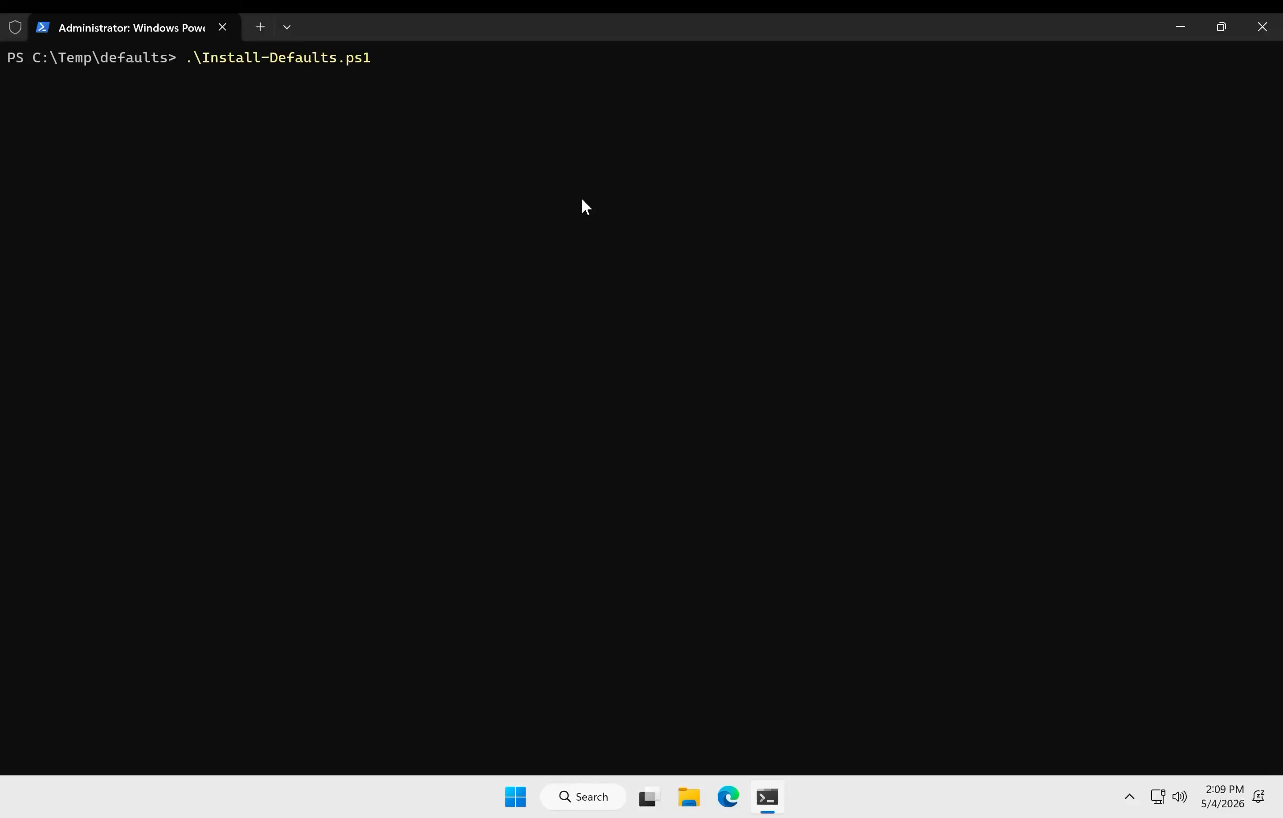

Slide 31
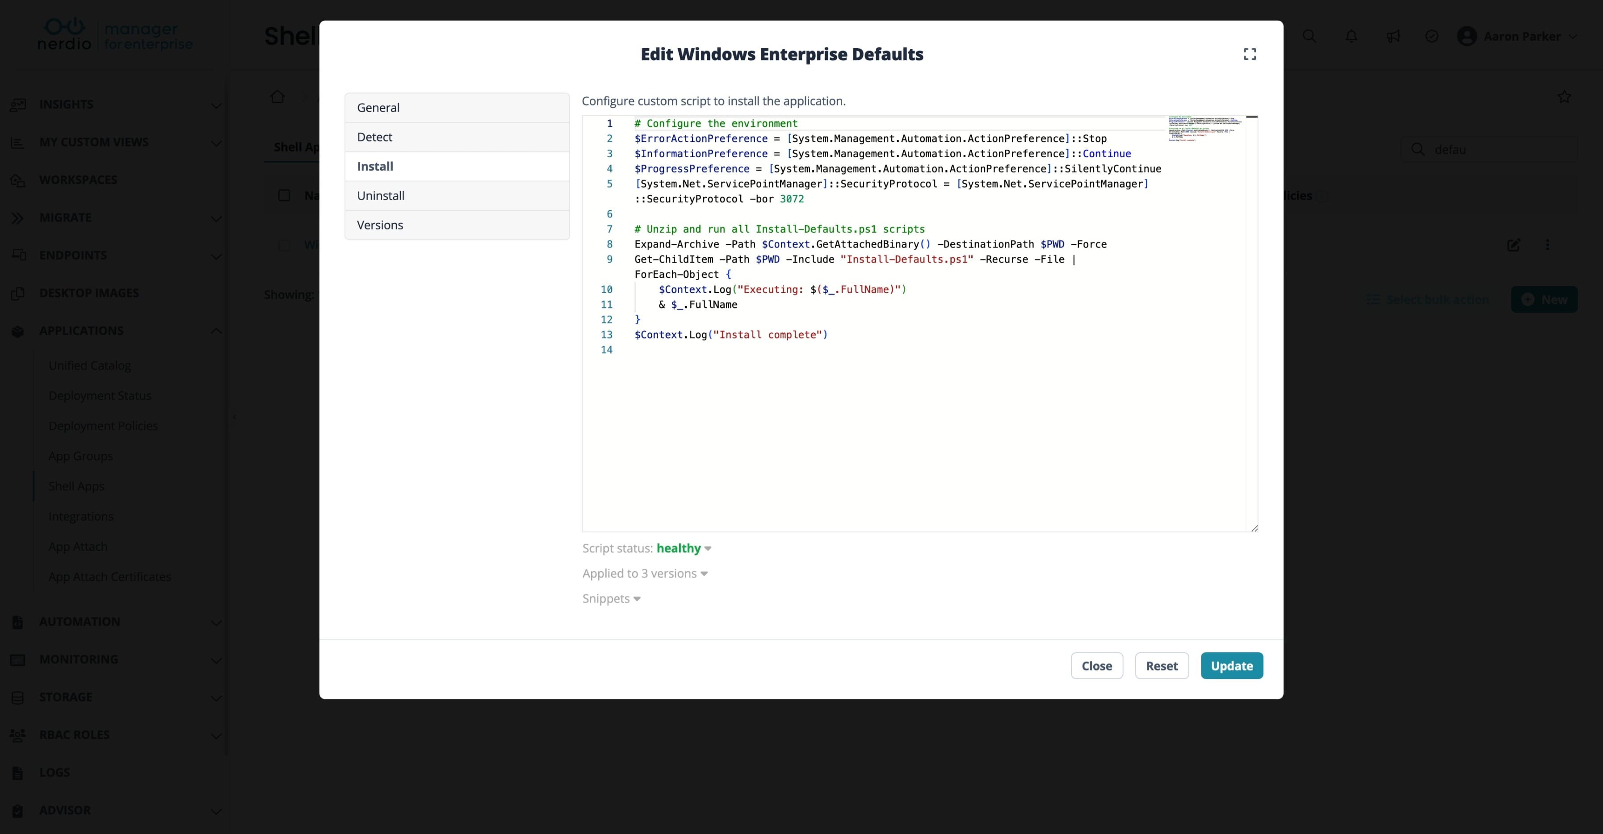

Slide 32
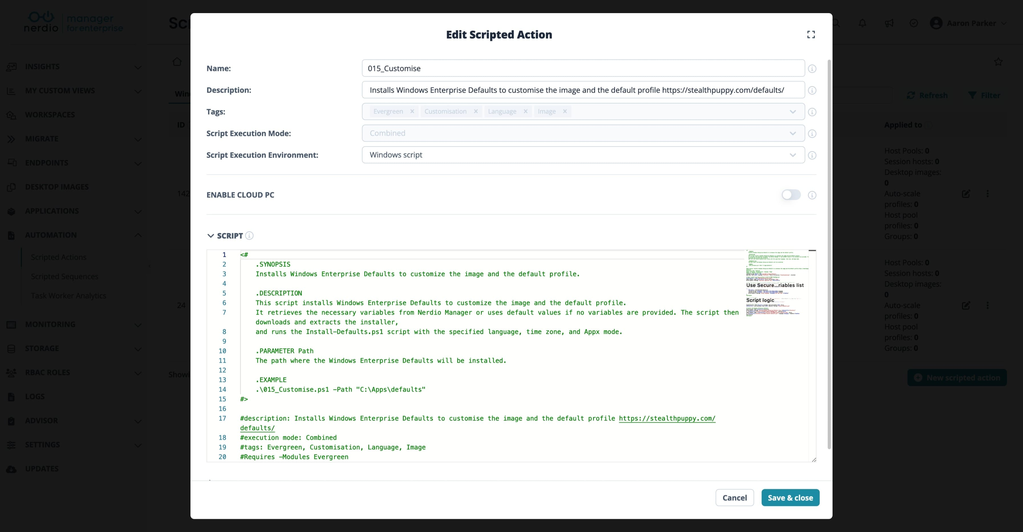

Slide 33
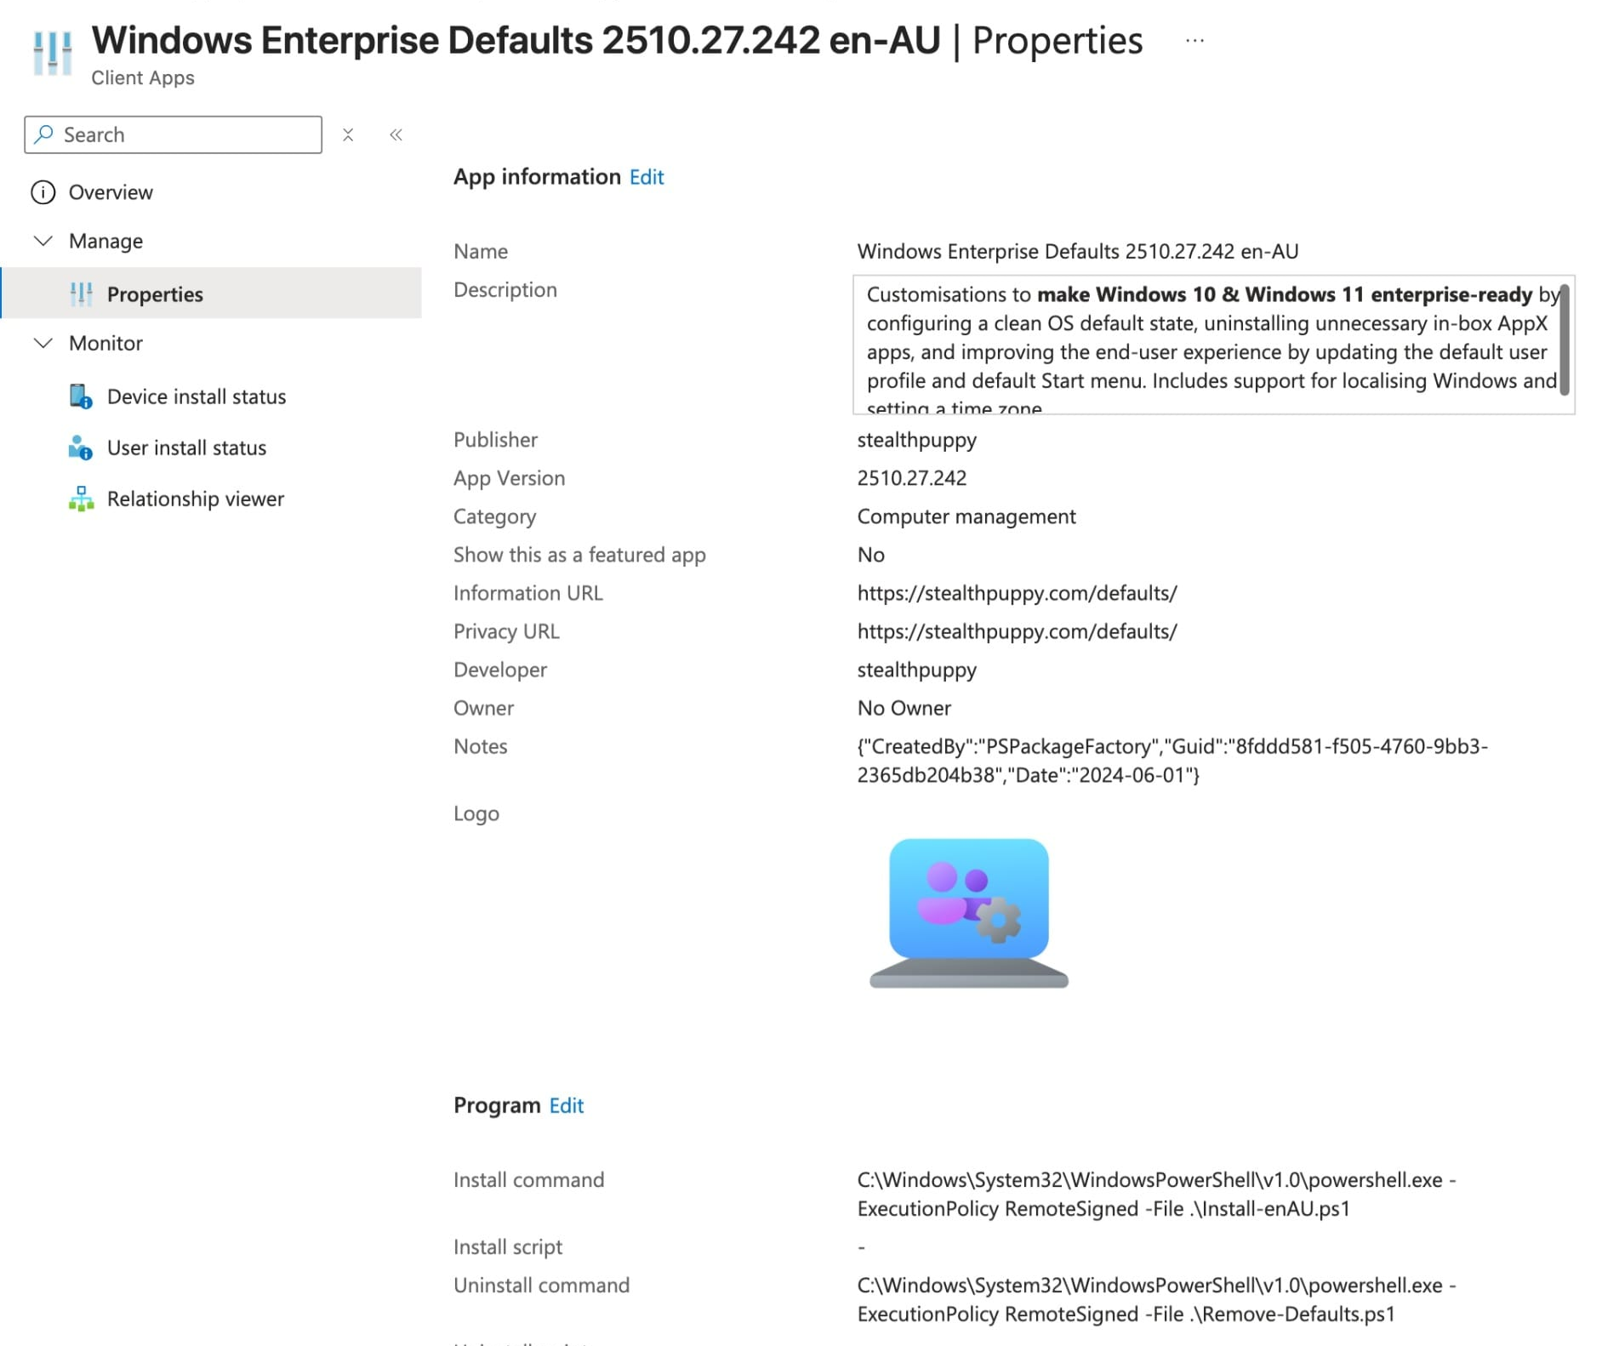

Slide 34
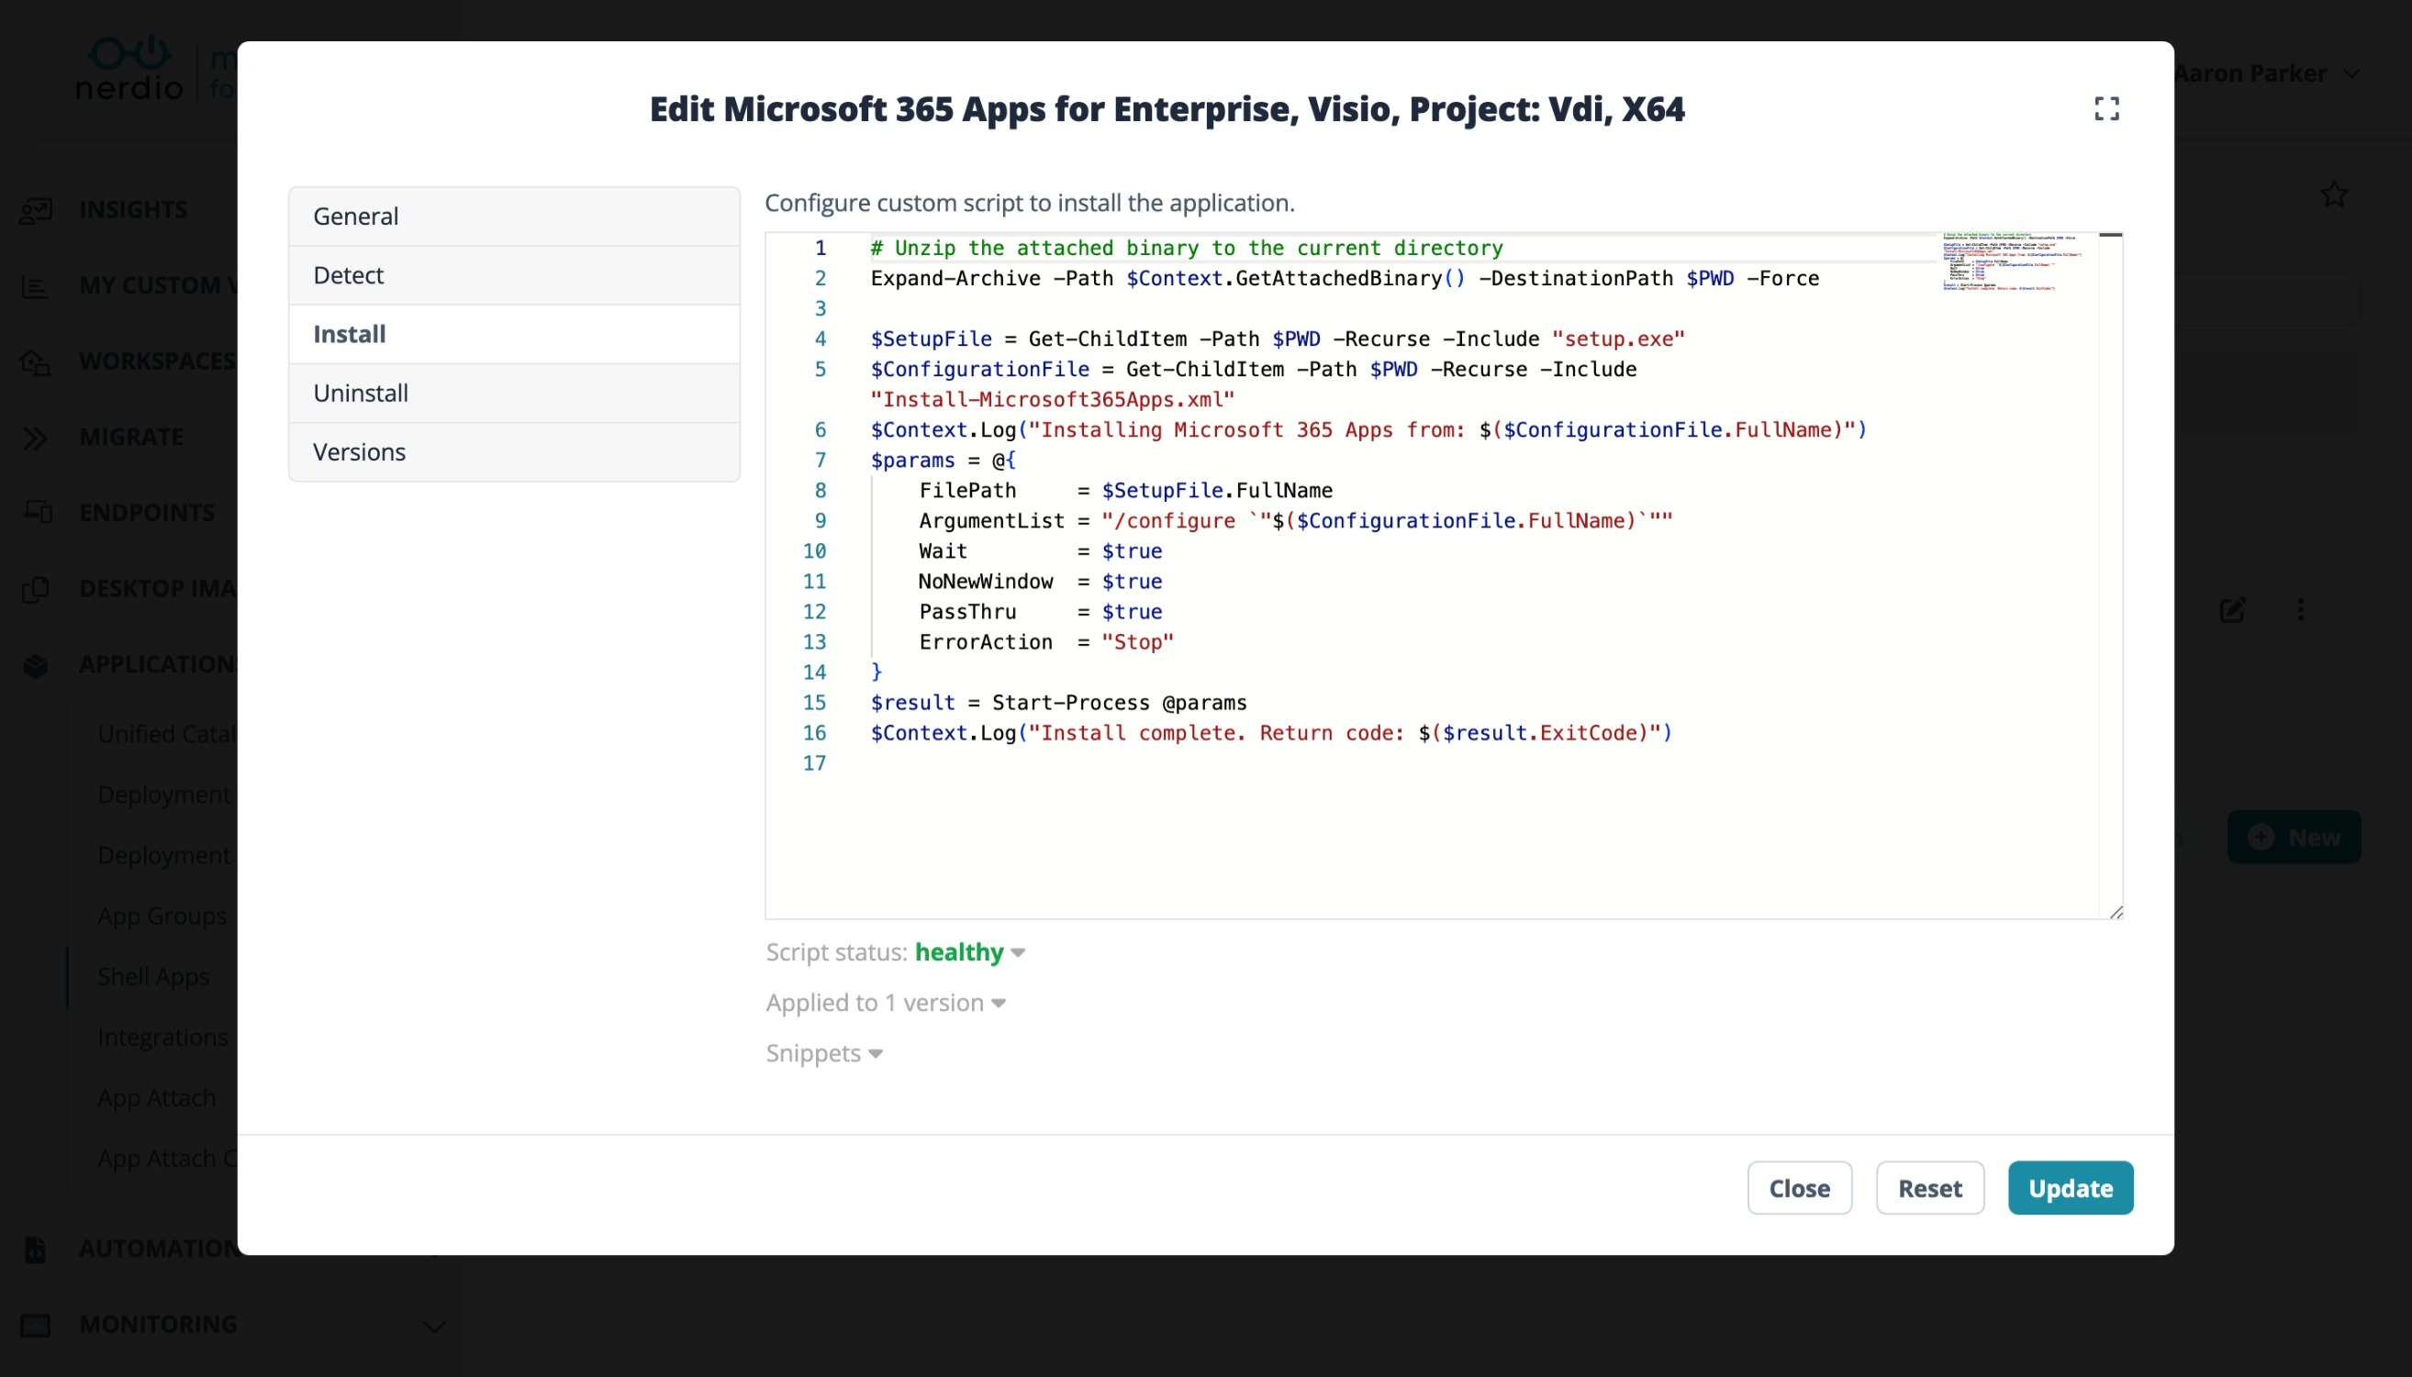

Slide 35
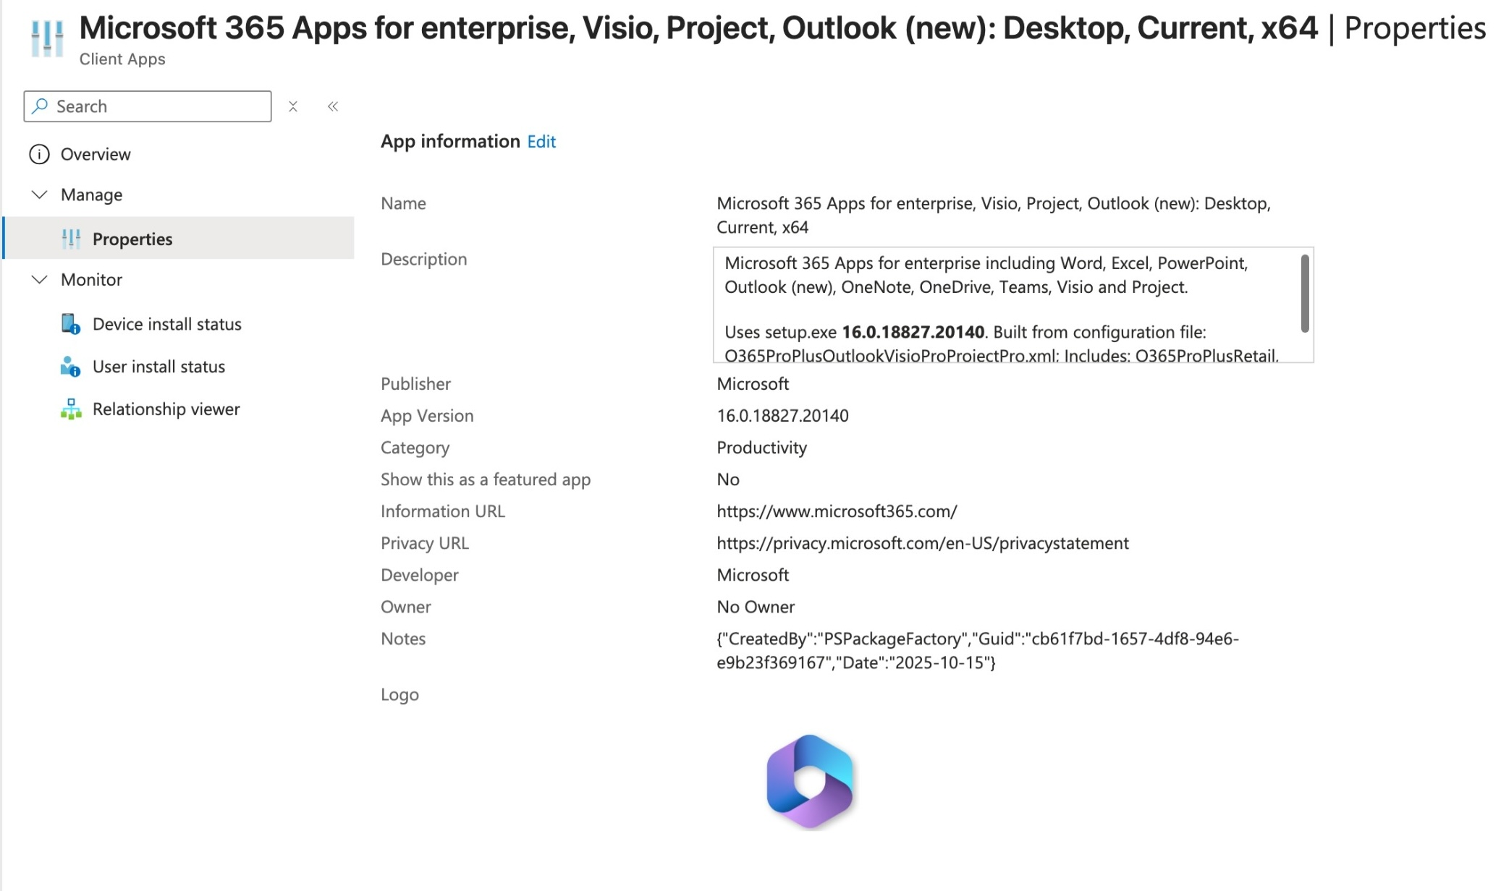

Slide 36
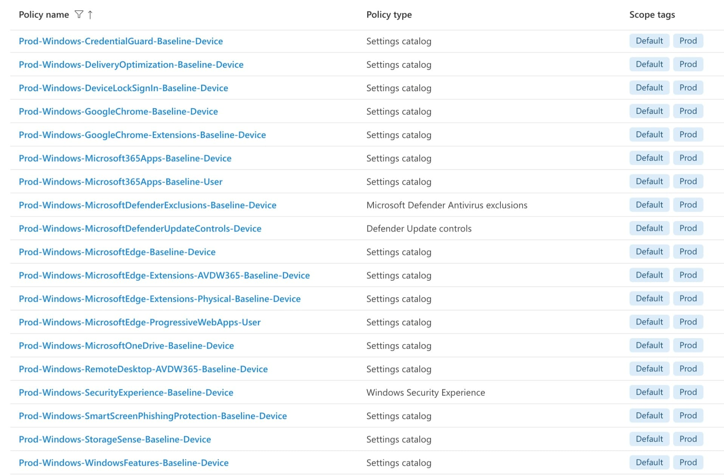

Slide 37

TOOLS FOR BUILDING GREAT DESKTOP USER EXPERIENCES
Windows Autopilot
Device pre-provisioning
Enterprise defaults
M365 apps Win32 package
Intune configuration profiles
Sync via M365 apps, OneDrive, Edge
Autopilot device prep
Gold images
Enterprise defaults
M365 apps Win32 package
Intune configuration profiles
Sync via M365 apps, OneDrive, Edge
Marketplace image + customisations
Gold images
Enterprise defaults
M365 apps Win32 package
Intune configuration profiles
Sync via M365 apps, OneDrive, Edge

Slide 38
Review

Slide 39
Optimizing Windows
Consistency across every device
Faster time to productive use
Lower support demand and fewer failures
Improved performance everywhere
Stronger user confidence and satisfaction
Notes:
Consistency across every device
A single, optimised image removes variation and drift, ensuring users get the same predictable desktop whether physical or virtual.
Faster time to productive use
A stripped‑back, policy‑aligned image reduces sign‑in time, eliminates first‑run noise and gets users working sooner.
Lower support demand and fewer failures
Removing redundant agents, legacy settings and conflicting defaults reduces errors, login issues and performance instability.
Improved performance everywhere
Optimised services, start‑up tasks and apps lead to measurable gains in responsiveness on low‑spec PCs, shared devices and cloud desktops.
Stronger user confidence and satisfaction
A desktop that behaves predictably improves trust in IT and reduces frustration across the organisation.
Why optimise
Less noise
Faster to “usable”
Speeds new device deployment or resets
Happy users
Consistent experience

Slide 40
What matters most
Drivers of experience:
Performance | Consistency | Productivity | Confidence | Satisfaction
What IT must optimize:
• Windows images: Establish a stable, consistent foundation across all device types.
• Policies and configuration: Reduce drift, noise, and conflicting behaviors.
• Apps and first-run experience: Remove delays and interruptions.
• Autopilot and device preparation: Deliver a clean, fast, enterprise-ready setup.
• Microsoft 365 preference sync: Provide a familiar experience across PCs, Windows 365, and VDI.
Outcome:
A fast, reliable Windows environment that boosts productivity and reduces support needs.
Notes:
User experience is a primary driver of perceived and actual performance, influencing productivity, satisfaction and trust in IT.
Optimising Windows at the image, policy and app layers is essential for consistent, high‑performance desktops across physical and virtual environments.
Windows Autopilot and Device Preparation require deliberate configuration to eliminate noise, reduce setup friction and deliver predictable first‑run behaviour.
Enterprise‑ready defaults for Windows, Edge and Microsoft 365 reduce variation, prevent drift and cut support demand.
Microsoft 365 services, including OneDrive, Edge and Office, synchronise user preferences to provide familiarity across devices.
Outcome: Users can move seamlessly across physical PCs, Windows 365 and VDI with minimal effort and maximum productivity.

Slide 41




Tools
Enterprise defaults
Scripted actions
Microsoft 365 apps
Intune policies

Slide 42


Slide 43



Slide 44
Please remember to fill out the post-breakout survey in the app.

