Slide 1
Standardize once, deploy everywhere with Autopilot
Hugo Salazar
Notes:
Hello everyone, thank you for joining today’s session- Standardize once, deploy everywhere with
Autopilot
I'm Hugo Salazar, and over the next 45 minutes I'm going to show you how Microsoft’s Windows Autopilot changed traditional computer deployment, how it evolved into something called device preparation, and how Nerdio turns it into something your MSP can actually run across every client, at scale, without losing your weekend.

Slide 2

SPEAKER
About your speaker
Hugo A. Salazar
Go live engineer
10 years of IT experience
Started in a small MSP team
Modern Work engineer
Identity Access Management engineer
I’m usually out camping

Slide 3
Traditional deployment pain
Classic Autopilot: what worked and what didn’t
What changed with device preparation
Demo: Setting up device configurations
Demo: Scaling with Nerdio Manager for MSP
Key takeaways and Q&A
Notes:
First, the pain points of traditional deployment — the world before Autopilot.
Then why Autopilot felt like the future when it first landed and how classic Autopilot actually worked under the hood and the pain point every MSP in this room knows too well — the part Autopilot v1 didn't fix.
what Microsoft did about it: device preparation also know as autopilot v2.
And finally a live walkthrough — first in Intune, then in Nerdio — followed by Q&A.
If you only stay for one section, stay for the demo. That's where the abstraction collapses into something you can run on Monday.
Presenter tip: Don't read the agenda verbatim. The slide is doing that work. Add the "stay for the demo" hook so the agenda has a payoff.
Transition: "Before we get into the technology."

Slide 4
My Autopilot story starts in 2020
The world went remote overnight. Devices were impossible to find, and we needed a fleet ready yesterday.
Traditional imaging suddenly felt too slow, too manual, and too tied to the office to keep up.
Deployed Autopilot across dozens of partner environments
Notes:
Intent: Hook the audience with a personal story so the structural pain on slide 5 lands as recognized truth, not abstract bullet points.
Talking track: Before we start I want to tell you about my experience with windows autopilot. I was working as an IT Support Analyst in downtown LA. My team was already launching Autopilot, before lockdown, however, as offices closed and the workforce went remote, we expedited our adoption for Autopilot. We needed to deploy devices to users across the nation, and Autopilot helped us achieve it— devices could be enrolled anywhere.
That's when traditional imaging started feeling too slow, too manual, too tied to the office. Since then, as a Modern Work Engineer, I've deployed Autopilot across many environments under real deadlines. I’ve built policies, standard operating procedures, and helped train IT teams on how to enroll devices with Intune. Time after time I saw the same four pain points show up
Presenter tip: Slow down on "the office was empty, that assumption fell apart in a single week." That is the line that earns you the audience's permission to talk about the rest. Look at one person when you say it.
Transition: "Here are the four pain points traditional deployment created — the same four Autopilot was built to solve.”

Slide 5
The pain of traditional deployment
Infrastructure: Imaging requires infrastructure, maintenance, and constant image updates.
The logistics nightmare: Devices often ship from distributor to MSP, then from MSP to the end user.
Margin killer: Manual prep work adds labor cost and lowers margins.
The update debt: Devices can already be out-of-date before first sign-in.
Notes:
Infrastructure. You need an imaging server. You need a golden image. You need somebody maintaining that image — patching it, updating drivers, testing it against every hardware model in your catalog. And the infrastructure to run it costs you money whether you’re deploying 2 devices or 200.
Logistics. Let's say you manually configure the device. device ships from the distributor to your shop. You receive it. You image it. You box it back up. You ship it again to the end user. Two shipping legs, two sets of packaging costs, and extra time before the user gets their laptop.
Margin. Every minute a tech spends on manual prep is a minute they're not billing strategic work. And for MSPs where device deployment is bundled into an MRR agreement, every minute is pure cost — it's eating your margin, invisibly, every single week.
And finally — update debt. Images need maintenance cycles and if you don't keep up with the date stamp by the time you deploy a new device, it could already be two to three patch cycles behind.

Slide 6
Why Autopilot mattered
The OEM-installed Windows build could be used as-is.
No need to maintain custom images per hardware model.
It reduced the need for hands-on staging by the MSP.
Notes:
What if you didn't need to deal with them? Microsoft introduced Windows Autopilot around 2017 with a compelling vision: what if the device went directly from the manufacturer to the user, and configured itself automatically using the preinstalled OS?
That was the original promise of Autopilot.
The OEM image is fine — use it as-is
No custom images per hardware model.
No hands-on staging.
This was a big deal. This was the moment zero-touch device enrollment became viable for partners. You were no longer geo-fenced, as device provisioning could occur anywhere with an internet connection

Slide 7
Classic Autopilot prerequisites
Supported Windows edition — Pro, Enterprise, or Education.
Licensing — M365 Business Premium, M365 E3/E5.
Autopilot profile and Enrollment status page (ESP).
Automatic MDM enrollment configured.
Hardware hash uploaded to the tenant before power-on.
Notes:
So quick overview on what was needed with classic Autopilot: You have a supported Windows Edition (Pro, Enterprise, Education, or any of the variations).
Need to ensure you have the proper licensing.
I have some customers who leverage their Intune license on their EntraID P1, though I do not recommend that.
Need to ensure you have your profile set up and automatic enrollment with Intune, as well as the hardware hash.
I want you to remember this phrase: "Hardware hash has become important later on."

Slide 8
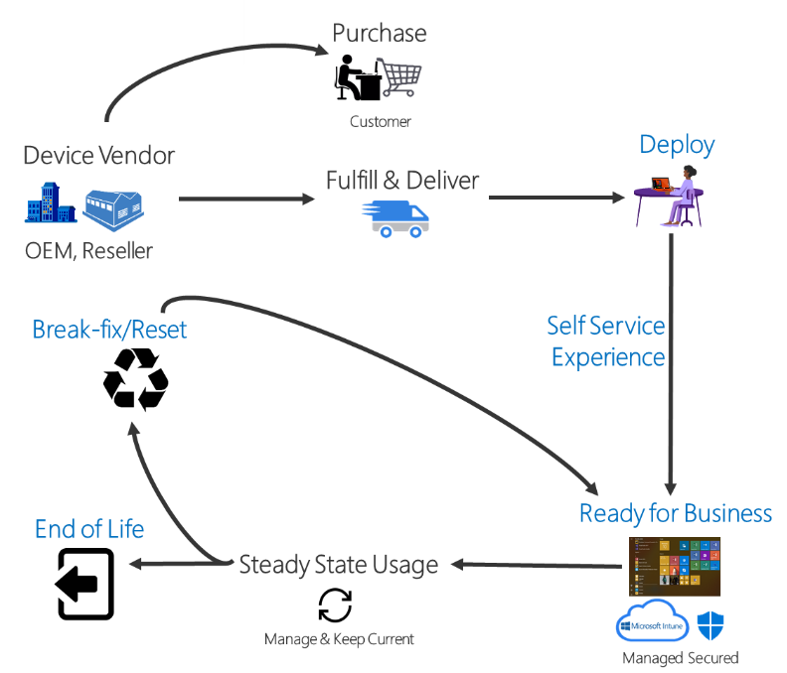
How classic
Autopilot worked
1. Device is enrolled into the partner’s tenant.
2. Device shipped directly to customer.
3. Device joins the network during OOBE.
4. Autopilot profile downloads.
5. Device joins Microsoft Entra, enrolls in Intune.
6. ESP runs—apps, policies, configurations deploy.
Notes:
After you Purchase the device this is what the flow looks like
Step one — the device gets enrolled into the partner's tenant. The enrollment is done using its hardware hash.
Step two — the device ships directly from the distributor to the end user. No stopover at your office. Huge logistics win.
Step three — the employee opens the box, signs in with their corporate credentials, and the device starts the configuration.
Step four — the device phones home to Microsoft and downloads its Autopilot profile — the profile you configured in Intune.
Step five — it joins Microsoft Entra, and enrolls in Intune.
Step six — the Enrollment Status Page, the ESP, runs. Apps deploy. Policies apply. Configurations land. A progress bar tells the user something is happening.
Once the enrollment completes you have a Business-ready devices — Teams, Outlook, the line-of-business apps — they are all there.
And here were some added benefits: If the device was lost or stolen, nobody could reset the device because as soon as you reset it, they'll be forced to log in with corporate credentials for that tenant that it's tied to.
If you ever need to reset that device, if you're troubleshooting anything, he can do so remotely without having to have the device shipped back to you to have one of your technicians complete an enrollment.
On paper? Beautiful. And for a lot of deployments, it really did deliver.
But I said we'd come back to hardware hash. Let's do that now, because this is where classic Autopilot started breaking for MSPs at scale.
Sometime you would need to chase down a distributor who forgot to upload the hash. The hardware hash that sometimes, mysteriously, does not match.
What if your hardware vendor couldn’t upload your hashes and this became your responsibility
💡 Presenter tip: Touch the slide diagram or point to it on each step — the visual flow is doing half the work. Don't fight it with too many words.
➜ Transition: "Look at this screen. Every single one of you who has worked with classic Autopilot recognizes this."

Slide 9
The MSP tax hardware hash collection
Notes:
Intent: Name the pain. Make the audience feel seen. Many in the room have personally suffered this.
Talking track
Every one of you who has worked with classic Autopilot recognizes this PowerShell script. Get-WindowsAutopilotInfo. Caputring the HWID into A CSV file. Uploading that CSV to Intune. Waiting for the autopilot profile to assign to the device.
And here is where it got ugly. You need to ensure you're uploading HWID into the correct tenant. If a device ended up in the wrong tenant, you had to deregister, clean it up, re-register.
I call it the MSP tax. It's the thing you did not quote to the customer, because if you did, they'd ask why they were paying for it. It was pure overhead. And it ate engineer time that should have been going to security posture improvements, actual strategic stuff.
Autopilot solved the user's problem. It did not solve the MSP's problem. That is the uncomfortable truth about classic Autopilot at scale.
💡 Presenter tip: Ask for a show of hands: "How many of you have run Get-WindowsAutopilotInfo in the last thirty days?" The hands will go up. That's your audience locking in.
➜ Transition: "And if hash collection was painful with one client, multiply it by fifty."

Slide 10
Why MSP scale made it worse
Every tenant adds process overhead.
Reuse and lifecycle events create cleanup work.
The customer experience stayed clean, but the backend did not.
Notes:
Intent: Seal the case against v1. The audience should now be asking: "so what did Microsoft do about it?"
Talking track
Every tenant adds process overhead. You're maintaining Autopilot and ESP profiles, group tags, dynamic groups— in every tenant. Separately.
Device reuse and lifecycle events create cleanup work. Replacing a motherboard could require to de-register and re-register the device.
The customer experience stayed clean, your customers had no idea any of this was happening. Backend chaos masked by frontend polish.
That's the environment Microsoft was staring at when they decided to evolve this thing.
💡 Presenter tip: "Backend chaos masked by frontend polish" is a memorable line. Deliver it slowly and look at the room.
➜ Transition: "So Microsoft put four words on a whiteboard."

Slide 11
Why Microsoft evolved it
1
2
3
4
Simple
Fast
Observable
Reliable
No need to maintain separate Autopilot profile and enrollment status page.
No more latency issues caused by dynamic groups.
Real time monitoring.
Configurations and apps are delivered serially.
Notes:
Intent: Introduce Microsoft's redesign goals before showing the result. Frame v2 as the answer to the problems you just named.
Talking track: Four words. Simpler. Faster. Observable. Reliable.
That's the product brief for device preparation — what some people are calling Autopilot v2. Same general idea as classic Autopilot. Very different execution.
Simple — Classic Autopilot required separate profiles, ESP configuration, dynamic device groups, and hardware hash registration before a single device could deploy. Admins had to juggle multiple places in Intune to wire it all together. v2 collapses everything into a single policy object.
Fast — The core problem with classic Autopilot was dynamic Entra groups. Apps and policies couldn't apply until the device landed in the right group — and dynamic group membership evaluation adds latency.
v2 solves this with Enrollment Time Grouping: the moment a user authenticates, the device is immediately added to a pre-defined assigned security group, and config starts deploying instantly. No query wait, no delay.
Observable — Classic Autopilot's reporting was effectively a black box. You knew a deployment succeeded or failed, but granular per-app, per-script status mid-deployment didn't exist. v2 ships near real-time monitoring: deployment time, app status, PowerShell script status — all visible in Intune as it happens. When it breaks, you can see exactly where and why.
Reliable — Classic Autopilot deployed LOB and Win32 apps simultaneously, which created conflicts and race conditions. v2 delivers configurations and apps serially, eliminating those conflicts.
Presenter tip: Land "Simpler. Faster. Observable. Reliable." like you're checking off items on a whiteboard — slight pause between each word. These four words are the spine of the next two slides.
Transition: "Four things that matter, four things you'll feel."

Slide 12
What changed in device preparation
Better visibility into provisioning progress and failure states
Reduced operational overhead compared with classic flows
Better fit for cloud-native deployment models
Notes:
Intent: Translate Microsoft's four-word brief into four concrete benefits the audience will feel.
Talking track
First — dramatically better visibility into provisioning.
That led to an Improved User Experience:
A simplified view during OOBE where the percentage of progress is displayed.
The user is informed when the OOBE setup is complete.
When issues arise, logs can be exported with ease.
Second — reduced operational overhead. No longer need to upload Hardware Hashes
Third — a better fit for cloud-native deployment models. Intune-managed, Entra-joined, no hybrid complexity weighing you down.
💡 Presenter tip: Hold on the fourth point. That's the bridge to Nerdio's value proposition, which you'll land in Slide 15.
➜ Transition: "Let's look at the comparisons. Row by row."

Slide 13
📸
Classic (v1) vs. device preparation (v2)
 | Classic Autopilot | Device preparation
Device pre-registration | Required (hardware hash) | Not required
Join type | Entra join or hybrid | Entra join only
App delivery during OOBE | Up to 100 apps via ESP | Up to 25 essential apps
Monitoring | Limited, delayed | Near real-time
Win32 + LOB in same deployment | No | Yes
Windows 10 support | Yes | No (Windows 11 only)
Notes:
Device pre-registration. v1: required — hardware hash, CSV, upload. v2: not required. That one change eliminates the number one MSP pain point. That's the biggest headline on this slide.
Join type. v1 gave you Entra or hybrid. v2 is Entra-join only. If you are still running hybrid, this is your nudge to plan the migration.
App delivery during OOBE. v1 allowed up to one hundred apps via the Enrollment Status Page. v2 is twenty-five essential apps during OOBE — the rest deploy after sign-in. Controversial at first. Turns out users don't need a hundred apps in the first five minutes — they need the essentials fast and the rest within the hour.
Monitoring. v1: limited and delayed. v2: near real-time. Night and day.
Win32 plus line-of-business apps in the same deployment. v1 Microsoft recommended not do that in one pass. v2 can. Huge for mixed app portfolios.
Windows 10 support. v1: yes. v2: Windows 11 only. This is not a limitation - If you are planning new deployments on Windows 10 in 2026, we should talk afterward.
One row is a small change. Six rows is a different product.
💡 Presenter tip: Pause long enough on this slide for people to actually take a picture. Don't rush. The table is doing the work.
➜ Transition: *"Enough theory. Let's build one."

Slide 14
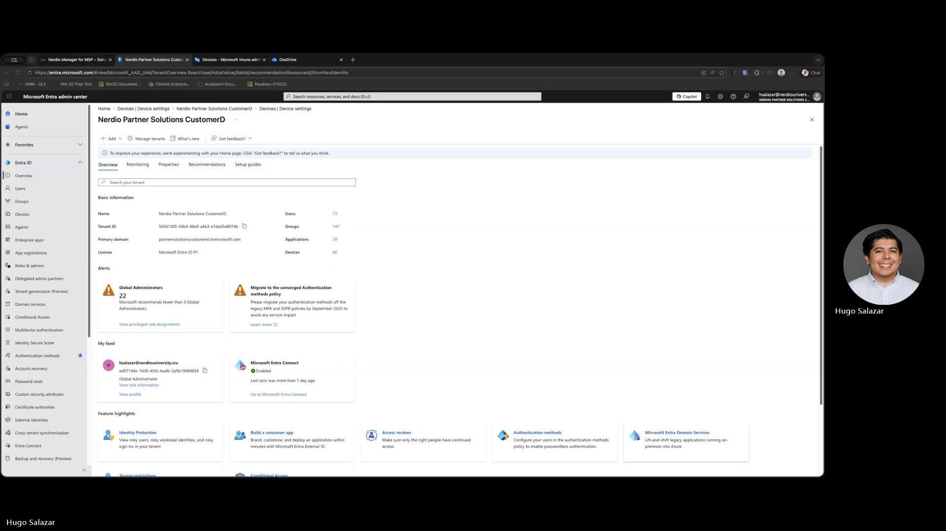
Device Preparation Set up
Notes:
Intent: Bridge from theory to practice. The two-part structure is critical — Intune first so the audience sees the raw Microsoft experience, Nerdio second so they see the automation layer.
Opening talking track
Okay. History lesson over. Let's build one. I'm going to walk you through this in two parts.
Part one — I'll create an Autopilot v2 profile, a device preparation profile, inside Intune directly. Raw Microsoft, the way your senior engineer would do it on a Monday morning. I'll show you the policy, the app assignments, the group setup, everything.
Part two — I'll do the same thing inside the Nerdio console. And when I say the same thing, I mean I'll deploy the same configuration — but as a reusable template that lands identically in every client in my portfolio. That's the punchline. That's why we are all here.
💡 Presenter tip: Switch windows decisively. Confidence with the tools is a bigger sale than anything you will say during the demo.

Slide 15
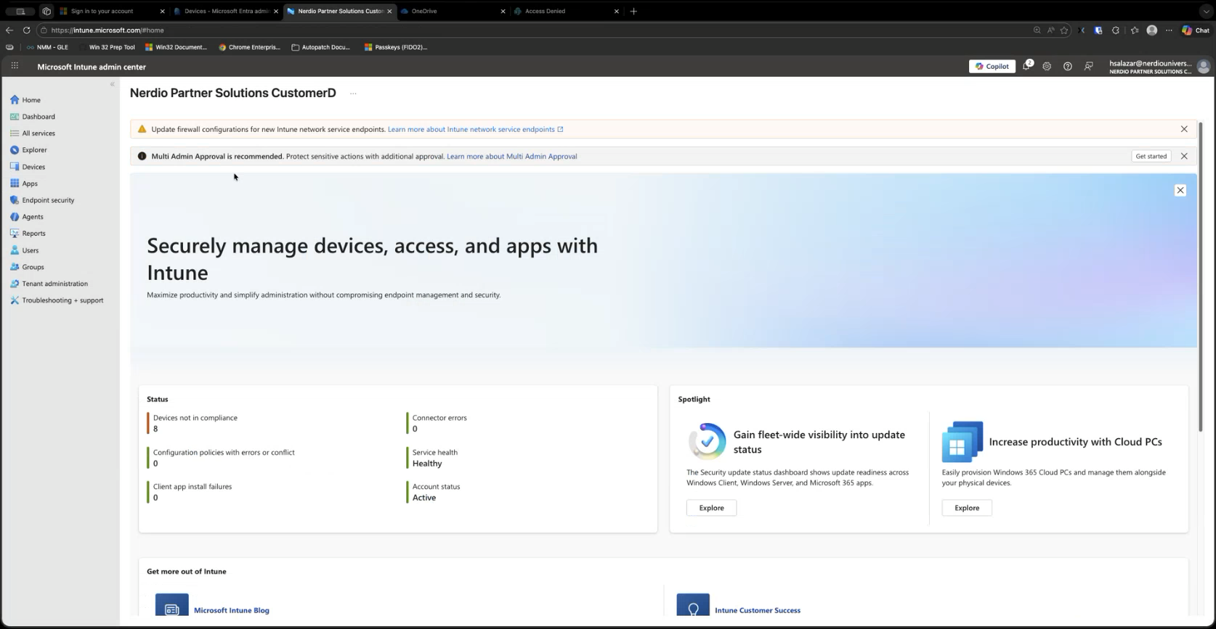
Intune Device Preparation Creation
Notes:
Intent: Bridge from theory to practice. The two-part structure is critical — Intune first so the audience sees the raw Microsoft experience, Nerdio second so they see the automation layer.
Opening talking track
Okay. History lesson over. Let's build one. I'm going to walk you through this in two parts.
Part one — I'll create an Autopilot v2 profile, a device preparation profile, inside Intune directly. Raw Microsoft, the way your senior engineer would do it on a Monday morning. I'll show you the policy, the app assignments, the group setup, everything.
Part two — I'll do the same thing inside the Nerdio console. And when I say the same thing, I mean I'll deploy the same configuration — but as a reusable template that lands identically in every client in my portfolio. That's the punchline. That's why we are all here.
💡 Presenter tip: Switch windows decisively. Confidence with the tools is a bigger sale than anything you will say during the demo.

Slide 16
Operationalizing in Nerdio Manager for MSP
Notes:
Intent: Bridge from theory to practice. The two-part structure is critical — Intune first so the audience sees the raw Microsoft experience, Nerdio second so they see the automation layer.
Opening talking track
Okay. History lesson over. Let's build one. I'm going to walk you through this in two parts.
Part one — I'll create an Autopilot v2 profile, a device preparation profile, inside Intune directly. Raw Microsoft, the way your senior engineer would do it on a Monday morning. I'll show you the policy, the app assignments, the group setup, everything.
Part two — I'll do the same thing inside the Nerdio console. And when I say the same thing, I mean I'll deploy the same configuration — but as a reusable template that lands identically in every client in my portfolio. That's the punchline. That's why we are all here.
💡 Presenter tip: Switch windows decisively. Confidence with the tools is a bigger sale than anything you will say during the demo.

Slide 17
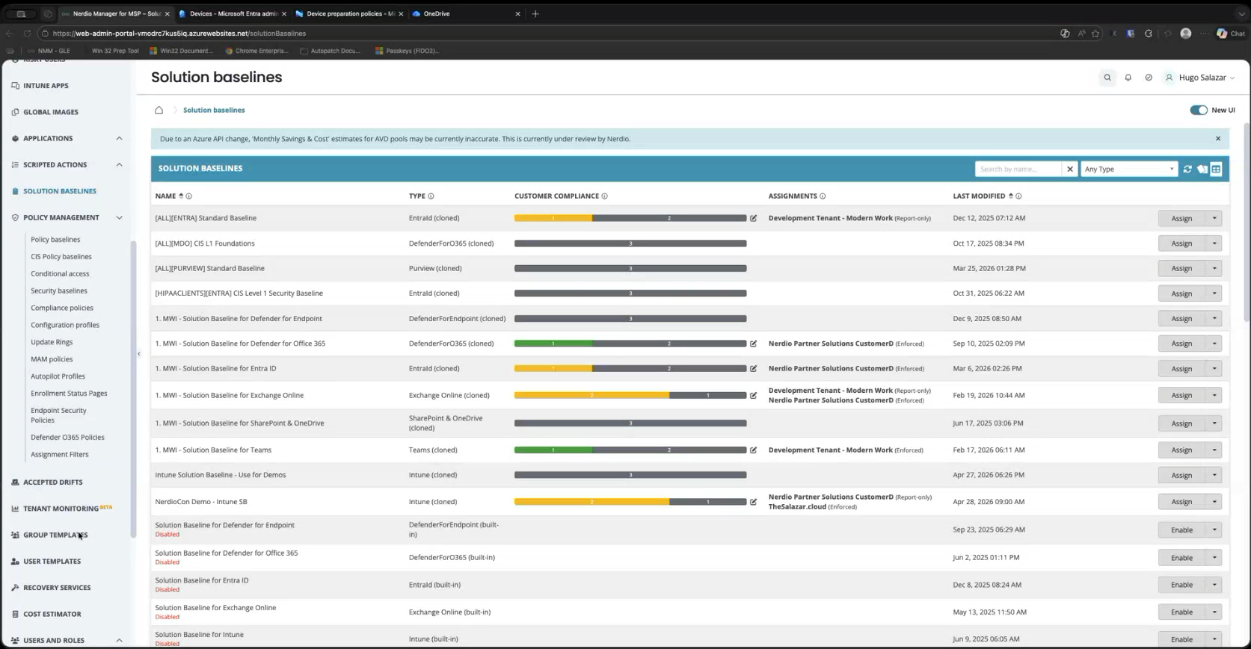
Group Templates
Notes:
Intent: Bridge from theory to practice. The two-part structure is critical — Intune first so the audience sees the raw Microsoft experience, Nerdio second so they see the automation layer.
Opening talking track
Okay. History lesson over. Let's build one. I'm going to walk you through this in two parts.
Part one — I'll create an Autopilot v2 profile, a device preparation profile, inside Intune directly. Raw Microsoft, the way your senior engineer would do it on a Monday morning. I'll show you the policy, the app assignments, the group setup, everything.
Part two — I'll do the same thing inside the Nerdio console. And when I say the same thing, I mean I'll deploy the same configuration — but as a reusable template that lands identically in every client in my portfolio. That's the punchline. That's why we are all here.
💡 Presenter tip: Switch windows decisively. Confidence with the tools is a bigger sale than anything you will say during the demo.

Slide 18
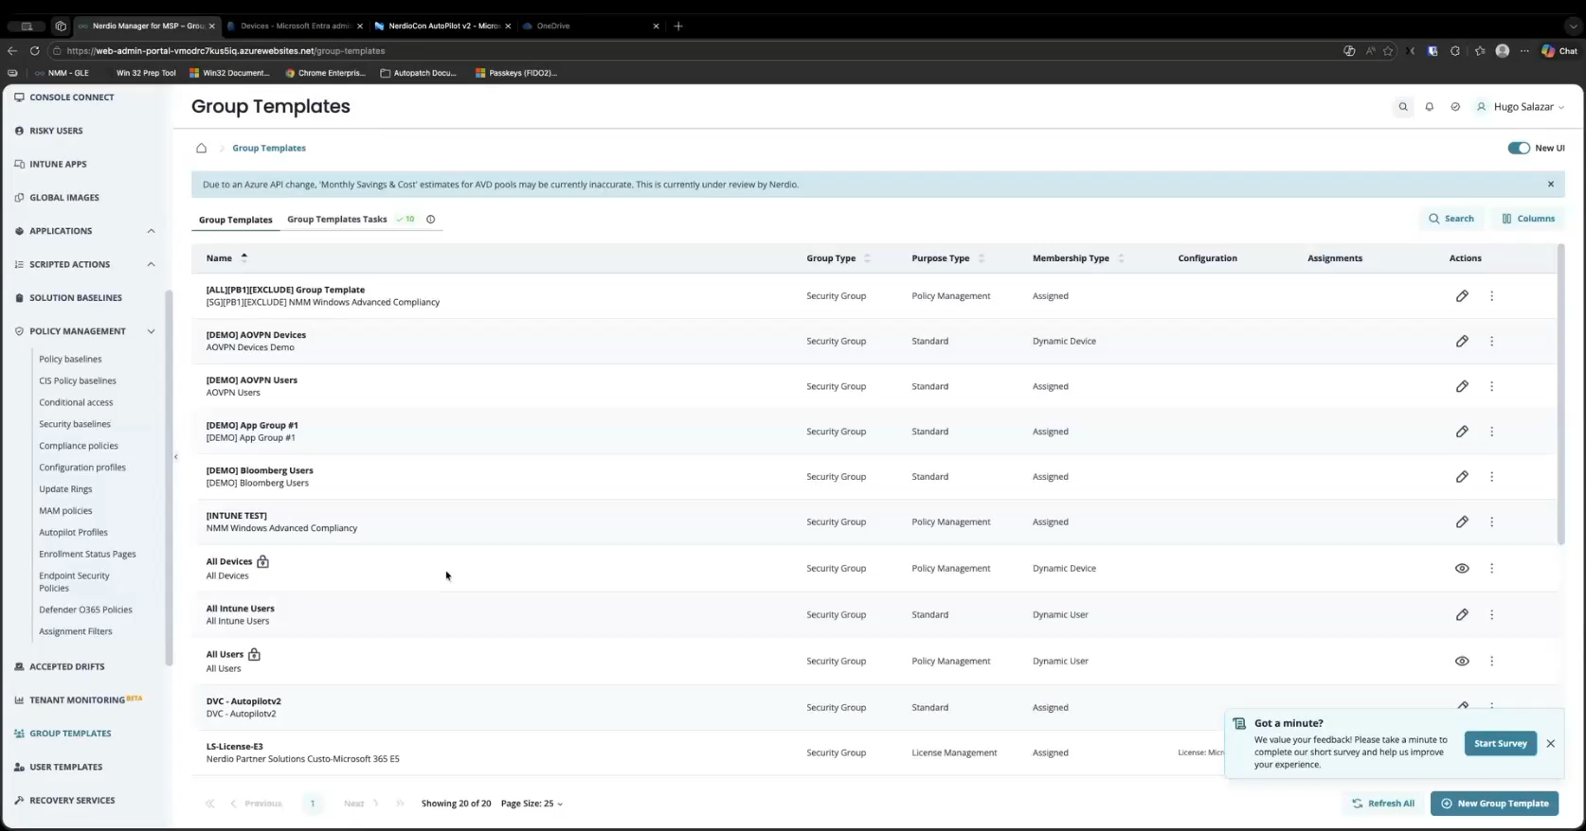
Managing the Device Preparation Profile
Notes:
Intent: Bridge from theory to practice. The two-part structure is critical — Intune first so the audience sees the raw Microsoft experience, Nerdio second so they see the automation layer.
Opening talking track
Okay. History lesson over. Let's build one. I'm going to walk you through this in two parts.
Part one — I'll create an Autopilot v2 profile, a device preparation profile, inside Intune directly. Raw Microsoft, the way your senior engineer would do it on a Monday morning. I'll show you the policy, the app assignments, the group setup, everything.
Part two — I'll do the same thing inside the Nerdio console. And when I say the same thing, I mean I'll deploy the same configuration — but as a reusable template that lands identically in every client in my portfolio. That's the punchline. That's why we are all here.
💡 Presenter tip: Switch windows decisively. Confidence with the tools is a bigger sale than anything you will say during the demo.

Slide 19
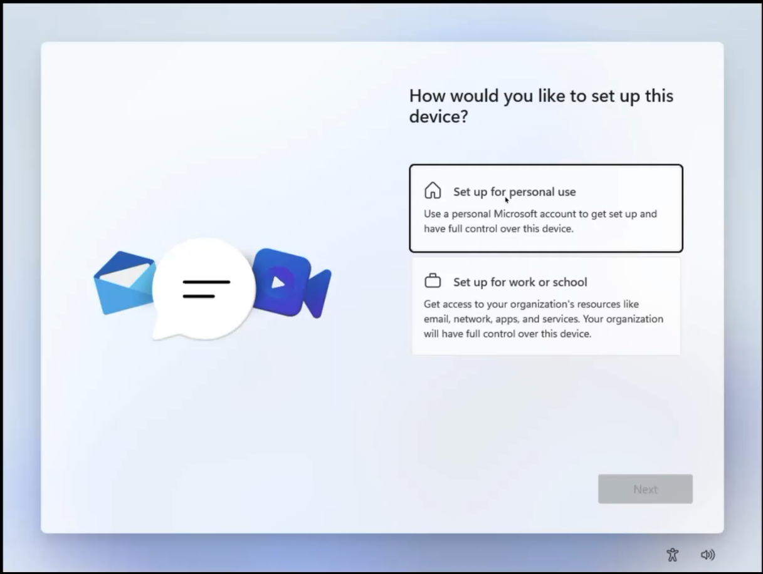
Enrollment in Action

Slide 20
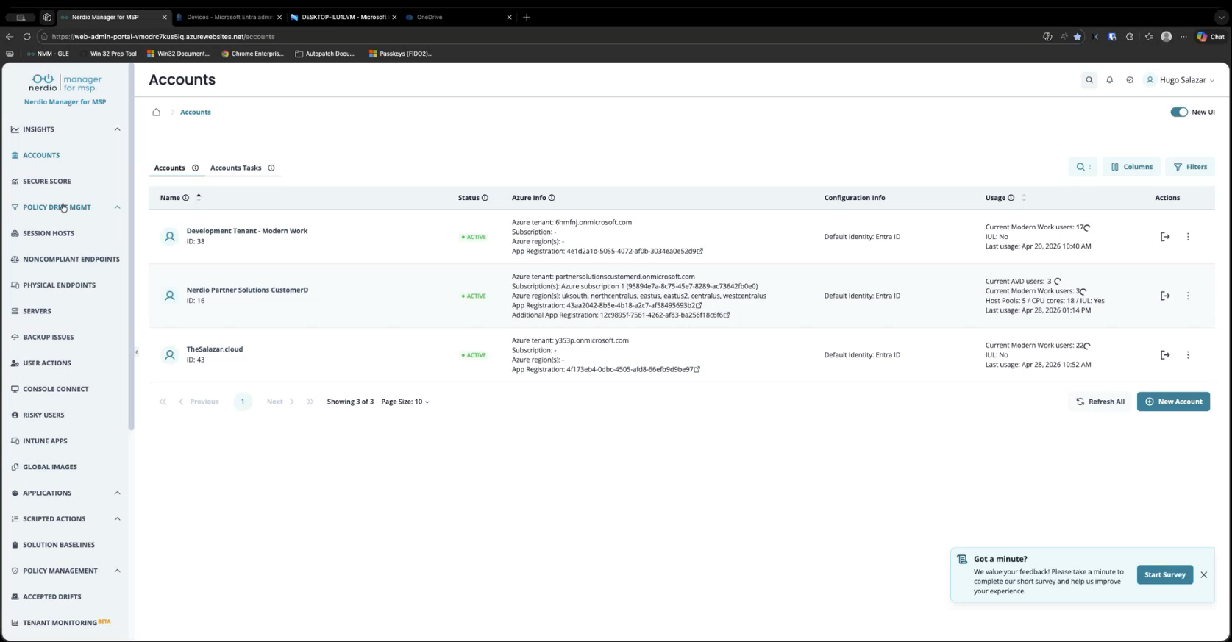
Management in Action

Slide 21
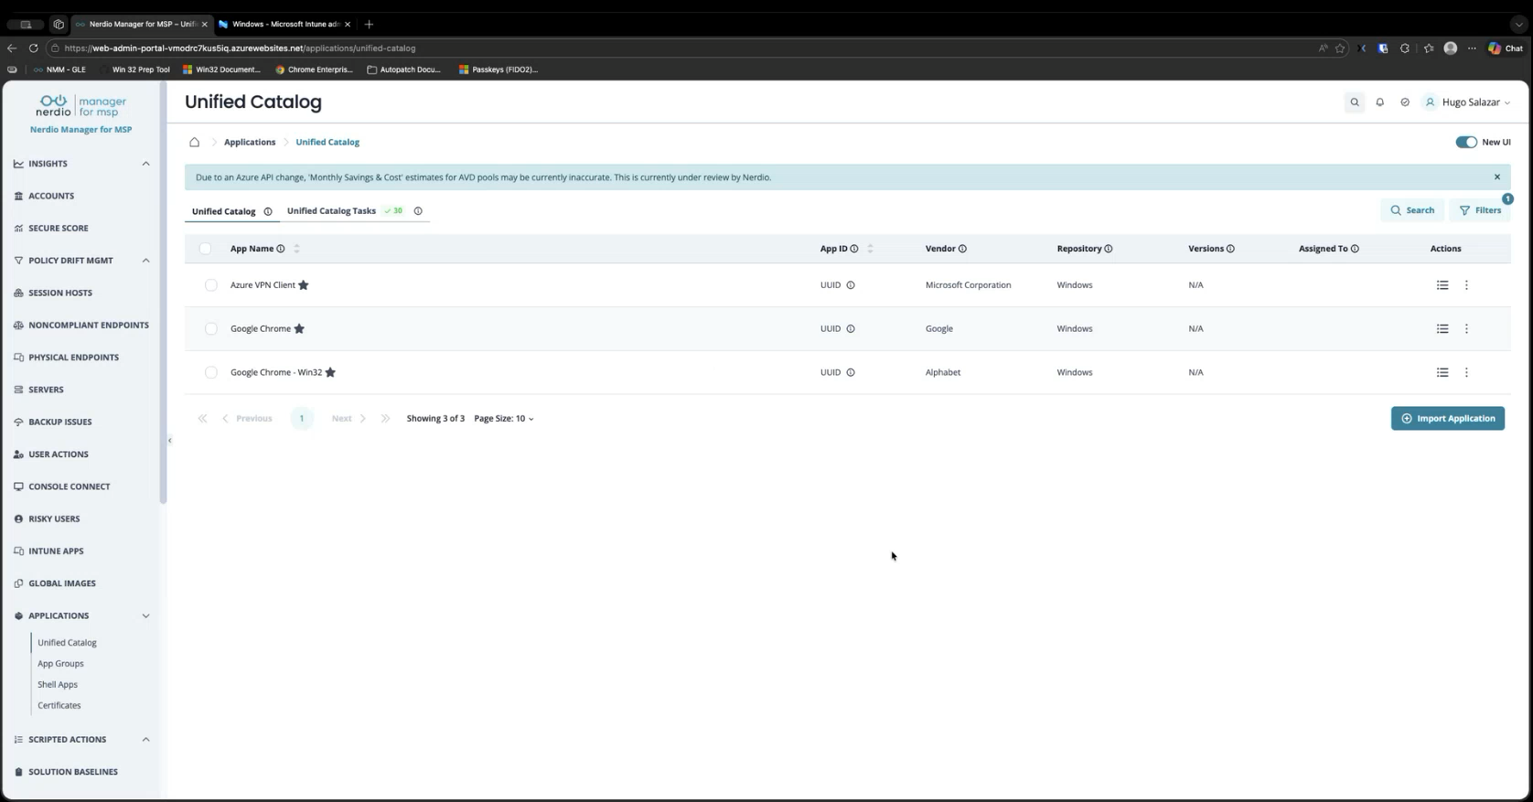
Application Management at Scale

Slide 22
Why Nerdio makes it scalable
Microsoft has made improved Autopilot. Nerdio makes it scalable.
Group templates.
Multi-tenant orchestration.
Policy pipeline that works the same way across every client in your portfolio.
App management.
Notes:
Microsoft has made improved Autopilot. That is a real win — device preparation is a genuinely good product. But improved is not the same as scalable.
Nerdio is what makes it scalable. Three things specifically.
Group templates — configure once, apply everywhere, versioned and governed. Multi-tenant orchestration — one console, every client, consistent deployment posture. And a policy pipeline that works identically across every tenant in your portfolio, without you rebuilding it from scratch each time.
That combination turns Autopilot from a feature you use in one tenant into a service you operationalize across your entire book of business. That is the difference between having Autopilot and running Autopilot at scale.
💡 Presenter tip: Deliver the final sentence slowly. This is the line that ends up in their notes — "Microsoft made it usable. Nerdio makes it scalable."
➜ Transition: "Questions. I want all of them."

Slide 23
Three recommendations
1. Pilot device preparation next week, not next quarter.
2. Build the profile right the first time.
3. Measure the pilot.
Notes:
Intent: Convert the talk into a specific, small, this-week action. Small commitments compound.
Talking track
Here's my recommendation. If you tried Autopilot v1 two years ago and walked away frustrated, re-engage. Device preparation removes the two biggest operational barriers: the pre-registration requirement — the hash tax — and the diagnostic black box.
You do not need to boil the ocean. Pick one client. A small one. A new one onboarding this month works best. Pilot device preparation with them next week. Next week. Not next quarter. The learning curve is shorter than you think, and the first deployment will tell you everything you need to know.
If you take one action item out of this room today, make it that.
💡 Presenter tip: Repeat "next week" twice, as the script has it. Repetition signals commitment. And look at someone directly when you say it.
➜ Transition: "And here's the bigger insight I want you to leave with."

Slide 24
1. Pick the right pilot client
Cloud-only skip the legacy cleanup tax.
Ensure the device is not registered to classic Autopilot.
Limit the scope.
License - M365 Business Premium / E3 / E5.
Notes:
Intent: Translate the "pick one client" line into concrete selection criteria so the audience can actually pick on Monday.
Talking track
Recommendation one was "pick one client." Now let me tell you which one. Five filters. Don’t skip any of them.
First — pick a new onboarding, not a complex migration. A net-new tenant skips all the legacy cleanup tax. No deregistration cycles, no group-tag archaeology, no surprise hybrid join. You are starting from a clean sheet, which is exactly the environment device preparation was designed for.
Second — keep it small. Five to twenty-five devices. Big enough to be real, small enough that one person can run the pilot end-to-end and learn from every deployment. If something breaks, you have time to fix it before it becomes the customer’s problem.
Third — cloud-native ready. This is non-negotiable. Microsoft Entra-join only. Windows 11, version 22H2 or later. If the client is still on Windows 10, or still running hybrid join, this is not your pilot. Go find a different one.
Fourth — check the licensing before you scope the engagement. Microsoft 365 Business Premium, Microsoft 365 E3 or E5, or the standalone Entra ID P1 plus Intune. If the client doesn’t have one of those, you have a licensing conversation before you have a deployment conversation.
Fifth — an engaged sponsor on the customer side. One person at the client willing to be your first guinea pig and willing to give you honest feedback. The first deployment will surface something. You want them in the room when it does.
💡 Presenter tip: Walk through these five out loud, then say: "If you cannot find a client that hits all five, you do not yet have your pilot. Keep looking."
➔ Transition: "You picked the client. Now let’s talk about the profile, because most people get this part wrong on the first try."

Slide 25
2. Build the profile right the first time
Use an assigned device group.
Target the device group within your policies and applications
Limit your essential apps.
Mix Win32 and LOB apps freely.
Notes:
Intent: Give the audience six concrete profile-build decisions that prevent the most common first-deployment failures.
Talking track
Recommendation two. The profile. Get this right the first time and your pilot succeeds. Get it wrong and you are debugging at 9 PM the night before go-live.
Use an assigned device group, not a dynamic one. Microsoft is explicit about this in the docs. Enrollment Time Grouping, where the device gets added to a pre-defined security group at enrollment, deploys faster and more reliably than waiting for dynamic membership rules to evaluate. Static assignment, every time.
Target the device group, not the user. Every app and every PowerShell script in the profile must be configured to install in System context, and must be assigned to the device group. User-context anything will not run during OOBE. This is the number one cause of "why didn’t my app install" tickets.
Cap the OOBE app list at 25 essential apps. As of January 2026, Microsoft raised the limit from 10 to 25, but that is a ceiling, not a target. Be ruthless. Office, Teams, your RMM agent, your security stack — if it is not blocking the user’s first hour, it deploys after sign-in, not during OOBE.
Mix Win32 and line-of-business apps freely in the same profile. This was a no-go in v1 — Microsoft explicitly recommended against it. In device preparation, the providers were re-architected, so you can deploy both in one pass. Use it.
If you block personal device enrollments via enrollment restrictions, add a corporate identifier — serial number, manufacturer, model — before the device touches OOBE. That is the gate that says "this is a corporate device." If you don’t use enrollment restrictions, you can skip this step.
Last one. Plan for the quality update. Monthly security updates install during OOBE for device preparation, and they add 20 to 40 minutes to provisioning. You cannot turn this off. Set the timeout in the profile accordingly, and tell the customer up front so the first user isn’t staring at a screen wondering if it’s frozen.
💡 Presenter tip: Pause on the System-context line. Look at the room. Say: "If you remember nothing else from this slide, remember that one. It is the failure I see most often."
➔ Transition: "Profile is built, devices are deploying. Now — how do you prove the pilot worked?"

Slide 26
3. Measure the pilot like a service launch
Deployment success rate.
Time-to-desktop. From OOBE start to productive desktop.
Customer feedback.
Notes:
Intent: Convert the pilot into a measurable service launch with five KPIs the MSP can take to a QBR.
Talking track
Recommendation three. Measure it. Most pilots fail not because the technology didn’t work, but because nobody captured the data that proves it did. Five KPIs. Track all of them.
Deployment success rate. The Windows Autopilot device preparation reporting dashboard tracks this per device, in near real-time. Your target is 95% first-attempt success. Anything below 90% means your profile needs another iteration before you scale to client number two.
Time-to-desktop. From OOBE start to a productive desktop. Stopwatch it. Then put it next to your old imaging baseline. If your baseline was four hours of tech-touch and you are now at 45 minutes of zero-touch, that is the number that sells the next deployment internally.
App and script status per device. Use the deployment report to spot patterns. If the same app fails on three out of five devices, you have a profile bug, not a device bug. Catch it in the pilot before you replicate the bug across fifty tenants.
Hash collection time eliminated. This was the biggest line item in your v1 cost model — the hash tax. Calculate the hours per device you used to spend on Get-WindowsAutopilotInfo, CSV uploads, and tenant-mismatch cleanup. Multiply by the pilot device count. That is your first hard ROI number.
Tech-touch hours per device. The KPI that turns this from a feature story into a margin story. Walk into your QBR with a chart that shows tech-touch hours dropping by 80%. That is the conversation that gets you the green light to roll device preparation across your entire book of business.
💡 Presenter tip: Hold up one finger for each KPI as you list them. Five fingers, five numbers, one slide. Then say: "If you measure these five things in your pilot, you have everything you need to scale."
➔ Transition: "That is the playbook. Pick the client, build the profile, measure the result. Questions?"

Slide 28
Please remember to fill out the post-breakout survey in the app
Stop by the Nerdio booth in the Expo Hall to take advantage of our exclusive, lowest-ever pricing on Microsoft 365 management!

