Slide 1
Empowering your help desk with Nerdio Manager for MSP
Chuck Mikuzis

Slide 2
A long time ago…(Intro)
Prepping your Stormtrooper Operating Procedure (SOP)
Attack of the clones: Common day-to-day operations
Rogue one: Improved aim at less common targets
Q&A

Slide 3

Chuck Mikuzis
Product Manager, Nerdio Manager for MSP
AVD and Azure infrastructure

Slide 4
Prepping your Stormtrooper operating procedure (SOP)
Even in a galaxy of chaos, your empire needs some standards.

Slide 5
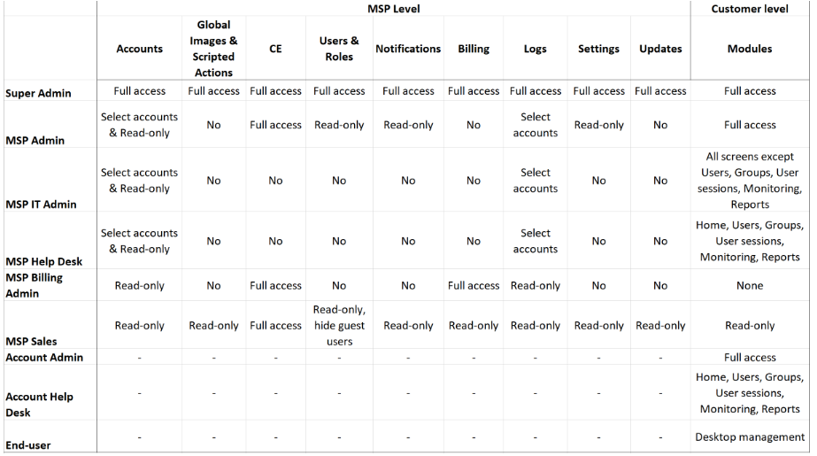
RBAC roles for help desk

Slide 6
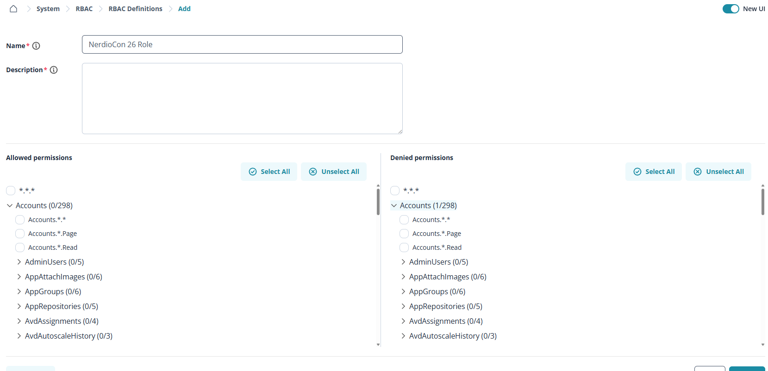
RBAC roles for help desk

Slide 7
APPROVAL WORKFLOWS–THE JEDI COUNCIL MUST APPROVE
Prevent help desk technicians from making unauthorized changes—route sensitive actions through an approval chain before execution
Technician
initiates action
▶
Request
submitted
▶
Approver
notified
▶
Approved/ denied
▶
Action
executed
Configurable per action type
Email notifications
Define which operations require manager's sign-off vs. self-service.
Approvers receive instant alerts; requestors get confirmation on resolution.
Audit trail
Scope-aware
Every request, approval, and denial is logged for compliance.
Approvals can be configured per client/tenant for granular control.
Prevent help desk technicians from making unauthorized changes—route sensitive actions through an approval chain before execution.

Slide 8
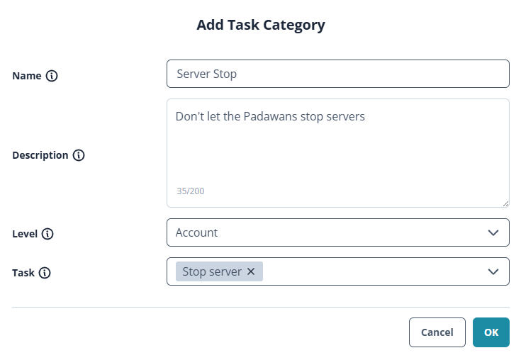
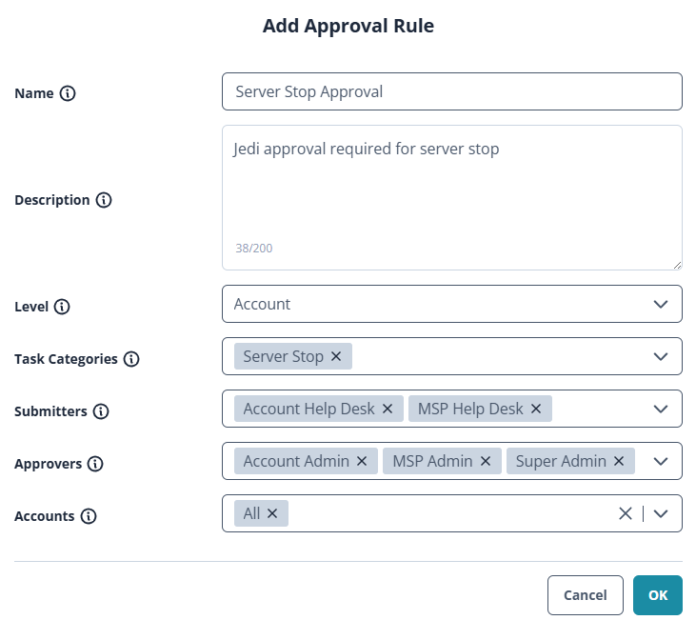
Approval workflows in only 2 steps!

Slide 9
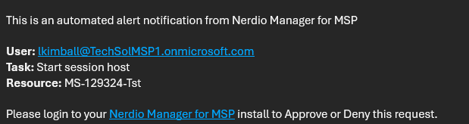
Approval workflows—get notified!

Slide 10
OFFBOARDING WORKFLOW — EXECUTING ORDER 66 (THE SAFE KIND)
OFFBOARDING WORKFLOW—EXECUTING ORDER 66 (THE SAFE KIND)
Schedule and execute complete user offboarding workflows from Nerdio—automatically handling AVD, Azure, and M365 cleanup steps in the correct sequence.
Scheduled execution
Immediate execution
Set offboarding to trigger at a future date/time—perfect for planned departures. The workflow executes automatically at the scheduled moment, even outside business hours.
Execute the offboarding workflow immediately for emergency or surprise departures—all steps fire in the correct order with real-time status feedback.
What the offboarding workflow handles:
Disable and block the Azure AD/AD account sign-in.
Remove user from AVD host pool and application groups.
Revoke active AVD sessions and sign out the user.
Detach and optionally cleanup FSLogix profile container.
Remove M365 license assignments to free up license costs.
Send email notifications to stakeholders via configured templates.

Slide 11
OFFBOARDING EMAIL TEMPLATES—ORDER 66 NOTIFICATIONS
Configure pre-built email notification templates that automatically fire when offboarding user flow execute —communicate to stakeholders at lightspeed
Email notification preview
Fully customizable
Edit HTML/text templates with dynamic token substitution like {UserName}, {DateTime}, {TenantName}.
To: manager@mspcorp.com Subject: User Offboarding Complete—{UserName} The offboarding workflow for {UserName} has completed. • AVD Session removed • Host pool deallocation complete • Storage accounts detached • AD account disabled Completed: {DateTime}
Multi-recipient
Notify managers, security teams, IT admins—or any stakeholder group simultaneously.
Workflow-triggered
Templates fire automatically at defined workflow stages—no manual steps needed.
Compliance ready
Creates a documented evidence trail for regulatory or audit requirements.

Slide 12
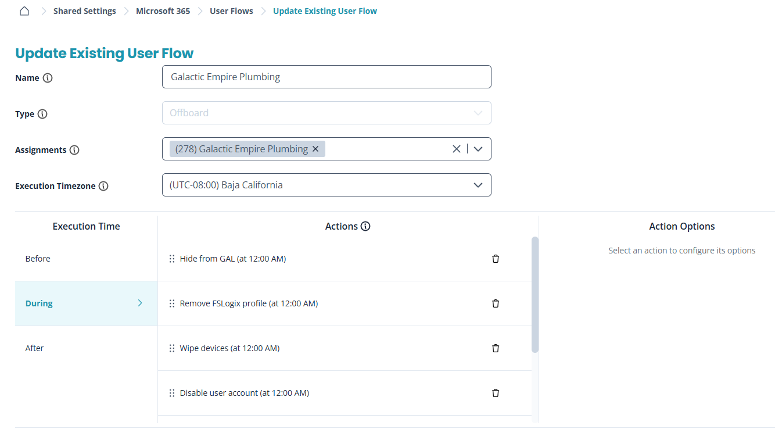

Slide 13
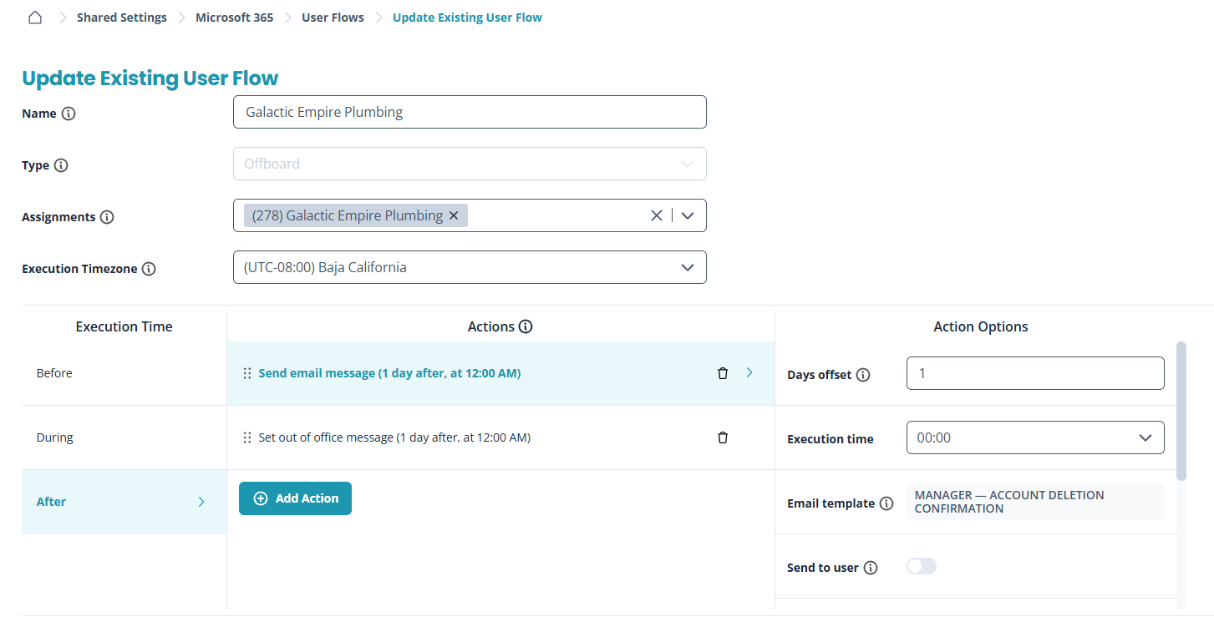

Slide 14
Attack of the clones:
Common day-to-day ops
Sith Happens IT and Galactic Empire Plumbing: an MSP case study in a galaxy far, far away.

Slide 15
GLOBAL SEARCH—USE THE FORCE TO FIND ANYTHING
Nerdio’s Global Search lets technicians instantly find any resource across all clients without digging through menus
Search users, hosts, storage, VMs, clients...
Users
Session hosts
Host pools
Find any user across all AVD tenants by name, UPN, or email.
Locate VMs by name, pool, or client —jump to management instantly
Navigate to any pool config across your entire MSP client base.
Storage accounts
Client tenants
Search for FSLogix shares.
Jump to any MSP-managed tenant dashboard without menu hunting.

Slide 16
PASSWORD & MFA RESETS—UNLOCKING THE HOLOCRON VAULT
Nerdio gives technicians one place to reset passwords, clear MFA, and manage Active Directory objects
Password reset
AD DS object & user management
Reset AD/Azure AD passwords for any user.
Enforce change at next login toggle.
Works across all MSP-managed tenants.
RBAC-scoped—techs only see their clients.
Manage your Active Directory Domain Services objects directly from the Nerdio portal—no RDP to a DC needed:
Enable/disable AD user accounts.
Unlock AD accounts.
Modify user attributes and group memberships.
Reset passwords directly via AD connector.
Search and browse AD objects.
View user properties and last logon info.
MFA reset
Clear TOTP/Authenticator registrations.
Unblock locked-out MFA users.
Force re-enrollment on next login.

Slide 17

Global Search and password/MFA reset

Slide 18
AVD INSIGHTS—THE FORCE AWAKENS YOUR MONITORING DASHBOARDS
Nerdio’s AVD Insights module gives help desk teams a simple dashboard with the information they need without requiring Azure Monitor expertise.
User RTT times
Session host performance
User session overview
Monitor round-trip time latency per user session—identify poor experience before users complain.
CPU, RAM, per VM—spot overloaded hosts and bottlenecks.
Active, disconnected, idle sessions at a glance across all host pools and clients.
Azure Files usage
Historical trend analysis
View file share usage, large profile discovery, unused profile charting.
Review performance trends over time to tune auto-scaling and capacity plans.

Slide 19

AVD Insights dashboards

Slide 20
CONSOLE CONNECT–BOARDING THE STAR DESTROYER DIRECTLY–NERDIO MANAGER FOR MSP
Console Connect lets help desk technicians access endpoints and shadow user sessions directly in the Nerdio portal with no extra tools or VPNs
Console Connect to VMs and endpoints
Shadow user sessions
Direct console access to session host VMs
Bypass need for full RDP admin access
Useful for device-level (physical or VM) troubleshooting without logging in as admin
Accessible directly from Nerdio
RBAC-scoped—techs see only their assigned clients
View a live user's desktop session in real time
Provide live visual support without taking over the session
Identify application errors and performance issues as the user sees them
Initiate from the user session management panel
Requires appropriate RBAC permissions configured

Slide 21

Console Connect

Slide 22
Rogue one: Improved aim at less common targets

Slide 23
EXCHANGE ONLINE MANAGEMENT—INTERCEPTING IMPERIAL TRANSMISSIONS
Nerdio lets help desk technicians manage Exchange Online mailboxes without using the M365 Admin Center
Mailbox management
Shared mailboxes
Distribution groups
Configure mailbox settings, aliases, out-of-office, and mailbox permissions for users.
Create, modify, and assign shared mailboxes for departments and teams.
Add/remove users from distribution lists and mail-enabled security groups.
Delegate access
Mailbox archiving
Grant Send As, Send on Behalf, or Full Access delegation between mailboxes.
Enable and configure Exchange Online archive mailboxes for compliance.

Slide 24
USER CREATION—BUILDING YOUR REBEL SQUADRON
Provision new users from Nerdio in one guided workflow, including account creation, host pool assignment, Azure Files access, and permissions
1
2
3
Identity creation
License
assignment
Host pool
assignment
▶
▶
Create AD/Entra user account with UPN, display name, and department attributes.
Assign M365 licenses appropriate to the user's role and requirements.
Add user to the appropriate AVD host pool and application group for desktop access.

Slide 25
DYNAMIC GROUP EDITING—ASSEMBLING THE REBEL ALLIANCE
Dynamic groups define user access. Nerdio lets technicians view and update them without using the Azure Portal.
Dynamic groups use rule-based membership—e.g. 'all users in Department=Finance'—eliminating manual group management. Nerdio surfaces these so help desk teams can understand and adjust membership rules without Azure Portal access.
View group rules
Edit membership rules
See the current dynamic membership rule syntax for any Azure AD group in plain language.
Modify rule expressions to add/remove departments, job titles, locations, or custom attributes.
Host pool assignments
Sync & verify
Understand and update which groups are assigned to which AVD host pools and app groups.
Trigger group membership recalculation and verify target users appear correctly post-change.

Slide 26
INTUNE DEVICE WIPE—FORCE-WIPING THE DEATH STAR
Run Intune actions, such as wipe, retire, and compliance checks, from the Nerdio portal without Intune admin access
Full device wipe
Retire (selective wipe)
Factory reset the device—removes ALL data, apps, and configuration. Used for lost/stolen devices or employee departures requiring complete data sanitization.
Remove corporate data and apps while preserving personal data. Ideal for BYOD offboarding—removes M365 apps, email profiles, and MDM enrollment.
Remote lock
Sync & compliance check
Lock the device immediately—prevents access until unlocked. Essential when a device is suspected lost or the user account is compromised.
Force the device to check in with Intune and re-evaluate its compliance state—useful for policy enforcement and resolving conditional access blocks.

Slide 27
BITLOCKER & LAPS—CRACKING THE DEATH STAR VAULT CODES
Retrieve BitLocker recovery keys and LAPS credentials directly from the Nerdio portal without searching through Azure AD or Intune
BitLocker key retrieval
LAPS password retrieval
Retrieve the 48-digit BitLocker recovery key for any enrolled device
Useful when users are locked out of their encrypted drive
Searches by device name or user—fast for help desk workflows
Keys sourced from Azure AD/Intune BitLocker storage
Full audit trail of key retrievals for compliance
RBAC-gated—only authorized roles can retrieve keys
Fetch the current Local Admin Password Solution credential for any device
Essential for local admin access when domain connectivity fails
Passwords auto-rotate per configured schedule—always current
Sourced from Azure AD LAPS or Windows LAPS policies
Access logs maintained for security and accountability
Scoped to authorized technicians per RBAC configuration

Slide 28
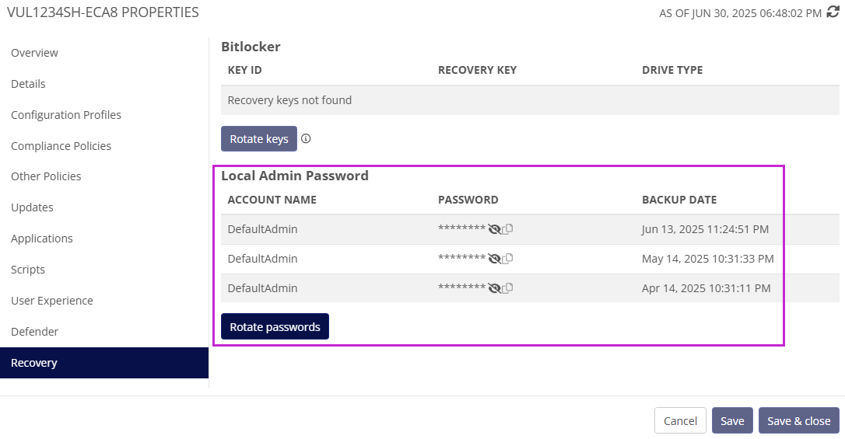

Slide 29

What about that offboarding user flow?

Slide 30
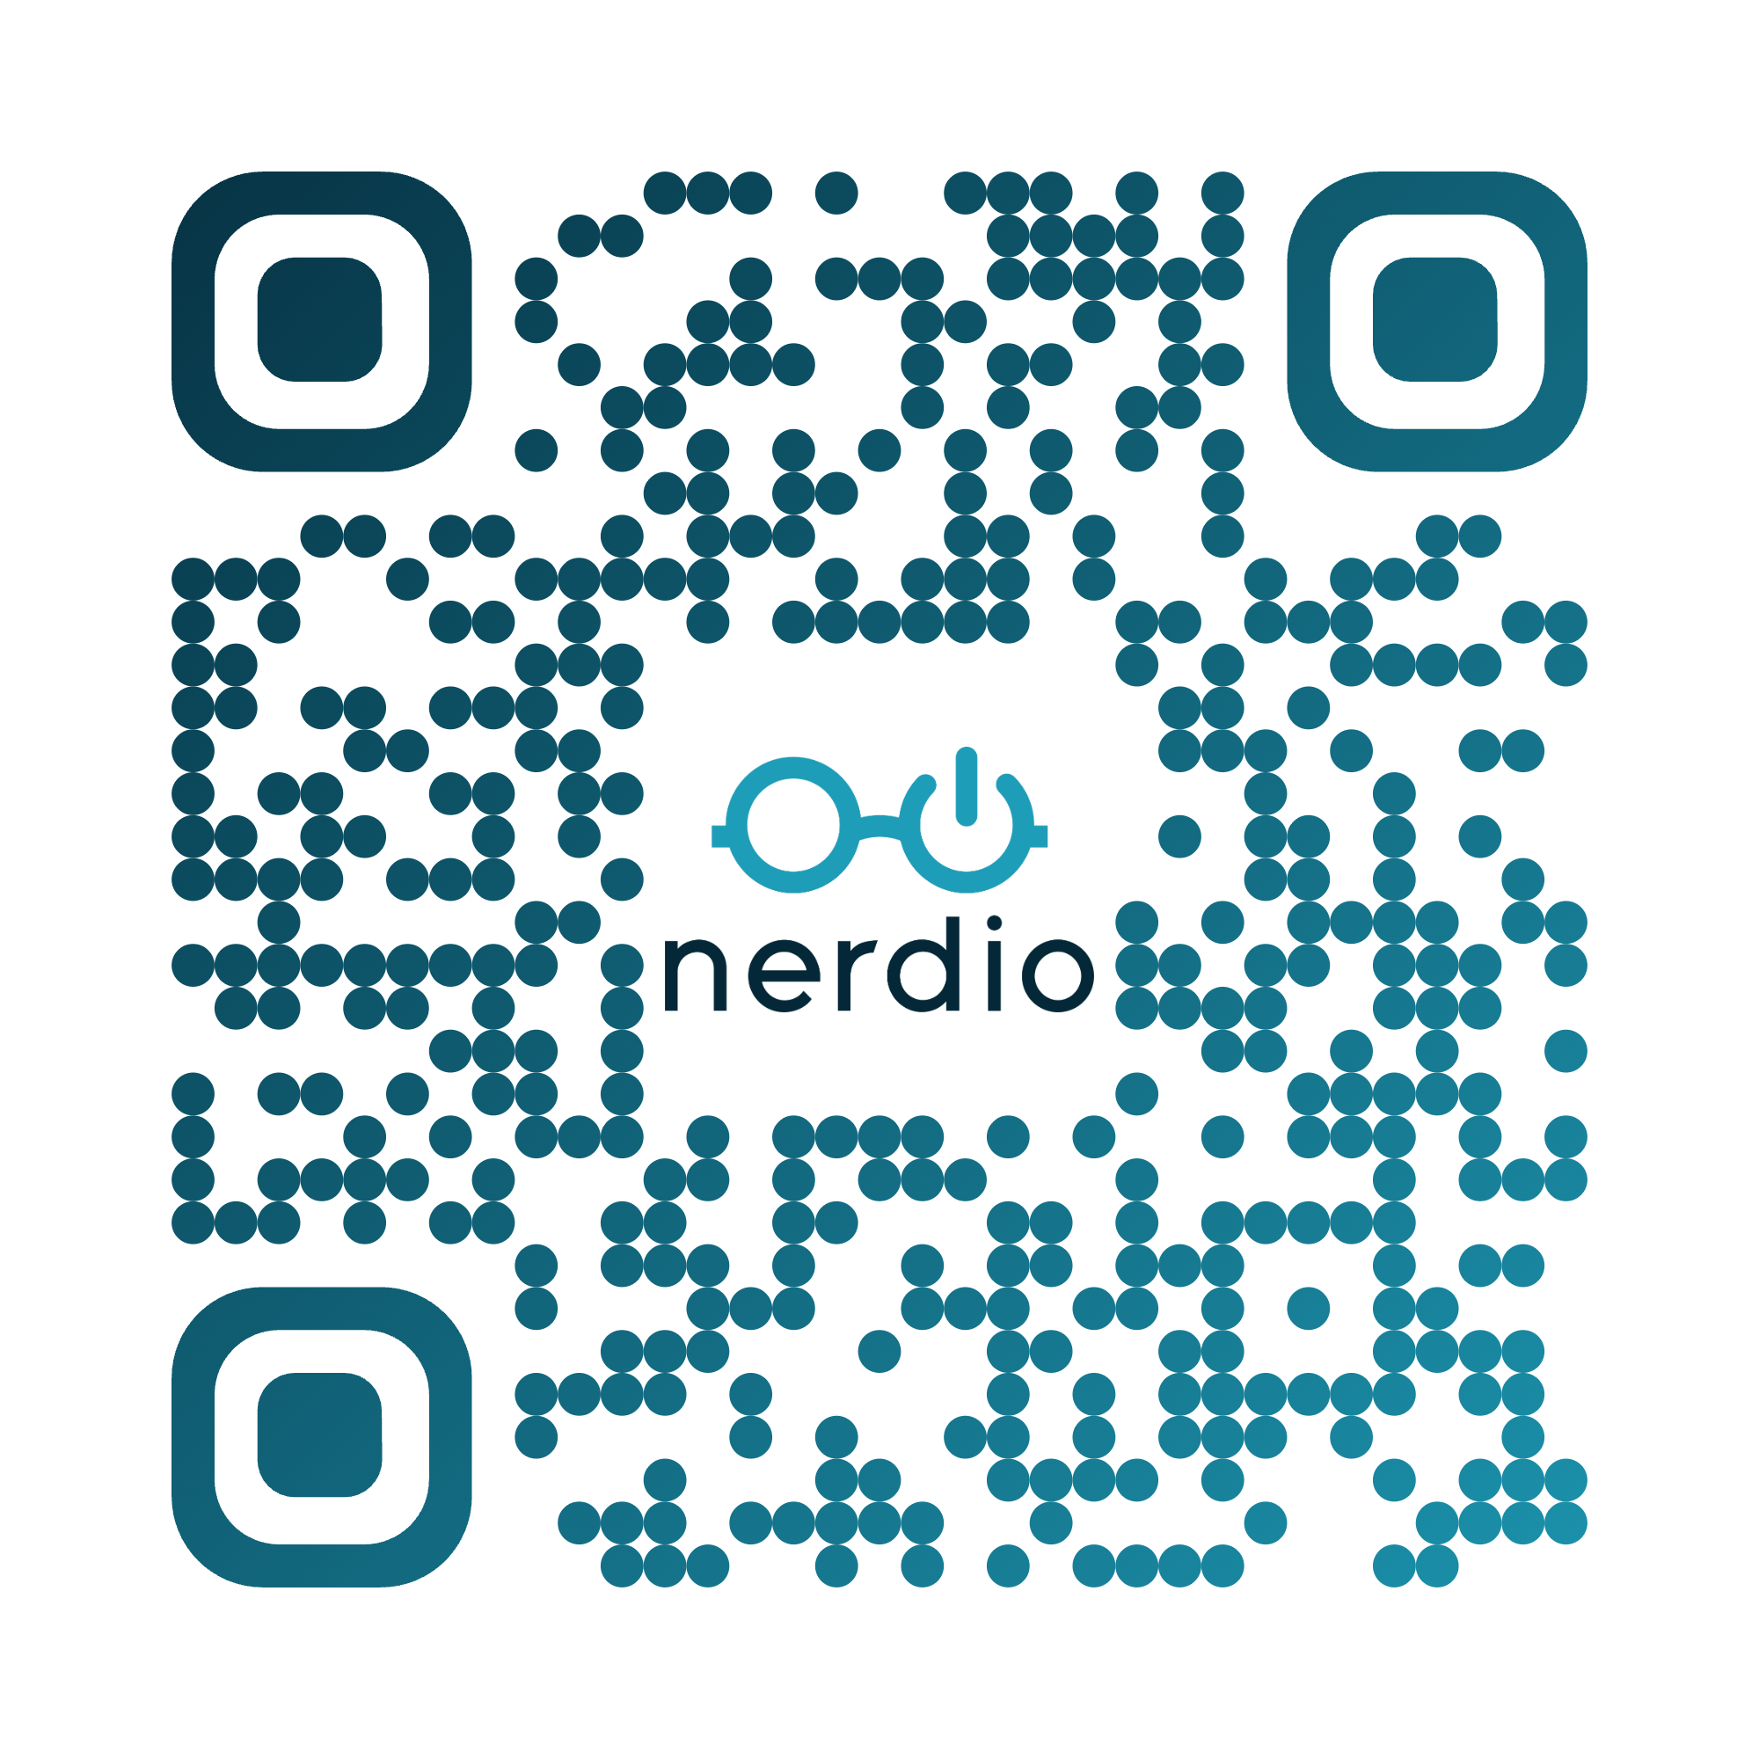
Connect with the Product Team
We’d love to have interviews with you!
nerdio.co/nmm-pdi
Please remember to fill out the post-breakout survey

Slide 32
Thank you
Please remember to fill out the post-breakout survey in the app.
Stop by the Nerdio booth in the Expo Hall to take advantage of our exclusive, lowest-ever pricing on Microsoft 365 management!

